Slide 1
PROGRAMMING FOR PROBLEM SOLVING BCSE-1201
Course Name: B. Tech (CSE) Semester: 2nd
Prepared by: Sahilpreet Singh
education for life www.rimt.ac.in
Department of Computer Science & Engineering

Slide 2
TOPIC:-Class and Object
education for life www.rimt.ac.in

Slide 3
CLASS
A Class is a user-defined data type that has data members and member functions.
Data members are the data variables and member functions are the functions used to manipulate these variables together.
In other words, a class is a collection of objects of the same kind. For example, Facebook, Instagram, Twitter, and Snapchat all come under social media class.
In the example of class Car, the data member will be speed limit, mileage, etc, and member functions can be applying brakes, increasing speed, etc.
education for life www.rimt.ac.in

Slide 4
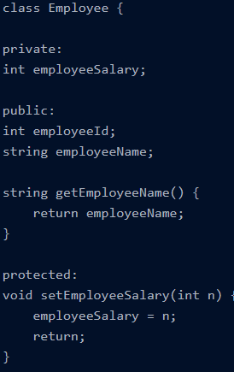
Access modifiers: These are the specifiers which provide or grant access for the members. They are of three types:
public - members are accessible from outside the class
private - members cannot be accessed (or viewed) from outside the class
protected - members cannot be accessed from outside the class, however, they can be accessed in inherited classes
education for life www.rimt.ac.in

Slide 5
class MyClass { public: // Public access specifier int x; // Public attribute private: // Private access specifier int y; // Private attribute }; int main() { MyClass myObj; myObj.x = 25; // Allowed (public) myObj.y = 50; // Not allowed (private) return 0; }
error: y is private
education for life www.rimt.ac.in

Slide 6
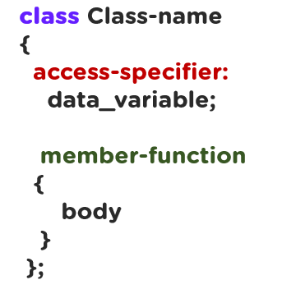
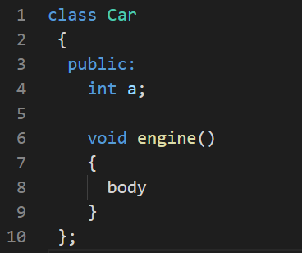
education for life www.rimt.ac.in

Slide 7
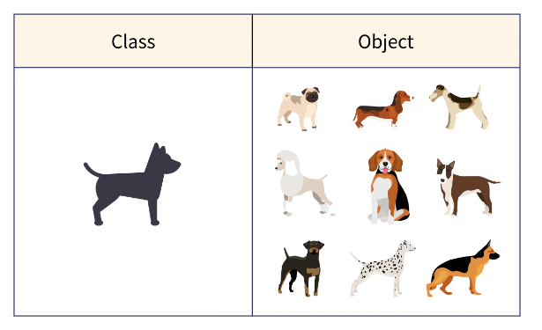
OBJECT
An object is a data structure that is an instance of a class.
So when a class is created no memory is allocated but when an instance is created by declaring an object, memory is then allocated to store data and perform required functions on them
Syntax:
Class ObjectName;
Dog dog;
education for life www.rimt.ac.in

Slide 8
class Dog{ // class ClassName
public: //Access specifiers
string breed, color; //Data members
void displayColor(){ //Member functions
cout<<color<<" ";
}
void displayBreed(){
cout<<breed<<" ";
}
}; // end with semicolon
education for life www.rimt.ac.in

Slide 9
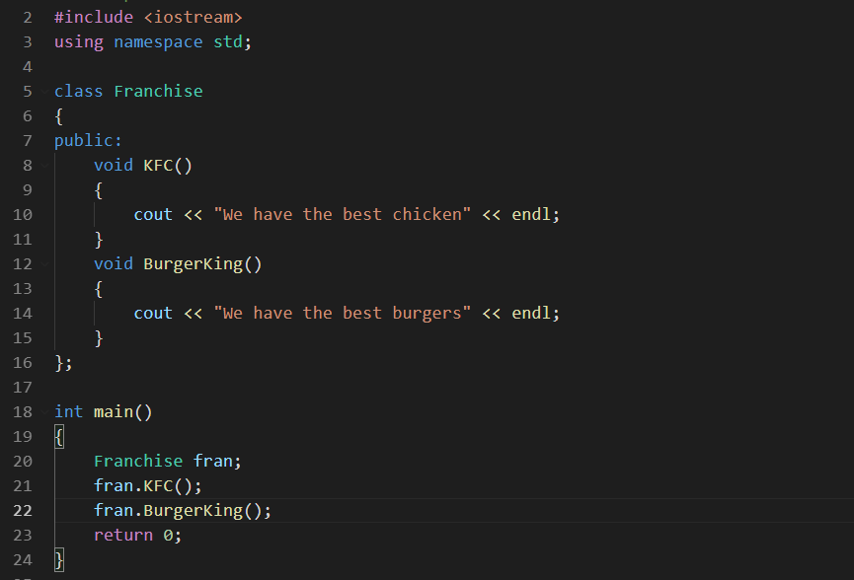
This example has created a class ‘Franchise’,
there are two functions, i.e., KFC() and BurgerKing() with access specifier as public.
there is an object fran of class Franchise
education for life www.rimt.ac.in

