Slide 1
Web Development/BTCS-2410
Course Name: B.Tech CSE Semester:4th
Prepared by: Ms. Yogesh
education for life www.rimt.ac.in
Department of Computer Science & Engineering

Slide 2
Classes and IDs
HTML has two attributes that make CSS even more useful: class and ID. They make it easy to apply style to just about any tag.
Classes can describe a generic style that can be applied to any HTML element, or can be created for specific elements.
When defining a style for elements with a particular class attribute in the Style Sheet, declare a rule using a dot (.) followed by the class name. To limit the style to a particular element with that class attribute, use a selector combining the tag name with a dot followed immediately by the class name.
The following rule would apply to any element with the attribute class=“shade"
.shade { background: yellow; }
The following rule would apply only to paragraph tags with the class shade (<p class="shade">)
p.shade { background: red; }
IDs are similar to classes, but IDs are unique – they can only be used with one instance of an element within a document.
When defining a CSS rule using an ID-based selector, use a number/pound/hash sign (#) followed by the style name. To limit the style to a particular element with that id attribute, use a selector combining the tag name with a # and then the id name.
The following rule would apply to any element with the attribute id="intro"
#intro { font-size: 2em; }
The following rule would apply only to heading 1 tags with the id intro (<h1 id="intro">)
h1#intro { color: green; }
education for life www.rimt.ac.in

Slide 3
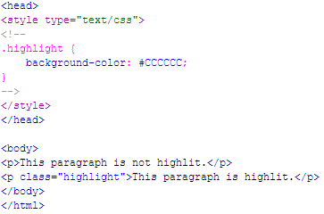
Class example
Here’s an example of a web page with an internal CSS style with a class called “highlight”:
education for life www.rimt.ac.in

Slide 4
Inline vs. Block Display (HTML)
All HTML elements (tags) are assigned a display property value of either inline or block.
Inline elements display in browsers horizontally.
[INLINE ELEMENT 1] [INLINE ELEMENT 2] [INLINE ELEMENT 3]
Block elements display in browsers vertically (stacked one on top of the other).
[BLOCK ELEMENT 1] [BLOCK ELEMENT 2] [BLOCK ELEMENT 3]
Examples of inline elements:
<a> <img> <strong> <em> <span>
Examples of block elements:
<p> <h1-h6> <div> <hr> <table> <ul> <ol>
education for life www.rimt.ac.in

Slide 5
Inline vs. Block Display (CSS)
Using CSS, you can change this inherent display property:
To force a block display, use the declaration display: block;
To force an inline display, use the declaration display: inline;
To force a list, use the declaration display: list-item;
To hide elements matching the selector, use the declaration display: none;
education for life www.rimt.ac.in

Slide 6
Example – display: block;
Normally, <a> tags display inline.
But, if you add the style a {display: block;}, they will display as a vertical navigation menu:
education for life www.rimt.ac.in

Slide 7
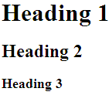
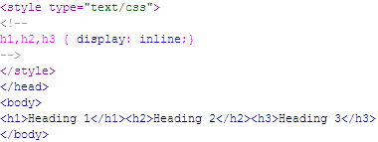
Example – display: inline;
Normally, the heading tags display in block format:
But, to have them display inline, add the style h1,h2,h3 {display: inline;}:
education for life www.rimt.ac.in

Slide 8
Span and Div
There are two tags that are particularly useful when using CSS: <span> and <div>. They are both container tags that have minimal formatting associated with them.
The <span> tag is an inline element that simply holds text without doing anything special to it.
The <div> tag is a block element and causes the text it encloses to start on a new line.
Using <span> and <div> tags in conjunction with classes and IDs allows for great flexibility in creating pages.
education for life www.rimt.ac.in

Slide 9
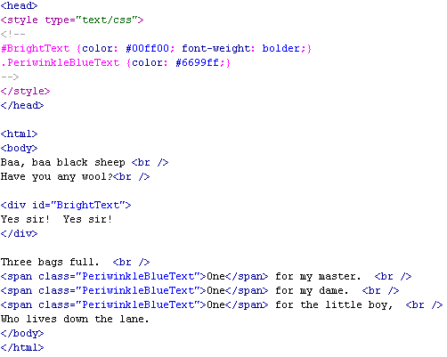
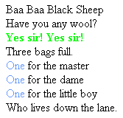
Example using SPAN, DIV, Class, and ID
Here’s an example of a web page using a class, an id, and the span and div tags:
education for life www.rimt.ac.in

Slide 10
Resources
A List Apart – articles on practical issues and suggestions for working with CSS correctly http://www.alistapart.com/topics/code/css
Example XHTML Pages, with and without the CSS Style Sheet: http://techbriefings.stanford.edu/web_standards/example1.html http://techbriefings.stanford.edu/web_standards/example2.html http://techbriefings.stanford.edu/web_standards/example.css
The CSS Zen Garden shows some of the most advanced uses of CSS: http://www.csszengarden.com/
CSS in the real world: ajc.com's 'News Break': http://www.holovaty.com/blog/archive/2002/09/28/2340
Microsoft's CSS Information: http://msdn.microsoft.com/workshop/author/css/reference/attributes.asp
Microsoft's Style Sheet Demonstrations: http://www.microsoft.com/typography/css/gallery/extract1.htm http://www.microsoft.com/typography/css/gallery/slide1.htm
W3C Style Examples http://www.w3.org/Style/Examples/007
W3C CSS 2.1 Specifications: http://www.w3.org/TR/CSS21/
W3Schools CSS Tutorial: http://www.w3schools.com/css
W3Schools CSS Reference: http://www.w3schools.com/css/css_reference.asp
Webmonkey’s Cascading Style Sheet Guide: http://www.webmonkey.com/reference/stylesheet_guide/
Brian Wilson’s Cascading Style Sheet Reference Guide: http://www.blooberry.com/indexdot/css/index.html
education for life www.rimt.ac.in

