Slide 1
ELEMENTS OF MECHANICAL ENGG.(BMEC-1201)Subject Name with Code
Course Name: EME Semester: 2ND
Prepared by: Dr. Sachin Saini
education for life www.rimt.ac.in
Department of Computer Science & Engineering

Slide 2
CENTROID
education for life www.rimt.ac.in
Department of Computer Science & Engineering

Slide 3
CENTROID
education for life www.rimt.ac.in
Department of Computer Science & Engineering

Slide 4
Centroid
education for life www.rimt.ac.in
Department of Computer Science & Engineering

Slide 5
Impact on CG
education for life www.rimt.ac.in
Department of Computer Science & Engineering

Slide 6
Moments
education for life www.rimt.ac.in
Department of Computer Science & Engineering

Slide 7
Centre of Gravity
education for life www.rimt.ac.in
Department of Computer Science & Engineering

Slide 8
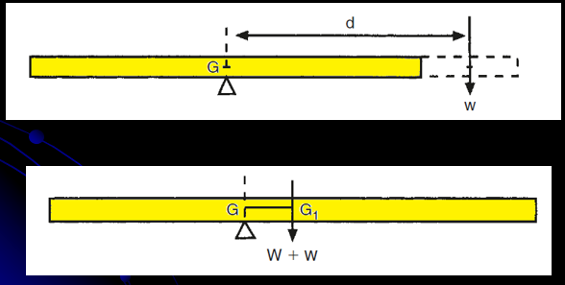
Centre of Gravity
education for life www.rimt.ac.in
Department of Computer Science & Engineering

Slide 9
Centre of Gravity
education for life www.rimt.ac.in
Department of Computer Science & Engineering

Slide 10
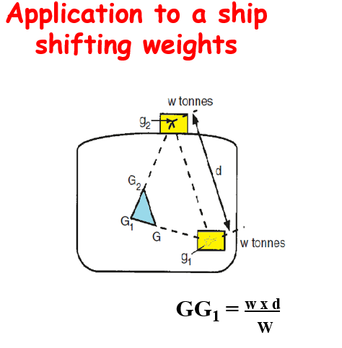
Centre of Gravity
education for life www.rimt.ac.in
Department of Computer Science & Engineering

Slide 11
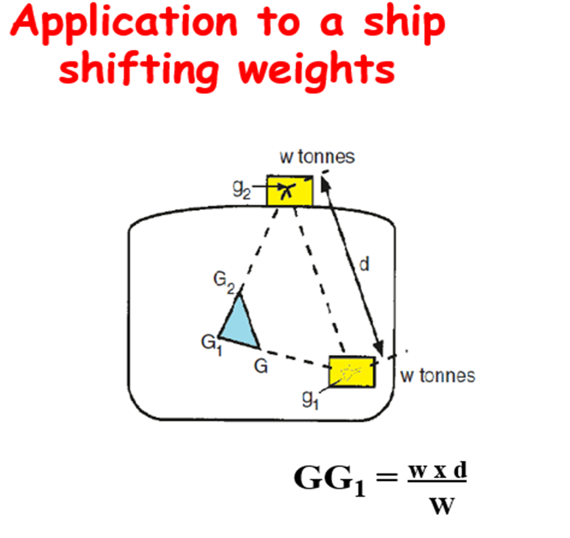
Centre of Gravity
education for life www.rimt.ac.in
Department of Computer Science & Engineering

Slide 12
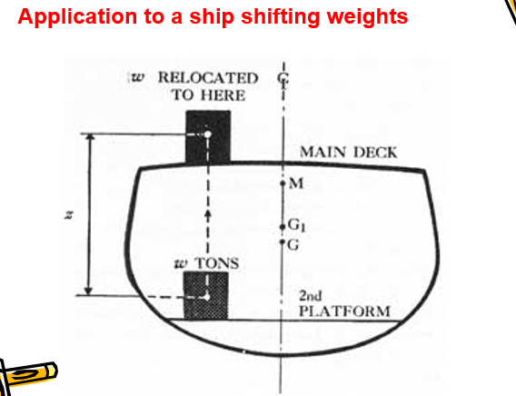
Centre of Gravity
education for life www.rimt.ac.in
Department of Computer Science & Engineering

Slide 13
Centre of Gravity
education for life www.rimt.ac.in
Department of Computer Science & Engineering

Slide 14
Centre of Gravity
education for life www.rimt.ac.in
Department of Computer Science & Engineering

Slide 15
Some Facts about C.G.
education for life www.rimt.ac.in
Department of Computer Science & Engineering

Slide 16
Some Facts about C.G.
education for life www.rimt.ac.in
Department of Computer Science & Engineering

Slide 17
MOMENT OF INERTIA
education for life www.rimt.ac.in
Department of Computer Science & Engineering

Slide 18
Perpendicular Axis of Theorem
education for life www.rimt.ac.in
Department of Computer Science & Engineering

Slide 19
Parallel axis Theorm
education for life www.rimt.ac.in
Department of Computer Science & Engineering

Slide 20
Examples
education for life www.rimt.ac.in
Department of Computer Science & Engineering

Slide 21
Numerical Problems
education for life www.rimt.ac.in
Department of Computer Science & Engineering

Slide 22
Summary
This topic is significant from the point of view that differentiating the centroid and centre of gravity
Moment of Inertia
Parallel and Perpendicular axis of Theorem
Determining the MOI for the I, T and channel sections
education for life www.rimt.ac.in
Department of Computer Science & Engineering

