Slide 1
EXPERT SYSTEM BTCS-3613
Course Name: B.Tech (CSE) Semester: 6th
Prepared by: Sahilpreet Singh
education for life www.rimt.ac.in
Department of Computer Science & Engineering

Slide 2
Topic:-Propositional logic
education for life www.rimt.ac.in

Slide 3
INTRODUCTION
A proposition is a declarative statement which is either true or false. It is a technique of knowledge representation in logical and mathematical form.
Propositional logic is also called Boolean logic as it works on 0 and 1.
Propositions can be either true or false, but it cannot be both.
Example
It is Sunday.
b) The Sun rises from West (False proposition)
c) 3+3= 7(False proposition)
d) 5 is a prime number.
education for life www.rimt.ac.in

Slide 4
There are two types of Propositions:
Atomic Proposition: Atomic propositions are the simple propositions. It consists of a single proposition symbol. These are the sentences which must be either true or false.
Example-
a)2+2 is 4, it is an atomic proposition as it is a true fact.
b) "The Sun is cold" is also a proposition as it is a false fact.
education for life www.rimt.ac.in

Slide 5
Compound proposition: Compound propositions are constructed by combining simpler or atomic propositions, using parenthesis and logical connectives.
Example-
a)It is raining today, and street is wet."
b) "Abhineet is a doctor, and his clinic is in Gobindgarh"
education for life www.rimt.ac.in

Slide 6
Logical Connectives:
Logical Connectives: Logical connectives are used to connect two simpler propositions or representing a sentence logically.
There are mainly five connectives, which are given as follows:
1. Negation: A sentence such as ¬ P is called negation of P. A literal can be either Positive literal or negative literal.
education for life www.rimt.ac.in

Slide 7
Conjunction: A sentence which has ∧ connective such as, P ∧ Q is called a conjunction. Example: Anujith is intelligent and hardworking. It can be written as, P= Anujith is intelligent, Q= Anujith is hardworking. → P∧ Q.
Disjunction: A sentence which has ∨ connective, such as P ∨ Q. is called disjunction, where P and Q are the propositions. Example: “Aakash is a doctor or Engineer", Here P= Aakash is Engineer Q= Aakash is Doctor, so we can write it as P ∨ Q.
education for life www.rimt.ac.in

Slide 8
Implication: A sentence such as P → Q, is called an implication. Implications are also known as if-then rules. It can be represented as If it is raining, then the street is wet. Let P= It is raining, and Q= Street is wet, so it is represented as P → Q
Biconditional: A sentence such as P⇔ Q is a Biconditional sentence, example If I a breathing, then I am alive P= I am breathing, Q= I am alive, it can be represented as P ⇔ Q.
education for life www.rimt.ac.in

Slide 9
education for life www.rimt.ac.in

Slide 10
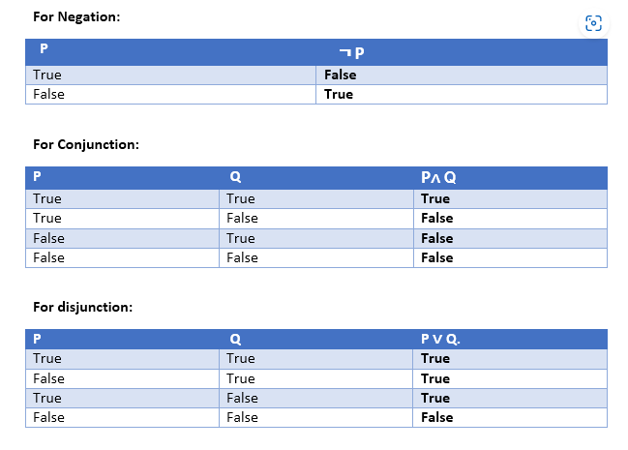
education for life www.rimt.ac.in

Slide 11
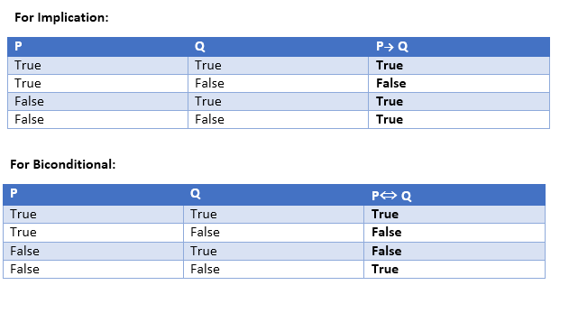
education for life www.rimt.ac.in

