Slide 1
Web Development/BTCS-2410
Course Name: B.Tech CSE Semester:4th
Prepared by: Ms. Yogesh
education for life www.rimt.ac.in
Department of Computer Science & Engineering

Slide 2
Transactions and JDBC
JDBC allows SQL statements to be grouped together into a single transaction
Transaction control is performed by the Connection object, default mode is auto-commit, I.e., each sql statement is treated as a transaction
We can turn off the auto-commit mode with con.setAutoCommit(false);
And turn it back on with con.setAutoCommit(true);
Once auto-commit is off, no SQL statement will be committed until an explicit is invoked con.commit();
At this point all changes done by the SQL statements will be made permanent in the database.
education for life www.rimt.ac.in

Slide 3
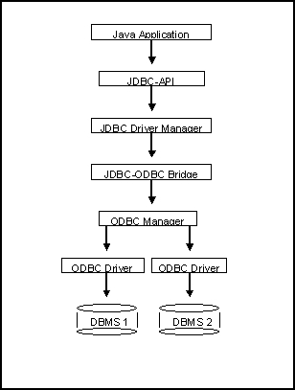
Another way to access database (JDBC-ODBC)
What’s a bit different
about this architecture?
Why add yet
another layer?
education for life www.rimt.ac.in

Slide 4
Sample program
import java.sql.*;
class Test {
public static void main(String[] args) {
try {
Class.forName("sun.jdbc.odbc.JdbcOdbcDriver"); //dynamic loading of driver
String filename = "c:/db1.mdb"; //Location of an Access database
String database = "jdbc:odbc:Driver={Microsoft Access Driver (*.mdb)};DBQ=";
database+= filename.trim() + ";DriverID=22;READONLY=true}"; //add on to end
Connection con = DriverManager.getConnection( database ,"","");
Statement s = con.createStatement();
s.execute("create table TEST12345 ( firstcolumn integer )");
s.execute("insert into TEST12345 values(1)");
s.execute("select firstcolumn from TEST12345");
education for life www.rimt.ac.in

Slide 5
Sample program(cont)
ResultSet rs = s.getResultSet();
if (rs != null) // if rs == null, then there is no ResultSet to view
while ( rs.next() ) // this will step through our data row-by-row
{ /* the next line will get the first column in our current row's ResultSet
as a String ( getString( columnNumber) ) and output it to the screen */
System.out.println("Data from column_name: " + rs.getString(1) );
}
s.close(); // close Statement to let the database know we're done with it
con.close(); //close connection
}
catch (Exception err) { System.out.println("ERROR: " + err); }
}
}
education for life www.rimt.ac.in

Slide 6
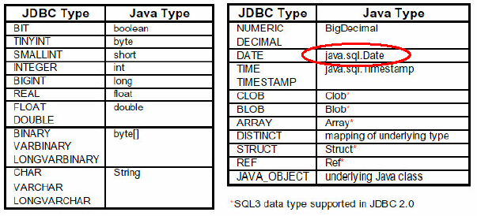
Mapping types JDBC - Java
education for life www.rimt.ac.in

Slide 7
JDBC 2 – Updateable ResultSet
…
Statement stmt =
con.createStatement(ResultSet.TYPE_FORWARD_ONLY,
ResultSet.CONCUR_UPDATABLE);
String query = " select students, grade from class
where type=‘really listening this presentation☺’ “;
ResultSet rs = stmt.executeQuery( query );
…
while ( rs.next() )
{
int grade = rs.getInt(“grade”);
rs.updateInt(“grade”, grade+10);
rs.updateRow();
}
education for life www.rimt.ac.in

Slide 8
SQLJ
// SQLJ
int n;
#sql { INSERT INTO emp VALUES (:n)};
// vs. straight JDBC
int n;
Statement stmt = conn.prepareStatement
(“INSERT INTO emp VALUES (?)”);
stmt.setInt(1,n);
stmt.execute ();
stmt.close();
education for life www.rimt.ac.in

Slide 9
JDBC references
JDBC Data Access API – JDBC Technology Homepage
http://java.sun.com/products/jdbc/index.html
JDBC Database Access – The Java Tutorial
http://java.sun.com/docs/books/tutorial/jdbc/index.html
JDBC Documentation
http://java.sun.com/j2se/1.4.2/docs/guide/jdbc/index.html
java.sql package
http://java.sun.com/j2se/1.4.2/docs/api/java/sql/package-summary.html
JDBC Technology Guide: Getting Started
http://java.sun.com/j2se/1.4.2/docs/guide/jdbc/getstart/GettingStartedTOC.fm.html
JDBC API Tutorial and Reference (book)
http://java.sun.com/docs/books/jdbc/
education for life www.rimt.ac.in

