Slide 1
Web Development/BTCS-2410
Course Name: B.Tech CSE Semester:4th
Prepared by: Ms. Yogesh
education for life www.rimt.ac.in
Department of Computer Science & Engineering

Slide 2
Boolean type
var iLike190M = true;
var ieIsGood = "IE6" > 0; // false
if ("web devevelopment is great") { /* true */ }
if (0) { /* false */ } JS
any value can be used as a Boolean
"falsey" values: 0, 0.0, NaN, "", null, and undefined
"truthy" values: anything else
converting a value into a Boolean explicitly:
var boolValue = Boolean(otherValue);
var boolValue = !!(otherValue);
education for life www.rimt.ac.in

Slide 3
for loop (same as Java)
var sum = 0;
for (var i = 0; i < 100; i++) {
sum = sum + i;
} JS
var s1 = "hello";
var s2 = "";
for (var i = 0; i < s.length; i++) {
s2 += s1.charAt(i) + s1.charAt(i);
}
// s2 stores "hheelllloo" JS
education for life www.rimt.ac.in

Slide 4
while loops (same as Java)
while (condition) {
statements;
} JS
do {
statements;
} while (condition); JS
break and continue keywords also behave as in Java
education for life www.rimt.ac.in

Slide 5
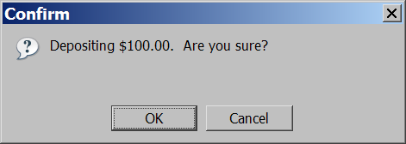
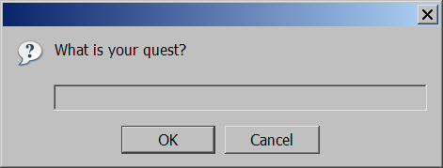
Popup boxes
alert("message"); // message
confirm("message"); // returns true or false
prompt("message"); // returns user input string JS
education for life www.rimt.ac.in

