Slide 1
Web Development/BTCS-2410
Course Name: B.Tech CSE Semester:4th
Prepared by: Ms. Yogesh
education for life www.rimt.ac.in
Department of Computer Science & Engineering

Slide 2
JDBC – Java DataBase Connectivity
education for life www.rimt.ac.in

Slide 3
What is JDBC?
“An API that lets you access virtually any tabular data source from the Java programming language”
JDBC Data Access API – JDBC Technology Homepage
What’s an API?
See J2SE documentation
What’s a tabular data source?
“… access virtually any data source, from relational databases to spreadsheets and flat files.”
JDBC Documentation
We’ll focus on accessing Oracle databases
education for life www.rimt.ac.in

Slide 4
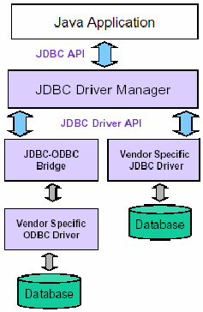
General Architecture
What design pattern is implied in this architecture?
What does it buy for us?
Why is this architecture also multi-tiered?
education for life www.rimt.ac.in

Slide 5
JDBC references
JDBC Data Access API – JDBC Technology Homepage
http://java.sun.com/products/jdbc/index.html
JDBC Database Access – The Java Tutorial
http://java.sun.com/docs/books/tutorial/jdbc/index.html
JDBC Documentation
http://java.sun.com/j2se/1.4.2/docs/guide/jdbc/index.html
java.sql package
http://java.sun.com/j2se/1.4.2/docs/api/java/sql/package-summary.html
JDBC Technology Guide: Getting Started
http://java.sun.com/j2se/1.4.2/docs/guide/jdbc/getstart/GettingStartedTOC.fm.html
JDBC API Tutorial and Reference (book)
http://java.sun.com/docs/books/jdbc/
education for life www.rimt.ac.in

