Slide 1
Numerical & Statistical Methods (BTEE-3604)
Course Name: B.Tech (EE) Semester: 6th
Prepared by: Sachin Syan
education for life www.rimt.ac.in
Department of Electrical Engineering

Slide 2
Topic Discussed
Bisection
Fixed-point iteration and Newton-Raphson Methods
Order of convergence
education for life www.rimt.ac.in
Department of Electrical Engineering

Slide 3
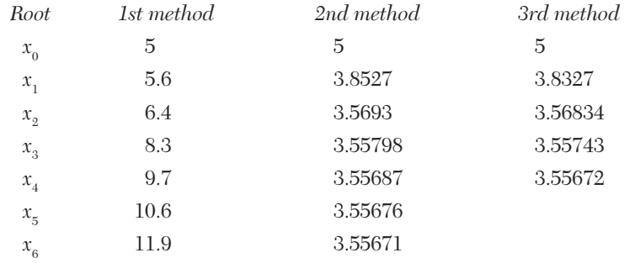
Rate of Convergence
Let x₀, x₁, x₂, ……. be the values of a root (α) of an equation at the 0th, 1st, 2nd ……. iterations while its actual value is 3.5567. The values of this root calculated by three different methods, are as given below:
education for life www.rimt.ac.in
Department of Electrical Engineering

Slide 4
Rate of Convergence
The values in the 1st method do not converge toward the root 3.5567. In the 2nd and 3rd methods, the values converge to the root after 6th and 4th iterations, respectively. Clearly 3rd method converges faster than the 2nd method. This fastness of convergence in any method is represented by its rate of convergence.
If e be the error then e_{i} = α-x_{i} = x_{i+1} -x_{i}
If e_{i+1}/e_{i} is almost constant, convergence is said to be linear, i.e., slow.
If e_{i+1}/e_{i} is nearly constant, convergence is said to be of order p, i.e., faster.
education for life www.rimt.ac.in
Department of Electrical Engineering

Slide 5
Bisection Method
This method is based on the repeated application of the intermediate value property. Let the function f(x) be continuous between a and b. For definiteness, let f(a) be negative and f (b) be positive. Then the first approximation to the root is
education for life www.rimt.ac.in
Department of Electrical Engineering

Slide 6
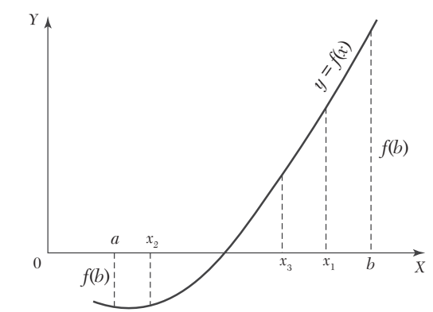
Bisection Method
education for life www.rimt.ac.in
Department of Electrical Engineering

Slide 7
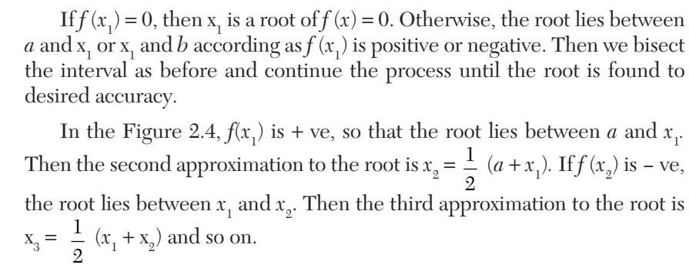
Bisection Method
education for life www.rimt.ac.in
Department of Electrical Engineering

Slide 8
Bisection Method
EXAMPLE: Find a root of the equation x³ - 4x - 9 =0, using the bisection method correct to three decimal places.
Sol Let f(x) = x³ - 4x - 9 Since f(2) is - ve and f(3) is + ve, a root lies between 2 and 3. Therefore First approximation to the root is
education for life www.rimt.ac.in
Department of Electrical Engineering

Slide 9
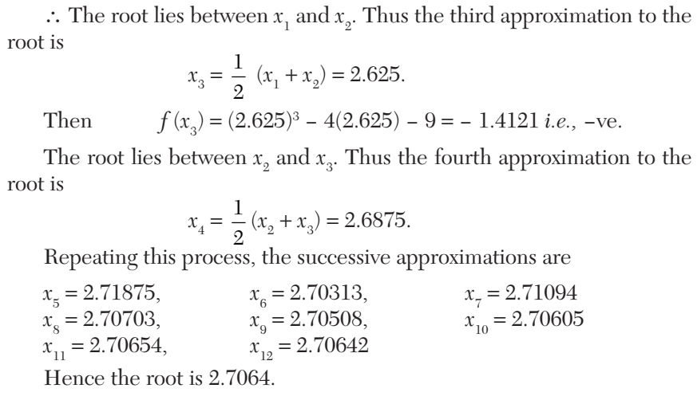
Bisection Method
education for life www.rimt.ac.in
Department of Electrical Engineering

Slide 10
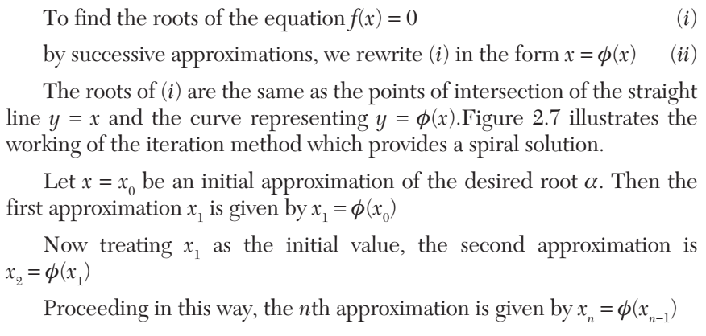
Iteration Method
education for life www.rimt.ac.in
Department of Electrical Engineering

Slide 11
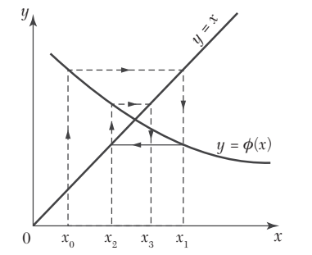
Iteration Method
education for life www.rimt.ac.in
Department of Electrical Engineering

Slide 12
Iteration Method
Sufficient condition for convergence of iterations
If (i) α be a root of f (x) = 0 which is equivalent to x =φ (x), (ii) I, be any interval containing the point x = α, (iii) |φ’(x) | < 1 for all x in I, then the sequence of approximations x₀, x₁, x₂,..., x_{n} will converge to the root α provided the initial approximation x₀ is chosen in I.
education for life www.rimt.ac.in
Department of Electrical Engineering

Slide 13
Iteration Method
EXAMPLE: Find a real root of the equation cos x = 3x - 1 correct to three decimal places using Iteration method
Solution: We have f(x) = cos x -3x + 1
education for life www.rimt.ac.in
Department of Electrical Engineering

Slide 14
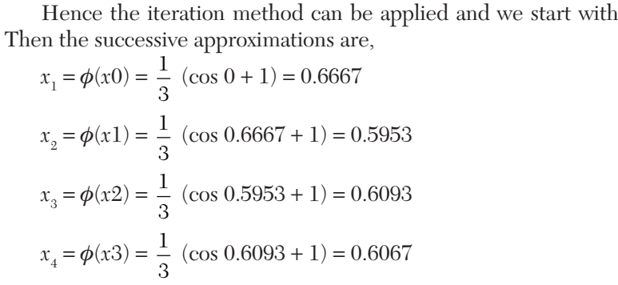
Iteration Method
education for life www.rimt.ac.in
Department of Electrical Engineering

Slide 15
Iteration Method
Hence x₅ and x₆ being almost the same, the root is 0.607 correct to three decimal places.
education for life www.rimt.ac.in
Department of Electrical Engineering

Slide 16
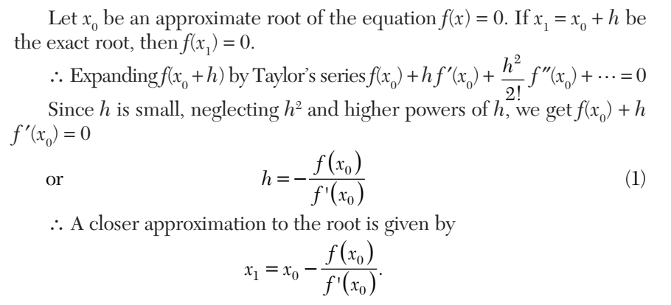
Newton-Raphson Method
education for life www.rimt.ac.in
Department of Electrical Engineering

Slide 17
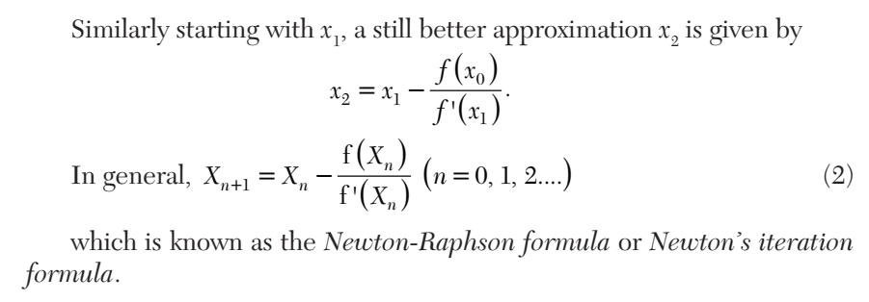
Newton-Raphson Method
education for life www.rimt.ac.in
Department of Electrical Engineering

Slide 18
Newton-Raphson Method
EXAMPLE
Find the positive root of x⁴ - x = 10 correct to three decimal places, using the Newton-Raphson method.
Solution: Let f(x) = x⁴ - x - 10 so that f(1) = - 10 = -ve, f(2) = 16 - 2 - 10 = 4 = + ve. ∴ A root of f(x) = 0 lies between 1 and 2.
Let us take x₀ =2 Also f ’ (x) = 4x³ - 1
education for life www.rimt.ac.in
Department of Electrical Engineering

Slide 19
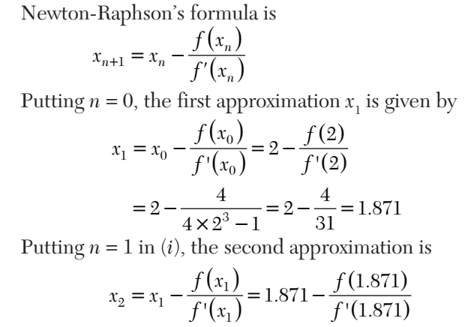
Newton-Raphson Method
education for life www.rimt.ac.in
Department of Electrical Engineering

Slide 20
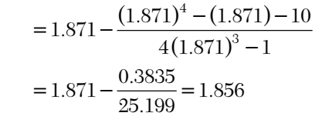
Newton-Raphson Method
Here x₂ = x₃. Hence the desired root is 1.856 correct to three decimal places.
education for life www.rimt.ac.in
Department of Electrical Engineering

Slide 21
Topics Discussed in Next Lecture
Gauss Elimination Method
Partial Pivoting
Complete Pivoting
Gauss Jordan Method
education for life www.rimt.ac.in
Department of Electrical Engineering

