Slide 1
Mathematics-III (BTCS-2302)
Course Name: B.Tech. (CSE) Semester: 3rd
Prepared by: Sachin Syan
education for life www.rimt.ac.in
Department of Computer Science and Engineering

Slide 2
Topic Discussed
Introduction
Objectives
Laplace Transform
Linearity of the Laplace Transform Change of Scale Property
First Shifting Theorem
Second Shifting Theorem (Heaviside’s Shifting Theorem):
Laplace Transform of the Derivative of 𝑓 (𝑡)
Laplace Transform of the Derivative of Order N
Laplace Transform of the Integral of 𝑓 (𝑡)
Laplace Transform of Some Important Functions
education for life www.rimt.ac.in
Department of Computer Science and Engineering

Slide 3
INTRODUCTION
The Laplace transform is named for the French mathematician Laplace, who studied this transform in 1782. Laplace transforms is an integral transform. It helps in solving the differential equations with boundary values without finding the general solution and values of the arbitrary constants. The method of Laplace transforms is a system that relies on algebra (rather than calculus-based methods) to solve linear differential equations. While it might seem to be a somewhat cumbersome method at times, it is a very powerful tool that enables us to readily deal with linear differential equations with discontinuous forcing functions.
education for life www.rimt.ac.in
Department of Computer Science and Engineering

Slide 4
OBJECTIVES
After studying this chapter we will learn about how Laplace transforms is useful for solving differential equations with boundary values without finding the general solution. With the use of different properties of Laplace transform and Inverse Laplace transform one can solve many important problem of physics with very simple way. Thus we will learn from this unit to use the Laplace transform for solving the differential equations.
education for life www.rimt.ac.in
Department of Computer Science and Engineering

Slide 5
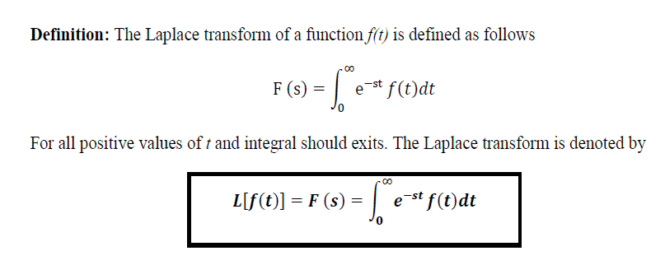
LAPLACE TRANSFORM
education for life www.rimt.ac.in
Department of Computer Science and Engineering

Slide 6
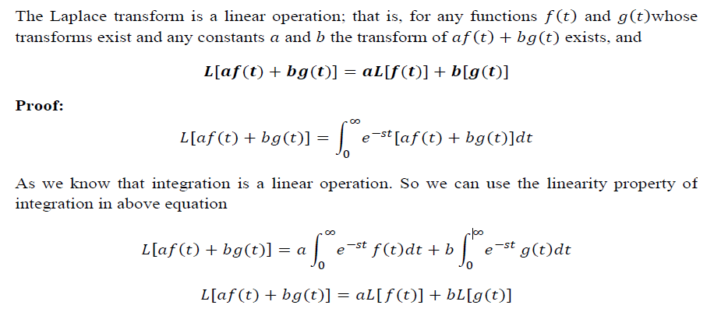
LINEARITY OF THE LAPLACE TRANSFORM
education for life www.rimt.ac.in
Department of Computer Science and Engineering

Slide 7
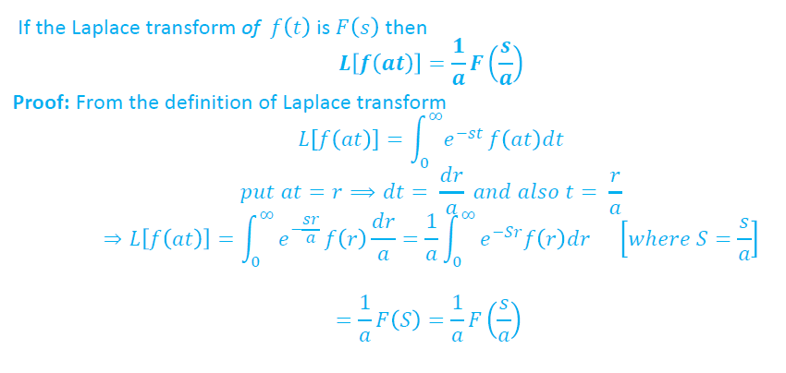
CHANGE OF SCALE PROPERTY
education for life www.rimt.ac.in
Department of Computer Science and Engineering

Slide 8
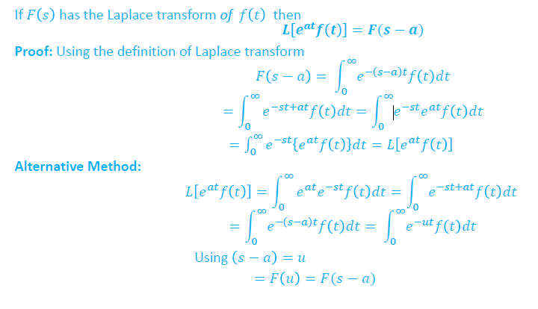
FIRST SHIFTING THEOREM
education for life www.rimt.ac.in
Department of Computer Science and Engineering

Slide 9
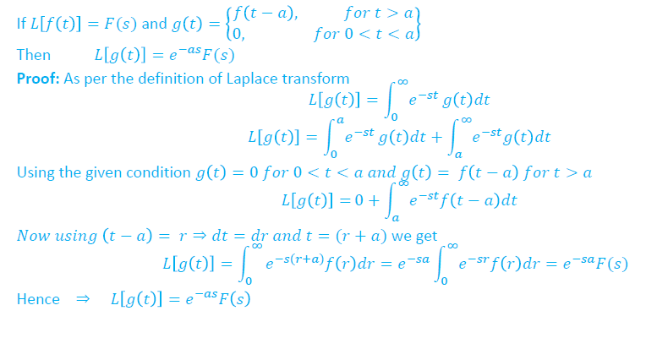
SECOND SHIFTING THEOREM (HEAVISIDE’S SHIFTING THEOREM)
education for life www.rimt.ac.in
Department of Computer Science and Engineering

Slide 10
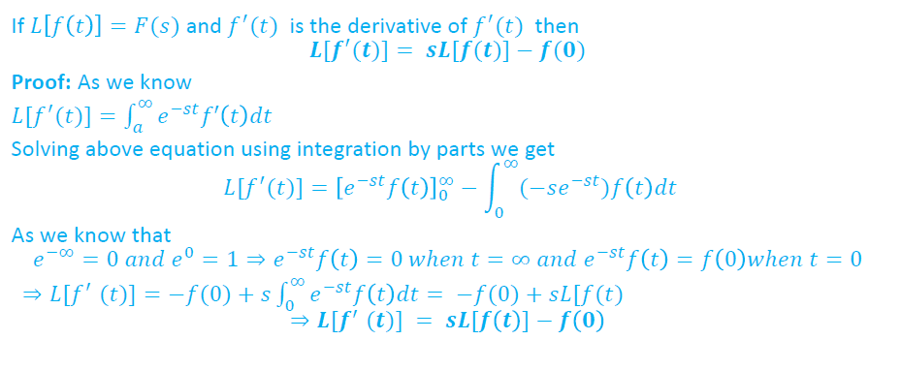
LAPLACE TRANSFORM OF THE DERIVATIVE OF 𝒇(𝒕)
education for life www.rimt.ac.in
Department of Computer Science and Engineering

Slide 11
LAPLACE TRANSFORM OF THE DERIVATIVE OF ORDER n
education for life www.rimt.ac.in
Department of Computer Science and Engineering

Slide 12
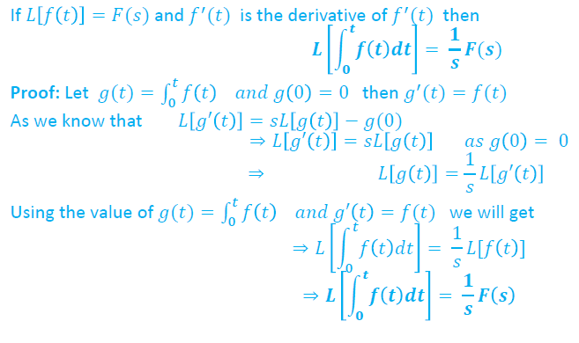
LAPLACE TRANSFORM OF THE INTEGRAL OF 𝒇(𝒕)
education for life www.rimt.ac.in
Department of Computer Science and Engineering

Slide 13
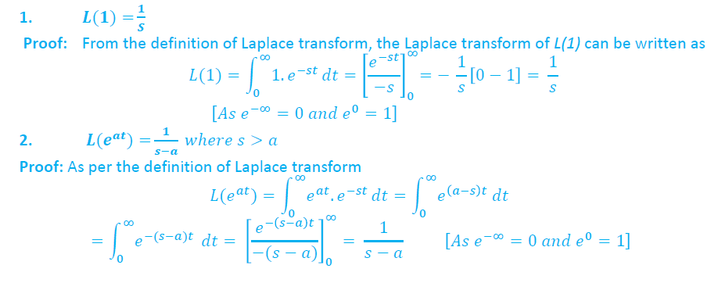
LAPLACE TRANSFORM OF SOME IMPORTANT FUNCTIONS
education for life www.rimt.ac.in
Department of Computer Science and Engineering

Slide 14
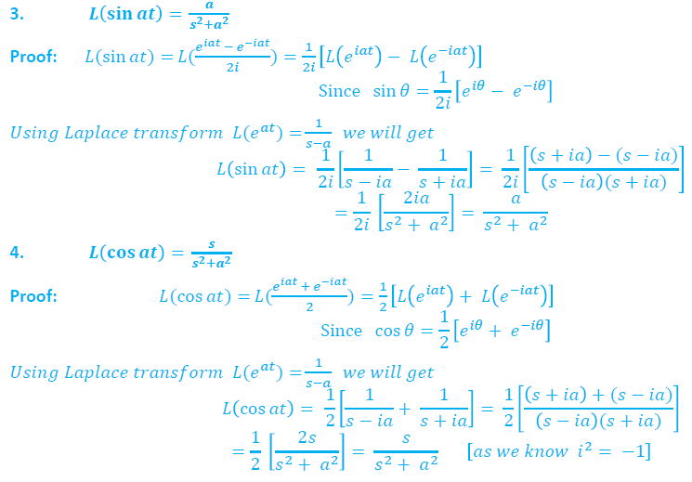
education for life www.rimt.ac.in
Department of Computer Science and Engineering

Slide 15
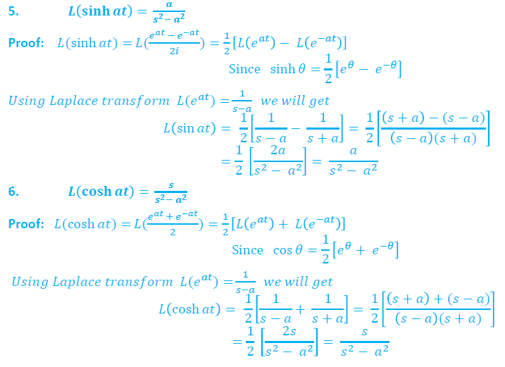
education for life www.rimt.ac.in
Department of Computer Science and Engineering

Slide 16
education for life www.rimt.ac.in
Department of Computer Science and Engineering

Slide 17
education for life www.rimt.ac.in
Department of Computer Science and Engineering

Slide 18
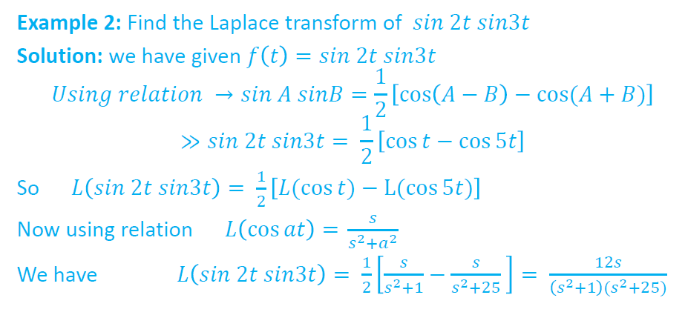
education for life www.rimt.ac.in
Department of Computer Science and Engineering

Slide 19
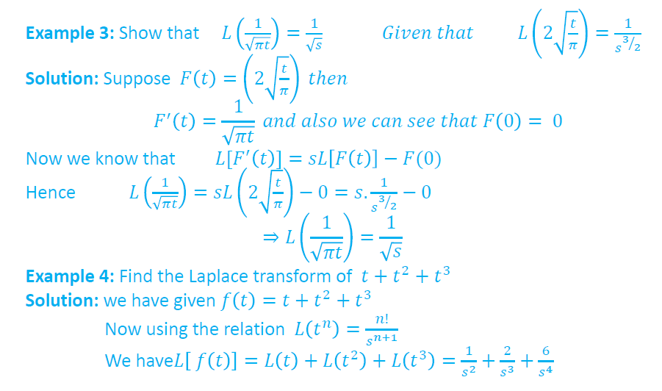
education for life www.rimt.ac.in
Department of Computer Science and Engineering

Slide 20
education for life www.rimt.ac.in
Department of Computer Science and Engineering

Slide 21
Topics Discussed in Next Lecture
Laplace Transform of 1/t 𝑓(𝑡)
Laplace Transform of t .𝑓(𝑡)
Unit Step Function
Laplace Transform of Unit Step Function
Periodic Functions
Some Important Formulae of Laplace Transform
education for life www.rimt.ac.in
Department of Computer Science and Engineering

