Slide 1
COMMUNICATIVE ENGLISH / BENG-1101
Course Name: B.Tech (Common to all branches) Semester: First
Prepared by: AMIT MOHAN
Head & Assistant Professor
education for life www.rimt.ac.in
Department of English

Slide 2
Topic Discussed
Communication Skills
Objectives of Communication
Types of Communication
education for life www.rimt.ac.in
Department of English

Slide 3
OBJECTIVES
Information​
Motivation​
Suggestion​
Education​
Advice​
Warning​
To raise Morale​
Persuasion
education for life www.rimt.ac.in
Department of English

Slide 4
education for life www.rimt.ac.in
Department of English

Slide 5
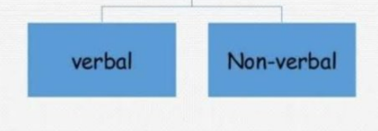
On the basis of Expressions
education for life www.rimt.ac.in
Department of English

Slide 6
VERBAL COMMUNICATION
Verbal Communication :
It means communication with words. It is further divided into two forms – Written and Oral Communication. ​
Examples​
Written communication : Letters, Notices, Emails, Fax, etc. ​
Oral Communication : Face-to-face Communication, Telephonic Conversation, Group discussion, etc.
education for life www.rimt.ac.in
Department of English

Slide 7
ADVENTAGES OF VERBAL COMMUNICATION
Written Communication
Oral Communication
Legal Validity ​
Permanent record ​
Suitable for Legal Validity ​
Permanent record ​
Suitable for lengthy messages​
Distortion free​
Easily distributed the same information
Distortion free​
Easily distributed the same information
Save times​
Save money ​
Instant feedback ​
Suitable for emergency​
Speedy​
Less formal​
Control over audience’s attention ​
education for life www.rimt.ac.in
Department of English

Slide 8
DISADVENTAGES OF VERBAL COMMUNICATION
Written Communication
Oral Communication
Time consuming ​
Not possible for distant people​
Instant feedback is not possible ​
Formalism​
Lengthy & Expensive
No legal validity ​
It cannot be retained for a long time​
Distortion​
Not suitable for lengthy messages ​
Speaker’s/Receiver’s ineffectiveness
​
education for life www.rimt.ac.in
Department of English

Slide 9
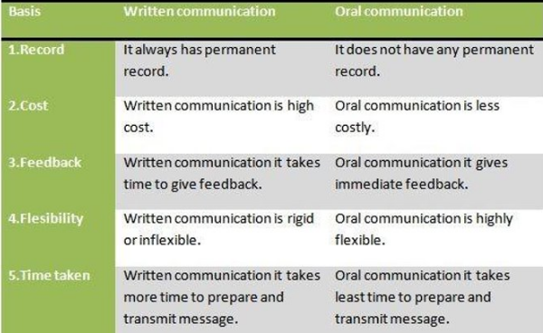
DIFFERENCE
education for life www.rimt.ac.in
Department of English

Slide 10
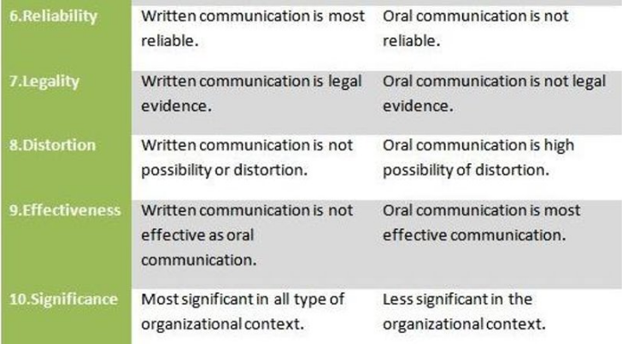
education for life www.rimt.ac.in
Department of English

Slide 11
Topics Discussed in Next Lecture
Communication
Non-Verbal Communication
education for life www.rimt.ac.in
Department of English

