Slide 1
Operating System/ BTCS-2401
Course Name: B.Tech CSE Semester: 4th
Prepared by: Er. Jasdeep Singh
education for life www.rimt.ac.in
Department of Computer Science & Engineering

Slide 2
Topic 24th : Security
education for life www.rimt.ac.in

Slide 3
Topics To Be Covered
User Authentication
Implementing Security Defenses
Firewalling to Protect Systems and Networks
Computer-Security Classifications
An Example: Windows
education for life www.rimt.ac.in

Slide 4
Authentication
Constraining set of potential senders of a message
Complementary and sometimes redundant to encryption
Also can prove message unmodified
Algorithm components
A set K of keys
A set M of messages
A set A of authenticators
A function S : K → (M→ A)
That is, for each k ∈ K, S(k) is a function for generating authenticators from messages
Both S and S(k) for any k should be efficiently computable functions
A function V : K → (M× A→ {true, false}). That is, for each k ∈ K, V(k) is a function for verifying authenticators on messages
Both V and V(k) for any k should be efficiently computable functions
education for life www.rimt.ac.in

Slide 5
Authentication (Cont.)
For a message m, a computer can generate an authenticator a ∈ A such that V(k)(m, a) = true only if it possesses S(k)
Thus, computer holding S(k) can generate authenticators on messages so that any other computer possessing V(k) can verify them
Computer not holding S(k) cannot generate authenticators on messages that can be verified using V(k)
Since authenticators are generally exposed (for example, they are sent on the network with the messages themselves), it must not be feasible to derive S(k) from the authenticators
education for life www.rimt.ac.in

Slide 6
Authentication – Hash Functions
Basis of authentication
Creates small, fixed-size block of data (message digest, hash value) from m
Hash Function H must be collision resistant on m
Must be infeasible to find an m’ ≠ m such that H(m) = H(m’)
If H(m) = H(m’), then m = m’
The message has not been modified
Common message-digest functions include MD5, which produces a 128-bit hash, and SHA-1, which outputs a 160-bit hash
education for life www.rimt.ac.in

Slide 7
Authentication - MAC
Symmetric encryption used in message-authentication code (MAC) authentication algorithm
Simple example:
MAC defines S(k)(m) = f (k, H(m))
Where f is a function that is one-way on its first argument
k cannot be derived from f (k, H(m))
Because of the collision resistance in the hash function, reasonably assured no other message could create the same MAC
A suitable verification algorithm is V(k)(m, a) ≡ ( f (k,m) = a)
Note that k is needed to compute both S(k) and V(k), so anyone able to compute one can compute the other
education for life www.rimt.ac.in

Slide 8
Authentication – Digital Signature
Based on asymmetric keys and digital signature algorithm
Authenticators produced are digital signatures
In a digital-signature algorithm, computationally infeasible to derive S(k_{s} ) from V(k_{v})
V is a one-way function
Thus, k_{v} is the public key and k_{s} is the private key
Consider the RSA digital-signature algorithm
Similar to the RSA encryption algorithm, but the key use is reversed
Digital signature of message S(k_{s} )(m) = H(m)^{ks} mod N
The key k_{s} again is a pair d, N, where N is the product of two large, randomly chosen prime numbers p and q
Verification algorithm is V(k_{v})(m, a) ≡ (a^{kv} mod N = H(m))
Where k_{v} satisfies k_{v}k_{s} mod (p − 1)(q − 1) = 1
education for life www.rimt.ac.in

Slide 9
Key Distribution
Delivery of symmetric key is huge challenge
Sometimes done out-of-band
Asymmetric keys can proliferate – stored on key ring
Even asymmetric key distribution needs care – man-in-the-middle attack
education for life www.rimt.ac.in

Slide 10
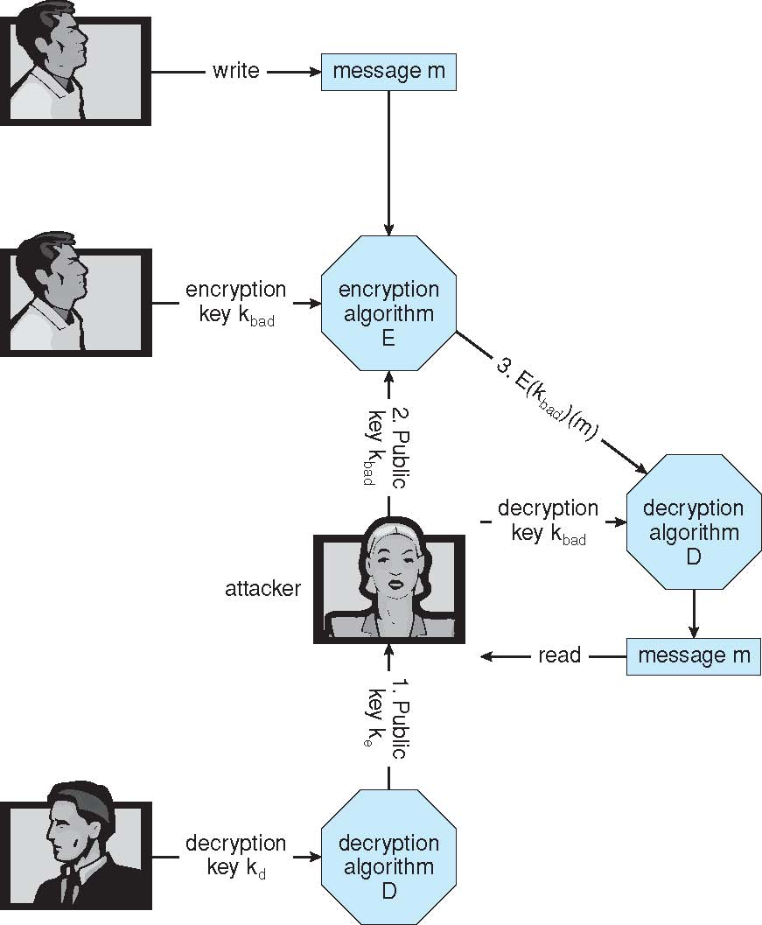
Man-in-the-middle Attack on Asymmetric Cryptography
education for life www.rimt.ac.in

Slide 11
Digital Certificates
Proof of who or what owns a public key
Public key digitally signed a trusted party
Trusted party receives proof of identification from entity and certifies that public key belongs to entity
Certificate authority are trusted party – their public keys included with web browser distributions
They vouch for other authorities via digitally signing their keys, and so on
education for life www.rimt.ac.in

Slide 12
Encryption Example - SSL
Insertion of cryptography at one layer of the ISO network model (the transport layer)
SSL – Secure Socket Layer (also called TLS)
Cryptographic protocol that limits two computers to only exchange messages with each other
Very complicated, with many variations
Used between web servers and browsers for secure communication (credit card numbers)
The server is verified with a certificate assuring client is talking to correct server
Asymmetric cryptography used to establish a secure session key (symmetric encryption) for bulk of communication during session
Communication between each computer then uses symmetric key cryptography
education for life www.rimt.ac.in

Slide 13
Passwords
Encrypt to avoid having to keep secret
But keep secret anyway (i.e. Unix uses superuser-only readably file /etc/shadow)
Use algorithm easy to compute but difficult to invert
Only encrypted password stored, never decrypted
Add “salt” to avoid the same password being encrypted to the same value
One-time passwords
Use a function based on a seed to compute a password, both user and computer
Hardware device / calculator / key fob to generate the password
Changes very frequently
Biometrics
Some physical attribute (fingerprint, hand scan)
Multi-factor authentication
Need two or more factors for authentication
i.e. USB “dongle”, biometric measure, and password
education for life www.rimt.ac.in

Slide 14
Implementing Security Defenses
Defense in depth is most common security theory – multiple layers of security
Security policy describes what is being secured
Vulnerability assessment compares real state of system / network compared to security policy
Intrusion detection endeavors to detect attempted or successful intrusions
Signature-based detection spots known bad patterns
Anomaly detection spots differences from normal behavior
Can detect zero-day attacks
False-positives and false-negatives a problem
Virus protection
Auditing, accounting, and logging of all or specific system or network activities
education for life www.rimt.ac.in

Slide 15
Firewalling to Protect Systems and Networks
A network firewall is placed between trusted and untrusted hosts
The firewall limits network access between these two security domains
Can be tunneled or spoofed
Tunneling allows disallowed protocol to travel within allowed protocol (i.e., telnet inside of HTTP)
Firewall rules typically based on host name or IP address which can be spoofed
Personal firewall is software layer on given host
Can monitor / limit traffic to and from the host
Application proxy firewall understands application protocol and can control them (i.e., SMTP)
System-call firewall monitors all important system calls and apply rules to them (i.e., this program can execute that system call)
education for life www.rimt.ac.in

Slide 16
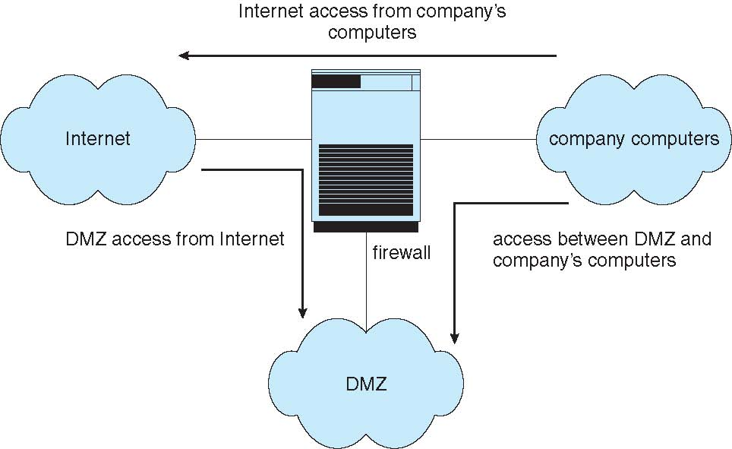
Network Security Through Domain Separation Via Firewall
education for life www.rimt.ac.in

Slide 17
Computer Security Classifications
U.S. Department of Defense outlines four divisions of computer security: A, B, C, and D
D – Minimal security
C – Provides discretionary protection through auditing
Divided into C1 and C2
C1 identifies cooperating users with the same level of protection
C2 allows user-level access control
B – All the properties of C, however each object may have unique sensitivity labels
Divided into B1, B2, and B3
A – Uses formal design and verification techniques to ensure security
education for life www.rimt.ac.in

Slide 18
Example: Windows
Security is based on user accounts
Each user has unique security ID
Login to ID creates security access token
Includes security ID for user, for user’s groups, and special privileges
Every process gets copy of token
System checks token to determine if access allowed or denied
Uses a subject model to ensure access security
A subject tracks and manages permissions for each program that a user runs
Each object in Windows has a security attribute defined by a security descriptor
For example, a file has a security descriptor that indicates the access permissions for all users
education for life www.rimt.ac.in

Slide 19
Summary
User Authentication
Implementing Security Defenses
Firewalling to Protect Systems and Networks
Computer-Security Classifications
An Example: Windows
education for life www.rimt.ac.in

Slide 20
Topics To Be Covered
Motivation
Types of Network-Based Operating Systems
Network Structure
Network Topology
education for life www.rimt.ac.in

Slide 21
References
Silberschatz and Peter B. Calvin, “Operating System Concepts" Addison Wesley Publishing Company
Dhamdhere, “Systems Programming & Operating Systems Tata McGraw Hill

