Slide 1
COMPUTER ARCHITECTURE BTCS-2301
Course Name: B.Tech (CSE) Semester: 3rd
Prepared by: Sahilpreet Singh
education for life www.rimt.ac.in
Department of Computer Science & Engineering

Slide 2
TOPIC:- BUS ARCHITECTURE
education for life www.rimt.ac.in

Slide 3
Buses – Structure
Serial versus parallel
Around 50-100 lines although it's possible to have as few as 3 or 4
Lines can be classified into one of four groups
Data lines
Address Lines
Control Lines
Power
education for life www.rimt.ac.in

Slide 4
Buses – Structure (continued)
Bus lines (parallel)
Data
Address
Control
Power
Bus lines (serial)
Data, address, and control are sequentially sent down single wire
There may be additional control lines
Power
education for life www.rimt.ac.in

Slide 5
Buses – Structure (continued)
Data Lines
Passes data back and forth
Number of lines represents width
Address lines
Designates location of source or destination
Width of address bus specifies maximum memory capacity
High order selects module and low order selects a location within the module
education for life www.rimt.ac.in

Slide 6
Bus Structure – Control lines
Because multiple devices communicate on a line, control is needed
Timing
Typical lines include:
Memory Read or Write
I/O Read or Write
Transfer ACK
Bus request
Bus grant
Interrupt request
Interrupt acknowledgement
Clock
Reset
education for life www.rimt.ac.in

Slide 7
Operation – Sending Data
Obtain the use of the bus
Transfer the data via the bus
Possible acknowledgement
education for life www.rimt.ac.in

Slide 8
Operation – Requesting Data
Obtain the use of the bus
Transfer the data request via the bus
Wait for other module to send data
Possible acknowledgement
education for life www.rimt.ac.in

Slide 9
Classic Bus Arrangement
All components attached to bus (STD bus)
Due to Moore's law, more and more functionality exists on a single board, so major components are now on same board or even the same chip
education for life www.rimt.ac.in

Slide 10
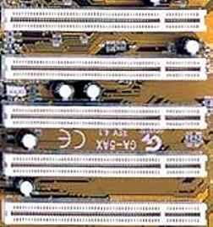
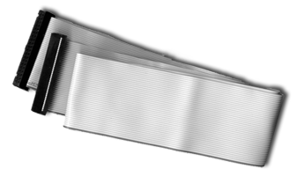
Physical Implementations
Parallel lines on circuit boards (ISA or PCI)
Ribbon cables (IDE)
education for life www.rimt.ac.in

Slide 11
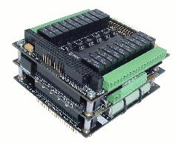
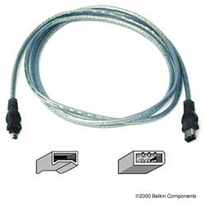
Physical Implementations (continued)
Strip connectors on mother boards (PC104)
External cabling (USB or Firewire)
education for life www.rimt.ac.in

Slide 12
Single Bus Problems
Lots of devices on one bus leads to:
Physically long buses
Propagation delays – Long data paths mean that co-ordination of bus use can adversely affect performance
Reflections/termination problems
Aggregate data transfer approaches bus capacity
Slower devices dictate the maximum bus speed
education for life www.rimt.ac.in

Slide 13
Multiple Buses
Most systems use multiple buses to overcome these problems
Requires bridge to buffer (FIFO) data due to differences in bus speeds
Sometimes I/O devices also contain buffering (FIFO)
education for life www.rimt.ac.in

Slide 14
Multiple Buses – Benefits
Isolate processor-to-memory traffic from I/O traffic
Support wider variety of interfaces
Processor has bus that connects as direct interface to chip, then an expansion bus interface interfaces it to external devices (ISA)
Cache (if it exists) may act as the interface to system bus
education for life www.rimt.ac.in

Slide 15
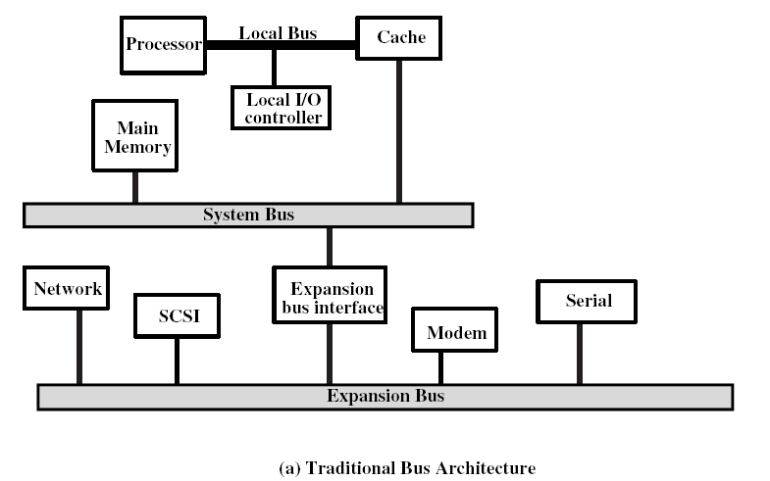
Expansion Bus Example
education for life www.rimt.ac.in

