Slide 1
COMMUNICATIVE ENGLISH / BENG-1101
Course Name: B.Tech (Common to all branches) Semester: First
Prepared by: AMIT MOHAN
Head & Assistant Professor
education for life www.rimt.ac.in
Department of English

Slide 2
Topic Discussed
Communication Skills
Barriers to Communication
education for life www.rimt.ac.in
Department of English

Slide 3
TYPES OF BARRIERS
Semantic Barriers ​
Emotional Barriers ​
Environmental Barriers ​
Socio-psychological Barriers ​
Physiological Barriers ​
Technical Barriers
education for life www.rimt.ac.in
Department of English

Slide 4
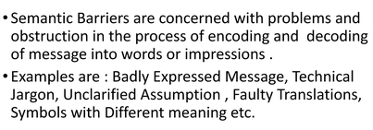
SEMANTIC BARRIERS
Faulty Language​
Faulty Pronunciation ​
Poor Vocabulary ​
Poor knowledge of Grammar ​
Usage of unfamiliar words/slang​
Weak Communication Skills
education for life www.rimt.ac.in
Department of English

Slide 5
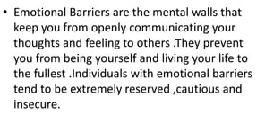
emotional barriers
Sad Memories​
Fear​
Past Experiences ​
Age gap​
Prejudice & Anger
education for life www.rimt.ac.in
Department of English

Slide 6
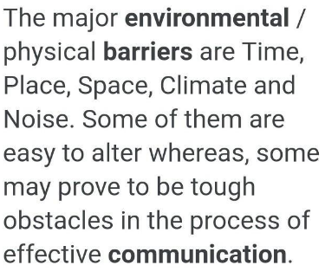
environmental barriers
Noise​
Time​
Place​
Distance​
Climate
education for life www.rimt.ac.in
Department of English

Slide 7
socio-Psychological barriers
Socio-psychological communication obstacles may be defined as the source of issues encountered during the execution of communication procedures. Individual psychology is recognized as the key component that gives birth to socio-psychological obstacles.
Premature Evaluation​
Inattentiveness ​
Status Barrier​
Distrust​
Difference in Perception ​
Close mindedness ​
Cultural Differences
education for life www.rimt.ac.in
Department of English

Slide 8
PHYSIOLOGICAL barriers
Physiological barriers to communication are related with the limitations of human body and human mind (memory, attention, and perception).
Such barriers may result from individuals’ personal discomfort, caused by ill-health, poor eye-sight, or hearing difficulties.
Hunger​
Tiredness​
Boredom​
Physical disability ​
Day Dreaming
Poor listening
Egotism
education for life www.rimt.ac.in
Department of English

Slide 9
Technical barriers
The technology is developing fast and as a result, It becomes difficult to keep up with the newest developments. Hence sometimes the technological advance may become a barrier to effective communication.
Week Network​
Wrong choice of Media​
Virus​
Defective Speakers / Mics ​
Poor knowledge of Technology
education for life www.rimt.ac.in
Department of English

Slide 10
Topics Discussed in Next Lecture
Communication
Phonetics
education for life www.rimt.ac.in
Department of English

