Slide 1
Discrete Structures (BTCS-2402)
Course Name: B.Tech CSE Semester: 4th
Prepared by:
Dr. Ankit
Assistant Professor
Departement of Mathematics
education for life www.rimt.ac.in
Department of Computer Science & Engineering

Slide 2
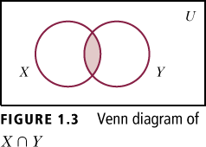
Intersection:
Example: If X = {1,2,3,4,5} and Y = {5,6,7,8,9}, then X ∩ Y = {5}
education for life www.rimt.ac.in
Department of Computer Science & Engineering

Slide 3
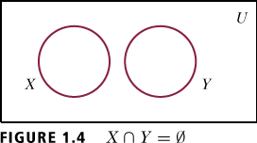
Disjoint Sets:
Example: If X = {1,2,3,4,} and Y = {6,7,8,9}, then X ∩ Y = ∅
education for life www.rimt.ac.in
Department of Computer Science & Engineering

Slide 4
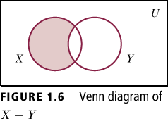
Difference
Example:
If X = {a,b,c,d} and Y = {c,d,e,f}, then X – Y = {a,b} and Y – X ={e,f}
education for life www.rimt.ac.in
Department of Computer Science & Engineering

Slide 5
Complement
The complement of a set X with respect to a universal set U is denoted by x^{c} and defined to be X^{c} = {x |x ∈ U, but x ∉ X}
Example: If U = {a,b,c,d,e,f} and X = {c,d,e,f}, then X^{c} = {a,b}
education for life www.rimt.ac.in
Department of Computer Science & Engineering

Slide 6
education for life www.rimt.ac.in
Department of Computer Science & Engineering

Slide 7
Ordered Pair:
X and Y are sets. If x ∈ X and y ∈ Y, then an ordered pair is written as (x,y)
Remark: Order of elements is important. (x, y) is not necessarily equal to (y, x).
Cartesian Product:
The Cartesian product of two sets X and Y , written X × Y , is the set
X × Y ={(x,y)|x ∈ X , y ∈ Y}
For any set X, X × ∅ = ∅ = ∅ × X.
Example: X = {a,b}, Y = {c,d}
X × Y = {(a,c), (a,d), (b,c), (b,d)}
Y × X = {(c,a), (d,a), (c,b), (d,b)}
education for life www.rimt.ac.in
Department of Computer Science & Engineering

Slide 8
education for life www.rimt.ac.in
Department of Computer Science & Engineering

Slide 9
Next Topic
In the next lecture, we will discussed relation and functions.
education for life www.rimt.ac.in
Department of Computer Science & Engineering

