Slide 1
COMMUNICATIVE ENGLISH / BENG-1101
Course Name: B.Tech (Common to all branches) Semester: First
Prepared by: AMIT MOHAN
Head & Assistant Professor
education for life www.rimt.ac.in
Department of English

Slide 2
Topic Discussed
phonetics
What is Phonetics?
Airstream Mechanism
education for life www.rimt.ac.in
Department of English

Slide 3
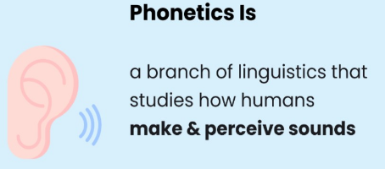
What is Phonetics?
Phonetics is the study of the production, transmission and reception of speech sounds. It studies speech organs, sound wave; the physical way in which sound is transmitted through air from one person to another.​
education for life www.rimt.ac.in
Department of English

Slide 4
Airstream mechanism
In phonetics, the airstream mechanism is the method by which airflow is created in the vocal tract. It means the air that we produced by our lungs. There are different airstream for different sounds. There are three types of airstream mechanisms are used in human speech and each mechanism has a different initiator. All the three mechanisms may be used to push air out (i.e. called egressive) or to pull it in (i.e. called ingressive).
The different types of airstream mechanism are:
a. Pulmonic Airstream Mechanism
b. Glottalic Airstream Mechanism
c. Velaric Airstream Mechanism
education for life www.rimt.ac.in
Department of English

Slide 5
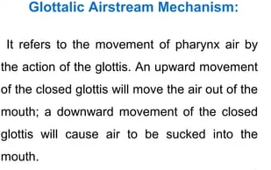
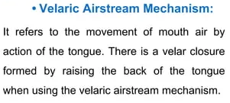
airstream mechanism
education for life www.rimt.ac.in
Department of English

Slide 6
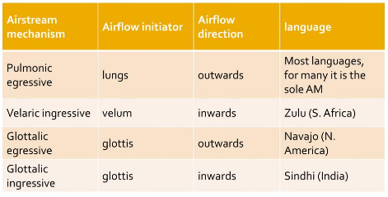
Classification
education for life www.rimt.ac.in
Department of English

Slide 7
Topics Discussed in Next Lecture
Phonetics
Organs of Speech
education for life www.rimt.ac.in
Department of English

