Slide 1
Web Development/BTCS-2410
Course Name: B.Tech CSE Semester:4th
Prepared by: Ms. Yogesh
education for life www.rimt.ac.in
Department of Computer Science & Engineering

Slide 2
JavaScript functions
function name() {
statement ;
statement ;
...
statement ;
} JS
function myFunction() {
alert("Hello!");
alert("How are you?");
} JS
the above could be the contents of example.js linked to our HTML page
statements placed into functions can be evaluated in response to user events
education for life www.rimt.ac.in

Slide 3
Event handlers
<element attributes onclick="function();">... HTML
<button onclick="myFunction();">Click me!</button> HTML
JavaScript functions can be set as event handlers
when you interact with the element, the function will execute
onclick is just one of many event HTML attributes we'll use
but popping up an alert window is disruptive and annoying
A better user experience would be to have the message appear on the page...
education for life www.rimt.ac.in
education for life www.rimt.ac.in

Slide 4
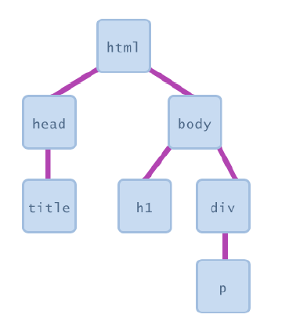
Document Object Model (DOM)
most JS code manipulates elements on an HTML page
we can examine elements' state
e.g. see whether a box is checked
we can change state
e.g. insert some new text into a div
we can change styles
e.g. make a paragraph red
education for life www.rimt.ac.in

Slide 5
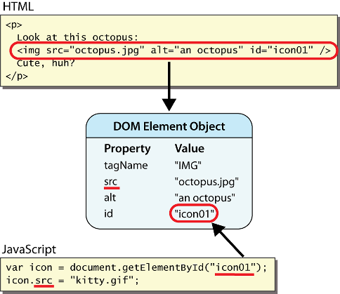
DOM element objects
education for life www.rimt.ac.in
Notes:
every element on the page has a corresponding DOM object access/modify the attributes of the DOM object with objectName.attributeName

Slide 6
Accessing elements: document.getElementById
var name = document.getElementById("id");
JS
<button onclick="changeText();">Click me!</button>
<span id="output">replace me</span>
<input id="textbox" type="text" /> HTML
function changeText() {
var span = document.getElementById("output");
var textBox = document.getElementById("textbox");
textbox.style.color = "red";
} JS
education for life www.rimt.ac.in
Notes:
span.innerHTML = textBox.value;

Slide 7
Accessing elements: document.getElementById
document.getElementById returns the DOM object for an element with a given id
can change the text inside most elements by setting the innerHTML property
can change the text in form controls by setting the value property
education for life www.rimt.ac.in

Slide 8
Changing element style: element.style
Attribute | Property or style object
color | color
padding | padding
background-color | backgroundColor
border-top-width | borderTopWidth
Font size | fontSize
Font famiy | fontFamily
education for life www.rimt.ac.in

