Slide 1
CLOUD COMPUTING BTCS-4712
Course Name: B. Tech (CSE) Semester: 7th
Prepared by: Sahilpreet Singh
education for life www.rimt.ac.in
Department of Computer Science & Engineering

Slide 2
Topic:-Application Programming Interfaces (API)
education for life www.rimt.ac.in

Slide 3
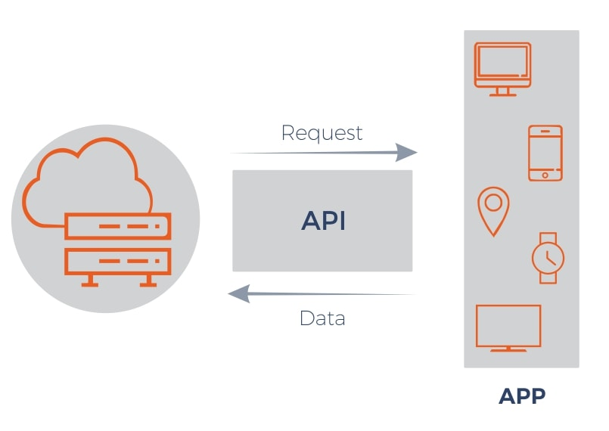
INTROUCTION
An Application programming interface is a software interface that helps in connecting between the computer or between computer programs
In simple words, you can say it is a software interface that offers service to the other pieces of software.
education for life www.rimt.ac.in

Slide 4
Features
An application programming interface is a software that allows two applications to talk to each other.
Application programming interface helps in enabling applications to exchange data and functionality easily.
Application programming interface helps in data monetization.
Application programming interface helps in improving collaboration.
education for life www.rimt.ac.in

Slide 5
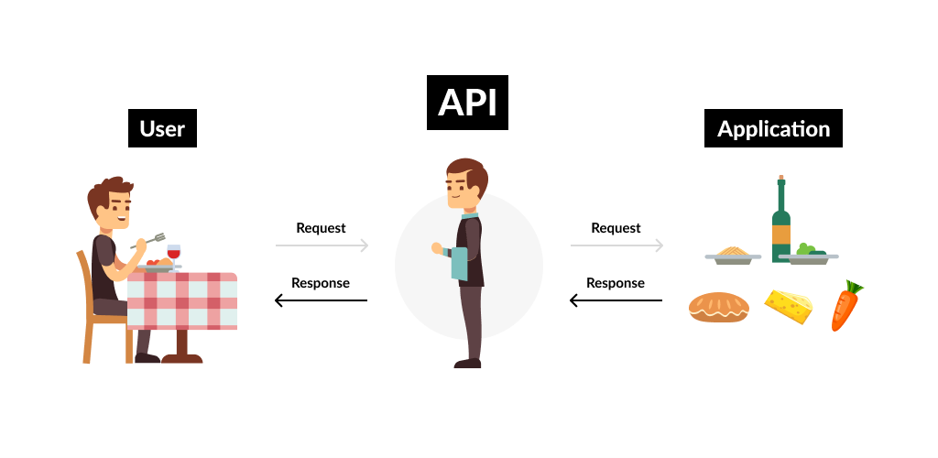
How API Works?
The API acts as a middleman between any two machines that want to connect with each other for a specified task.
An API works as a facilitator connecting software platforms that would otherwise not be able to interact.
education for life www.rimt.ac.in

Slide 6
Types of APIs
Open APIs –
It is also called public APIs which are available to any other users. Open APIs help external users to access the data and services.
Internal APIs –
It is also known as private APIs, only an internal system exposes this type of APIs. These are designed for the internal use of the company rather than the external users.
education for life www.rimt.ac.in

Slide 7
Composite APIs –
It is a type of APIs that combines different data and services. The main reason to use Composites APIs is to improve the performance and to speed the execution process and improve the performance of the listeners in the web interfaces.
Partner APIs –
It is a type of APIs in which a developer needs specific rights or licenses in order to access. Partner APIs are not available to the public.
education for life www.rimt.ac.in

Slide 8
Applications of APIs
Weather snippets –
In weather snippets, APIs are generally used to access a large set of datasets to access the information of weather forecast which is very helpful information in day-to-day life.
Login –
In this functionality, APIs are widely used to log in via Google, Linked In, Git Hub, Twitter and allow users to access the log-in portal by using the API interface.
education for life www.rimt.ac.in

Slide 9
Entertainment –
In this field, APIs are used to access and provide a huge set of databases to access movies, web series, comedy, etc.
E-commerce website –
In this, APIs provide the functionality like if you have purchase something, and now you want to pay so, API provides interface like you can pay using different bank debit cards, UPI(Unified Payments Interface), credit card, wallet, etc.
Gaming –
In gaming, it provides an interface like you can access the information of the game, and you can connect to different users and play with different-different users at the same time.
education for life www.rimt.ac.in

