Slide 1
Engineering Mathematics-I (BMAT-1111)
Course Name: B.Tech (CSE) Semester: Ist
Prepared by: Sachin Syan
education for life www.rimt.ac.in
Department of Computer Science & Engineering

Slide 2
Topic Discussed
Linear Ordinary Differential Equations of Second and Higher Order
Method of Variation of Parameters
Operator Method
Cauchy’ s Homogeneous Linear Equation
Legendre’s Linear Equation
Simultaneous Linear Equation with constant coefficients
education for life www.rimt.ac.in
Department of Computer Science & Engineering

Slide 3
Method of Variation of Parameters
education for life www.rimt.ac.in
Department of Computer Science & Engineering

Slide 4
Method of Variation of Parameters
education for life www.rimt.ac.in
Department of Computer Science & Engineering

Slide 5
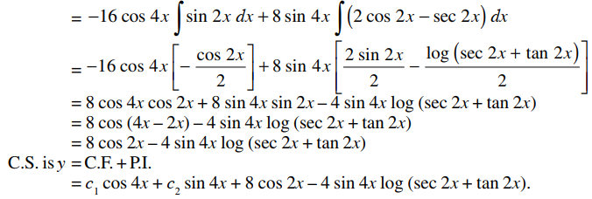
Method of Variation of Parameters
education for life www.rimt.ac.in
Department of Computer Science & Engineering

Slide 6
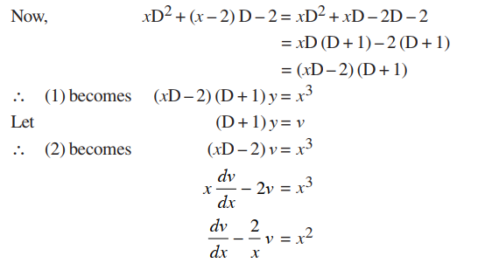
Operator Method
education for life www.rimt.ac.in
Department of Computer Science & Engineering

Slide 7
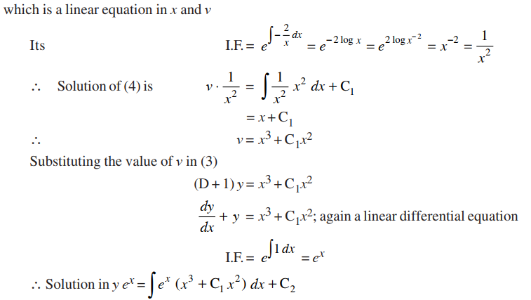
Operator Method
education for life www.rimt.ac.in
Department of Computer Science & Engineering

Slide 8
Operator Method
education for life www.rimt.ac.in
Department of Computer Science & Engineering

Slide 9
Cauchy’s homogeneous Linear Equation
education for life www.rimt.ac.in
Department of Computer Science & Engineering

Slide 10
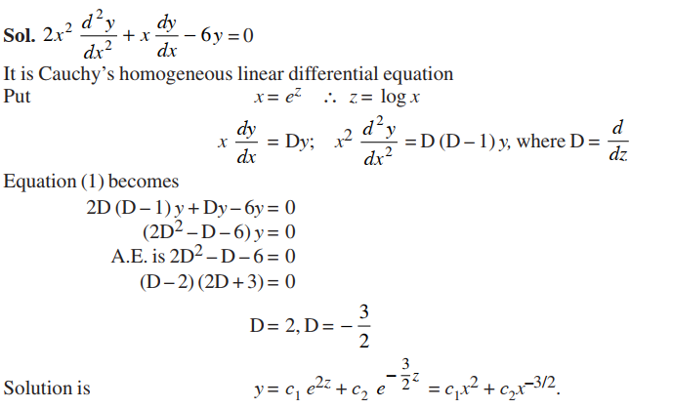
Cauchy’s homogeneous Linear Equation
education for life www.rimt.ac.in
Department of Computer Science & Engineering

Slide 11
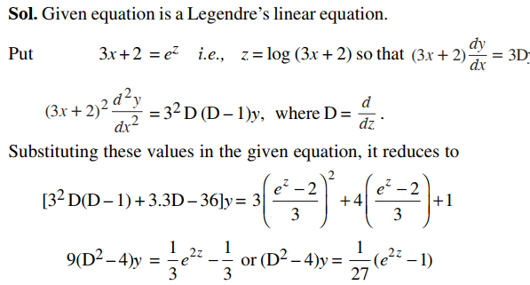
Legendre’s Linear Equation
education for life www.rimt.ac.in
Department of Computer Science & Engineering

Slide 12
Legendre’s Linear Equation
education for life www.rimt.ac.in
Department of Computer Science & Engineering

Slide 13
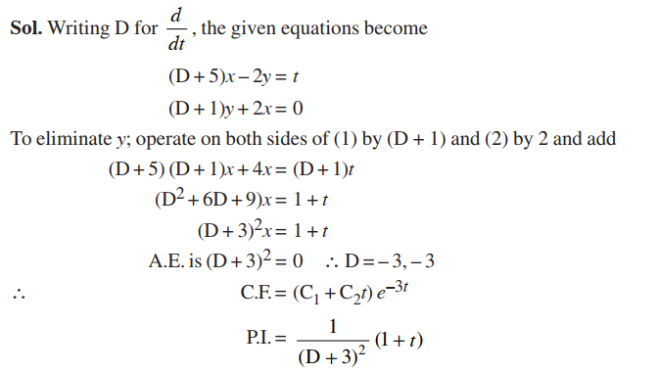
Simultaneous Linear Equations with constant coefficients
education for life www.rimt.ac.in
Department of Computer Science & Engineering

Slide 14
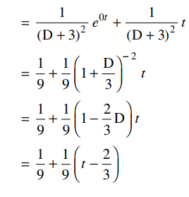
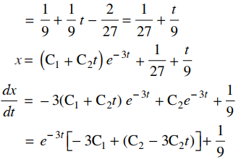
Simultaneous Linear Equations with constant coefficients
education for life www.rimt.ac.in
Department of Computer Science & Engineering

Slide 15
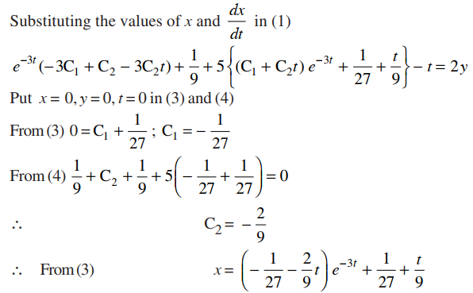
Simultaneous Linear Equations with constant coefficients
education for life www.rimt.ac.in
Department of Computer Science & Engineering

Slide 16
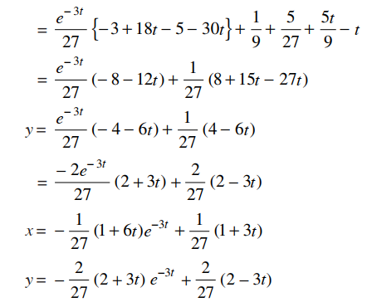
Simultaneous Linear Equations with constant coefficients
education for life www.rimt.ac.in
Department of Computer Science & Engineering

Slide 17
Topics Discussed in Next Lecture
Complex Numbers and Elementary Functions of Complex Variable
education for life www.rimt.ac.in
Department of Computer Science & Engineering

