Slide 1
Operating System/ BTCS-2401
Course Name: B.Tech CSE Semester: 4th
Prepared by: Er. Jasdeep Singh
education for life www.rimt.ac.in
Department of Computer Science & Engineering

Slide 2
Topic 17th : Virtual Memory
education for life www.rimt.ac.in

Slide 3
Topics To Be Covered
Thrashing
Memory-Mapped Files
Allocating Kernel Memory
Other Considerations
Operating-System Examples
education for life www.rimt.ac.in

Slide 4
Thrashing
If a process does not have “enough” pages, the page-fault rate is very high
Page fault to get page
Replace existing frame
But quickly need replaced frame back
This leads to:
Low CPU utilization
Operating system thinking that it needs to increase the degree of multiprogramming
Another process added to the system
education for life www.rimt.ac.in

Slide 5
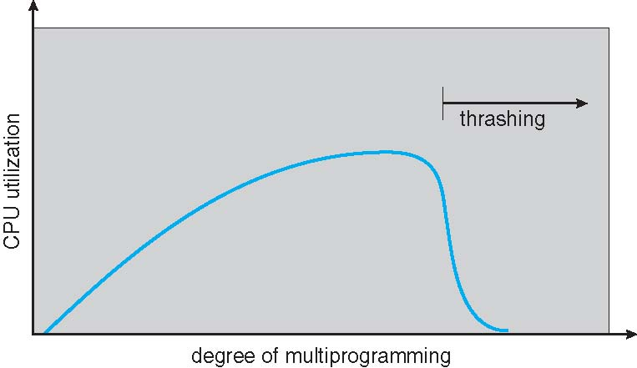
Thrashing (Cont.)
education for life www.rimt.ac.in

Slide 6
Demand Paging and Thrashing
Why does demand paging work?
Locality model
Process migrates from one locality to another
Localities may overlap
Why does thrashing occur? Σ size of locality > total memory size
Limit effects by using local or priority page replacement
education for life www.rimt.ac.in

Slide 7
Memory-Mapped Files
Memory-mapped file I/O allows file I/O to be treated as routine memory access by a mapping disk block to a page in memory
A file is initially read using demand paging
A page-sized portion of the file is read from the file system into a physical page
Subsequent reads/writes to/from the file are treated as ordinary memory accesses
Simplifies and speeds file access by driving file I/O through memory rather than read() and write() system calls
Also allows several processes to map the same file allowing the pages in memory to be shared
But when does written data make it to disk?
Periodically and / or at file close() time
For example, when the pager scans for dirty pages
education for life www.rimt.ac.in

Slide 8
Memory-Mapped File Technique for all I/O
Some OSes uses memory mapped files for standard I/O
Process can explicitly request memory mapping a file via mmap() system call
Now file mapped into process address space
For standard I/O (open(), read(), write(), close()), mmap anyway
But map file into kernel address space
Process still does read() and write()
Copies data to and from kernel space and user space
Uses efficient memory management subsystem
Avoids needing separate subsystem
COW can be used for read/write non-shared pages
Memory mapped files can be used for shared memory (although again via separate system calls)
education for life www.rimt.ac.in

Slide 9
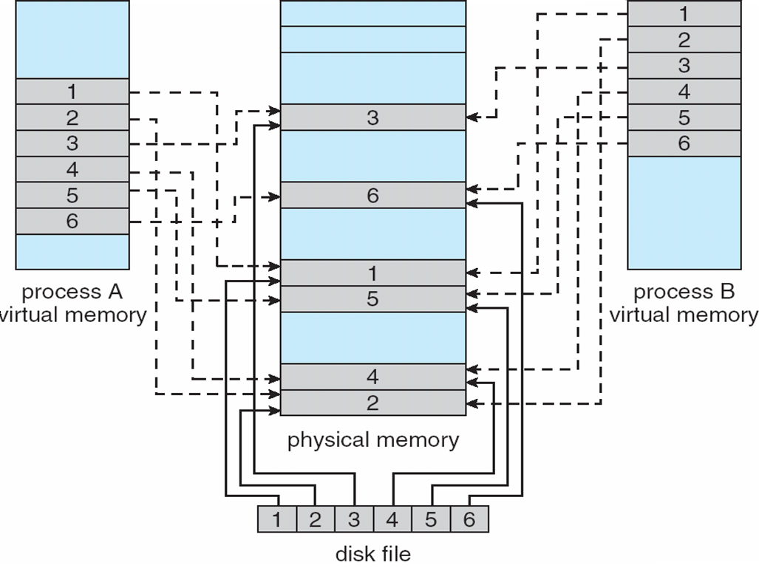
Memory Mapped Files
education for life www.rimt.ac.in

Slide 10
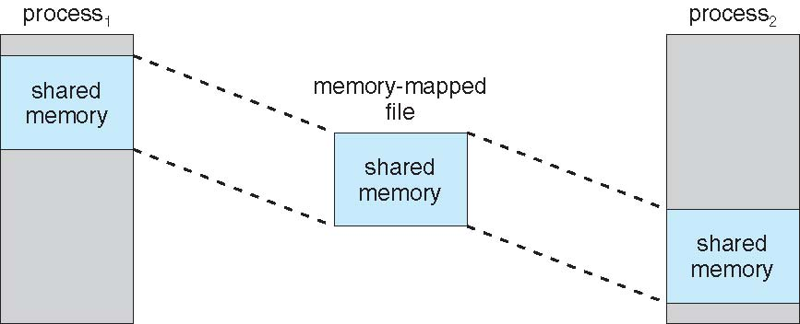
Memory-Mapped Shared Memory in Windows
education for life www.rimt.ac.in

Slide 11
Allocating Kernel Memory
Treated differently from user memory
Often allocated from a free-memory pool
Kernel requests memory for structures of varying sizes
Some kernel memory needs to be contiguous
I.e. for device I/O
education for life www.rimt.ac.in

Slide 12
Buddy System
Allocates memory from fixed-size segment consisting of physically-contiguous pages
Memory allocated using power-of-2 allocator
Satisfies requests in units sized as power of 2
Request rounded up to next highest power of 2
When smaller allocation needed than is available, current chunk split into two buddies of next-lower power of 2
Continue until appropriate sized chunk available
For example, assume 256KB chunk available, kernel requests 21KB
Split into A_{L} _{and} A_{r} of 128KB each
One further divided into B_{L} and B_{R} of 64KB
One further into C_{L} and C_{R} of 32KB each – one used to satisfy request
Advantage – quickly coalesce unused chunks into larger chunk
Disadvantage - fragmentation
education for life www.rimt.ac.in

Slide 13
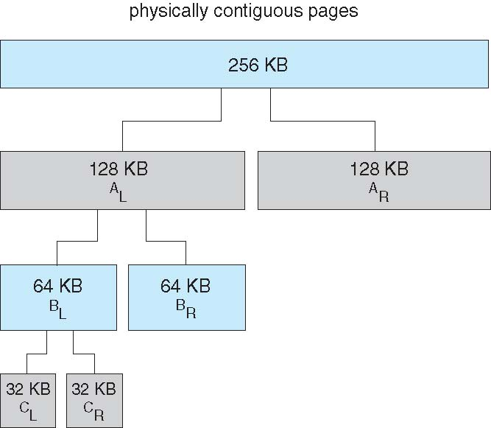
Buddy System Allocator
education for life www.rimt.ac.in

Slide 14
Slab Allocator
Alternate strategy
Slab is one or more physically contiguous pages
Cache consists of one or more slabs
Single cache for each unique kernel data structure
Each cache filled with objects – instantiations of the data structure
When cache created, filled with objects marked as free
When structures stored, objects marked as used
If slab is full of used objects, next object allocated from empty slab
If no empty slabs, new slab allocated
Benefits include no fragmentation, fast memory request satisfaction
education for life www.rimt.ac.in

Slide 15
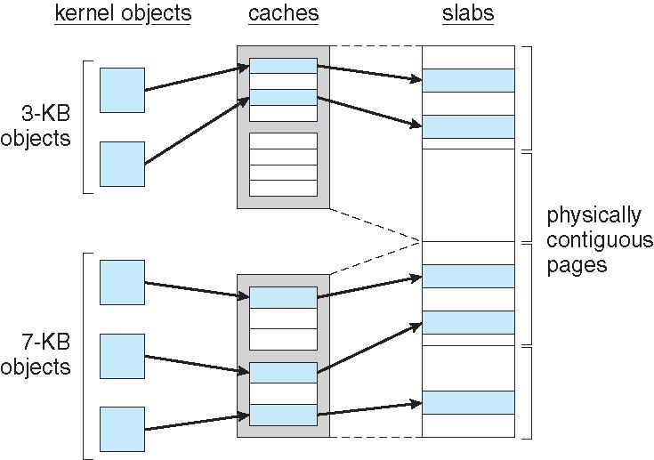
Slab Allocation
education for life www.rimt.ac.in

Slide 16
Other Considerations -- Prepaging
Prepaging
To reduce the large number of page faults that occurs at process startup
Prepage all or some of the pages a process will need, before they are referenced
But if prepaged pages are unused, I/O and memory was wasted
Assume s pages are prepaged and α of the pages is used
Is cost of s * α save pages faults > or < than the cost of prepaging s * (1- α) unnecessary pages?
α near zero ⇒ prepaging loses
education for life www.rimt.ac.in

Slide 17
Other Issues – Page Size
Sometimes OS designers have a choice
Especially if running on custom-built CPU
Page size selection must take into consideration:
Fragmentation
Page table size
Resolution
I/O overhead
Number of page faults
Locality
TLB size and effectiveness
Always power of 2, usually in the range 2¹² (4,096 bytes) to 2²² (4,194,304 bytes)
On average, growing over time
education for life www.rimt.ac.in

Slide 18
Other Issues – I/O interlock
I/O interlock -Pages must sometimes be locked into memory
Consider I/O - Pages that are used for copying a file from a device must be locked from being selected for eviction by a page replacement algorithm
education for life www.rimt.ac.in

Slide 19
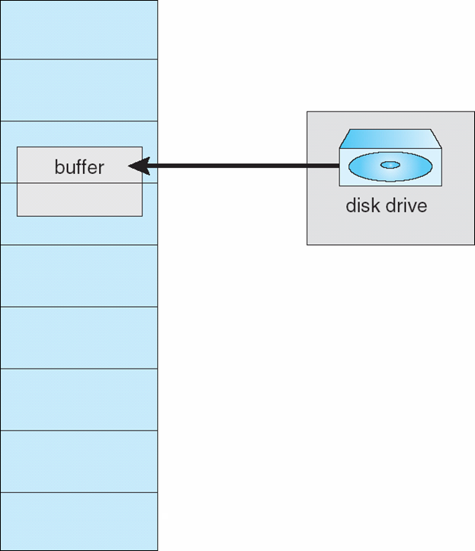
Reason Why Frames Used For I/O Must Be In Memory
education for life www.rimt.ac.in

Slide 20
Operating System Examples
Windows XP
Solaris
education for life www.rimt.ac.in

Slide 21
Solaris
Maintains a list of free pages to assign faulting processes
Lotsfree – threshold parameter (amount of free memory) to begin paging
Desfree – threshold parameter to increasing paging
Minfree – threshold parameter to being swapping
Paging is performed by pageout process
Pageout scans pages using modified clock algorithm
Scanrate is the rate at which pages are scanned. This ranges from slowscan to fastscan
Pageout is called more frequently depending upon the amount of free memory available
Priority paging gives priority to process code pages
education for life www.rimt.ac.in

Slide 22
Summary
Operating-System Thrashing
Memory-Mapped Files
Allocating Kernel Memory
Other Considerations
Examples
education for life www.rimt.ac.in

Slide 23
Topics To Be Next Covered
File-System Structure
File-System Implementation
Directory Implementation
Allocation Methods
education for life www.rimt.ac.in

Slide 24
References
Silberschatz and Peter B. Calvin, “Operating System Concepts" Addison Wesley Publishing Company
Dhamdhere, “Systems Programming & Operating Systems Tata McGraw Hill

