Slide 1
Operating System/ BTCS-2401
Course Name: B.Tech CSE Semester: 4th
Prepared by: Er. Jasdeep Singh
education for life www.rimt.ac.in
Department of Computer Science & Engineering

Slide 2
Topic 28th : The Linux System
education for life www.rimt.ac.in

Slide 3
Topics To Be Covered
Linux History
Design Principles
Kernel Modules
Process Management
Scheduling
Memory Management
File Systems
Input and Output
Inter process Communication
Network Structure
Security
education for life www.rimt.ac.in

Slide 4
Objectives
To explore the history of the UNIX operating system from which Linux is derived and the principles which Linux is designed upon
To examine the Linux process model and illustrate how Linux schedules processes and provides interprocess communication
To look at memory management in Linux
To explore how Linux implements file systems and manages I/O devices
education for life www.rimt.ac.in

Slide 5
History
Linux is a modern, free operating system based on UNIX standards
First developed as a small but self-contained kernel in 1991 by Linus Torvalds, with the major design goal of UNIX compatibility
Its history has been one of collaboration by many users from all around the world, corresponding almost exclusively over the Internet
It has been designed to run efficiently and reliably on common PC hardware, but also runs on a variety of other platforms
The core Linux operating system kernel is entirely original, but it can run much existing free UNIX software, resulting in an entire UNIX-compatible operating system free from proprietary code
Many, varying Linux Distributions including the kernel, applications, and management tools
education for life www.rimt.ac.in

Slide 6
The Linux Kernel
Version 0.01 (May 1991) had no networking, ran only on 80386-compatible Intel processors and on PC hardware, had extremely limited device-drive support, and supported only the Minix file system
Linux 1.0 (March 1994) included these new features:
Support for UNIX’s standard TCP/IP networking protocols
BSD-compatible socket interface for networking programming
Device-driver support for running IP over an Ethernet
Enhanced file system
Support for a range of SCSI controllers for high-performance disk access
Extra hardware support
Version 1.2 (March 1995) was the final PC-only Linux kernel
education for life www.rimt.ac.in

Slide 7
The Linux System
Linux uses many tools developed as part of Berkeley’s BSD operating system, MIT’s X Window System, and the Free Software Foundation's GNU project
The min system libraries were started by the GNU project, with improvements provided by the Linux community
Linux networking-administration tools were derived from 4.3BSD code; recent BSD derivatives such as Free BSD have borrowed code from Linux in return
The Linux system is maintained by a loose network of developers collaborating over the Internet, with a small number of public ftp sites acting as de facto standard repositories
education for life www.rimt.ac.in

Slide 8
Design Principles
Linux is a multiuser, multitasking system with a full set of UNIX-compatible tools
Its file system adheres to traditional UNIX semantics, and it fully implements the standard UNIX networking model
Main design goals are speed, efficiency, and standardization
Linux is designed to be compliant with the relevant POSIX documents; at least two Linux distributions have achieved official POSIX certification
The Linux programming interface adheres to the SVR4 UNIX semantics, rather than to BSD behavior
education for life www.rimt.ac.in

Slide 9
Components of a Linux System
education for life www.rimt.ac.in

Slide 10
Kernel Modules
Sections of kernel code that can be compiled, loaded, and unloaded independent of the rest of the kernel.
A kernel module may typically implement a device driver, a file system, or a networking protocol.
The module interface allows third parties to write and distribute, on their own terms, device drivers or file systems that could not be distributed under the GPL.
Kernel modules allow a Linux system to be set up with a standard, minimal kernel, without any extra device drivers built in.
Three components to Linux module support:
module management
driver registration
conflict resolution
education for life www.rimt.ac.in

Slide 11
Module Management
Supports loading modules into memory and letting them talk to the rest of the kernel
Module loading is split into two separate sections:
Managing sections of module code in kernel memory
Handling symbols that modules are allowed to reference
The module requestor manages loading requested, but currently unloaded, modules; it also regularly queries the kernel to see whether a dynamically loaded module is still in use, and will unload it when it is no longer actively needed
education for life www.rimt.ac.in

Slide 12
Driver Registration
Allows modules to tell the rest of the kernel that a new driver has become available
The kernel maintains dynamic tables of all known drivers, and provides a set of routines to allow drivers to be added to or removed from these tables at any time
Registration tables include the following items:
Device drivers
File systems
Network protocols
Binary format
education for life www.rimt.ac.in

Slide 13
Process Management
UNIX process management separates the creation of processes and the running of a new program into two distinct operations.
The fork system call creates a new process
A new program is run after a call to execve
Under UNIX, a process encompasses all the information that the operating system must maintain to track the context of a single execution of a single program
Under Linux, process properties fall into three groups: the process’s identity, environment, and context
education for life www.rimt.ac.in

Slide 14
Processes and Threads
Linux uses the same internal representation for processes and threads; a thread is simply a new process that happens to share the same address space as its parent.
A distinction is only made when a new thread is created by the clone system call.
fork creates a new process with its own entirely new process context
clone creates a new process with its own identity, but that is allowed to share the data structures of its parent
Using clone gives an application fine-grained control over exactly what is shared between two threads.
education for life www.rimt.ac.in

Slide 15
Scheduling
The job of allocating CPU time to different tasks within an operating system.
While scheduling is normally thought of as the running and interrupting of processes, in Linux, scheduling also includes the running of the various kernel tasks.
Running kernel tasks encompasses both tasks that are requested by a running process and tasks that execute internally on behalf of a device driver.
As of 2.5, new scheduling algorithm – preemptive, priority-based
Real-time range
nice value
education for life www.rimt.ac.in

Slide 16
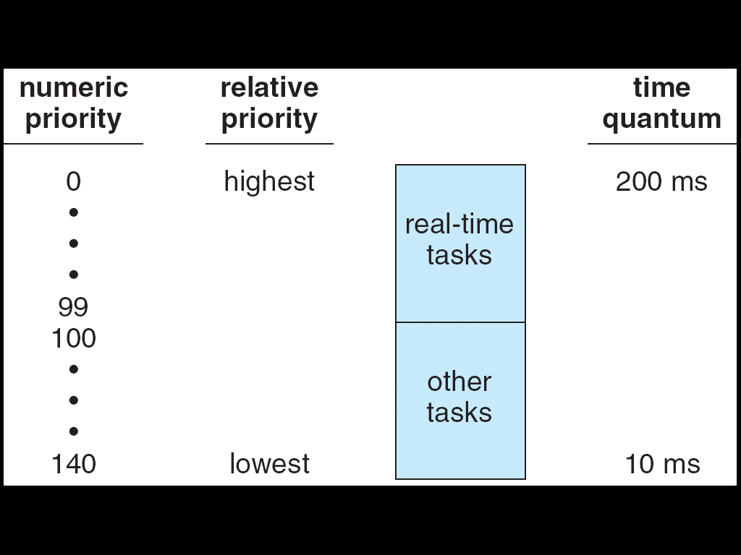
Relationship Between Priorities and Time-slice Length
education for life www.rimt.ac.in

Slide 17
Kernel Synchronization
A request for kernel-mode execution can occur in two ways:
A running program may request an operating system service, either explicitly via a system call, or implicitly, for example, when a page fault occurs
A device driver may deliver a hardware interrupt that causes the CPU to start executing a kernel-defined handler for that interrupt
Kernel synchronization requires a framework that will allow the kernel’s critical sections to run without interruption by another critical section.
education for life www.rimt.ac.in

Slide 18
Static and Dynamic Linking
A program whose necessary library functions are embedded directly in the program’s executable binary file is statically linked to its libraries.
The main disadvantage of static linkage is that every program generated must contain copies of exactly the same common system library functions.
Dynamic linking is more efficient in terms of both physical memory and disk-space usage because it loads the system libraries into memory only once.
education for life www.rimt.ac.in

Slide 19
File Systems
To the user, Linux’s file system appears as a hierarchical directory tree obeying UNIX semantics.
Internally, the kernel hides implementation details and manages the multiple different file systems via an abstraction layer, that is, the virtual file system (VFS).
The Linux VFS is designed around object-oriented principles and is composed of two components:
A set of definitions that define what a file object is allowed to look like
The inode-object and the file-object structures represent individual files
the file system object represents an entire file system
A layer of software to manipulate those objects.
education for life www.rimt.ac.in

Slide 20
Block Devices
Provide the main interface to all disk devices in a system
The block buffer cache serves two main purposes:
it acts as a pool of buffers for active I/O
it serves as a cache for completed I/O
The request manager manages the reading and writing of buffer contents to and from a block device driver
education for life www.rimt.ac.in

Slide 21
Character Devices
A device driver which does not offer random access to fixed blocks of data.
A character device driver must register a set of functions which implement the driver’s various file I/O operations.
The kernel performs almost no preprocessing of a file read or write request to a character device, but simply passes on the request to the device.
The main exception to this rule is the special subset of character device drivers which implement terminal devices, for which the kernel maintains a standard interface.
education for life www.rimt.ac.in

Slide 22
Interprocess Communication
Like UNIX, Linux informs processes that an event has occurred via signals
There is a limited number of signals, and they cannot carry information: Only the fact that a signal occurred is available to a process.
The Linux kernel does not use signals to communicate with processes with are running in kernel mode, rather, communication within the kernel is accomplished via scheduling states and wait.queue structures.
education for life www.rimt.ac.in

Slide 23
Network Structure
Networking is a key area of functionality for Linux.
It supports the standard Internet protocols for UNIX to UNIX communications
It also implements protocols native to nonUNIX operating systems, in particular, protocols used on PC networks, such as Appletalk and IPX
Internally, networking in the Linux kernel is implemented by three layers of software:
The socket interface
Protocol drivers
Network device drivers
education for life www.rimt.ac.in

Slide 24
Summary
Linux History
Design Principles
Kernel Modules
Process Management
Scheduling
Memory Management
File Systems
Input and Output
Inter process Communication
Network Structure
Security
education for life www.rimt.ac.in

Slide 25
Topics To Be Next Covered
History
Design Principles
System Components
Environmental Subsystems
File system
Networking
Programmer Interface
education for life www.rimt.ac.in

Slide 26
References
Silberschatz and Peter B. Calvin, “Operating System Concepts" Addison Wesley Publishing Company
Dhamdhere, “Systems Programming & Operating Systems Tata McGraw Hill
education for life www.rimt.ac.in

