Slide 1
Applied Thermodynamics(BMEC-2304)
Course Name: B.Tech- Mechanical Engineering Semester: 3rd
Prepared by: Ajay Singh Rana
education for life www.rimt.ac.in
Department of Mechanical Engineering

Slide 2
Topic Discussed
Introduction
Classifications of Steam Turbine
Advantage of Steam Turbine over steam engine
Compounding of Turbine
Impulse Turbine
Velocity Diagram of Impulse Turbine
Reaction Turbine
Velocity Diagram of Reaction Turbine
Governing of Turbine
education for life www.rimt.ac.in
Department of Mechanical Engineering

Slide 3
education for life www.rimt.ac.in
Department of Mechanical Engineering

Slide 4
education for life www.rimt.ac.in
Department of Mechanical Engineering

Slide 5
education for life www.rimt.ac.in
Department of Mechanical Engineering

Slide 6
education for life www.rimt.ac.in

Slide 7
education for life www.rimt.ac.in
Department of Mechanical Engineering

Slide 8
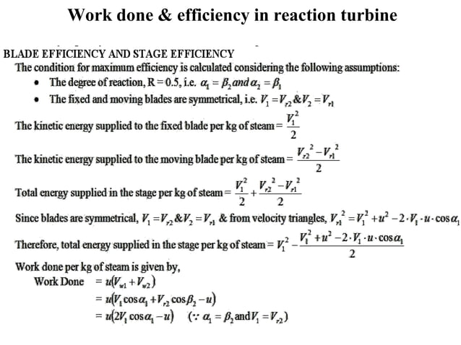
education for life www.rimt.ac.in
Department of Mechanical Engineering

Slide 9
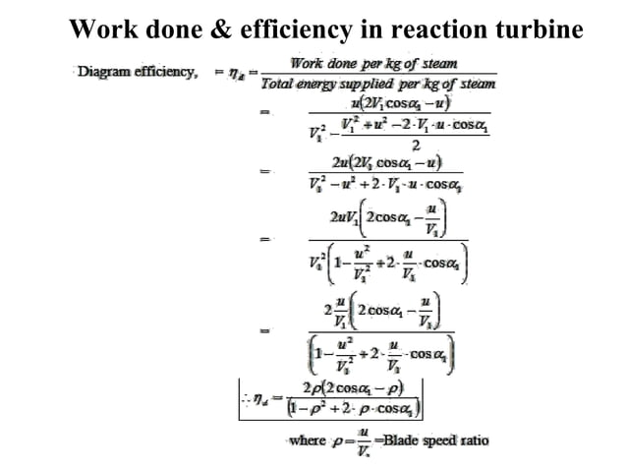
Department of Mechanical Engineering

Slide 10
education for life www.rimt.ac.in
Department of Mechanical Engineering

Slide 12
Department of Mechanical Engineering

Slide 13
education for life www.rimt.ac.in
Department of Mechanical Engineering

Slide 14
education for life www.rimt.ac.in
Department of Mechanical Engineering

Slide 15
Department of Mechanical Engineering

Slide 16
Department of Mechanical Engineering

Slide 17
Department of Mechanical Engineering

Slide 18
education for life www.rimt.ac.in
Department of Mechanical Engineering

