Slide 1
Discrete Structures (BTCS-2402)
Course Name: B.Tech CSE Semester: 4th
Prepared by:
Dr. Ankit
Assistant Professor
Departement of Mathematics
education for life www.rimt.ac.in
Department of Computer Science & Engineering

Slide 2
Subsets
“X is a subset of Y” is written as X ⊆ Y
Example:
If Y = {a,e,i,o,u} and X = {a, i, u} then X ⊆ Y.
education for life www.rimt.ac.in
Department of Computer Science & Engineering

Slide 3
Superset:
X and Y are sets. If X ⊆ Y, then “X is contained in Y” or “Y contains X” or Y is a superset of X, written Y ⊇ X.
Proper Subset:
X and Y are sets. X is a proper subset of Y if X ⊆ Y and there exists at least one element in Y that is not in X. This is written X ⊂ Y.
Example:
X = {a,e,i,o,u}, Y = {a,e,i,o,u,y}
X ⊂ Y , since y ∈ Y, but y ∉ X
education for life www.rimt.ac.in
Department of Computer Science & Engineering

Slide 4
Set Equality
X and Y are sets. They are said to be equal if every element of X is an element of Y and every element of Y is an element of X, i.e. X ⊆ Y and Y ⊆ X
Examples:
{1,2,3} = {2,3,1}
X = {red, blue, yellow} and Y = {c | c is a primary color} Therefore, X=Y
Empty (Null) Set: A Set is Empty (Null) if it contains no elements.
Remarks:
The Empty Set is written as ∅.
The Empty Set is a subset of every set.
education for life www.rimt.ac.in
Department of Computer Science & Engineering

Slide 5
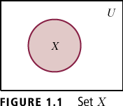
Universal Set:
In set theory, a universal set is a set which contains all objects, including itself.
Venn Diagrams
Abstract visualization of a Universal set, U as a rectangle, with all subsets of U shown as circles.
Shaded portion represents the corresponding set
Example:
In Figure, Set X, shaded, is a subset of the Universal set, U
education for life www.rimt.ac.in
Department of Computer Science & Engineering

Slide 6
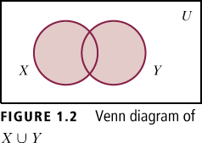
Set operations:
Union of Sets
Example: If X = {1,2,3,4,5} and Y = {5,6,7,8,9}, then
XUY = {1,2,3,4,5,6,7,8,9}
education for life www.rimt.ac.in
Department of Computer Science & Engineering

