Slide 1
Web Development/BTCS-2410
Course Name: B.Tech CSE Semester:4th
Prepared by: Ms. Yogesh
education for life www.rimt.ac.in
Department of Computer Science & Engineering

Slide 2
Layers and the “Bounding Box”
When the browser draws an object on a page, it places it into an invisible rectangular space called a “bounding box.” You can set the box’s exact location on the page or offset it from other objects on the page. As mentioned in the previous slides, you can also specify the size of the box.
With CSS, these boxes can be stacked one on top of another as layers. Horizontal and vertical positioning happen along the X and Y axes, and the layered positioning happens along the Z axis.
The Z axis is set using the CSS style z-index, which allows you to specify which layer appears on top of the others. By setting the z-index higher or lower, an object can move up and down a stack. The higher the z-index, the more “on top” it is.
education for life www.rimt.ac.in

Slide 3
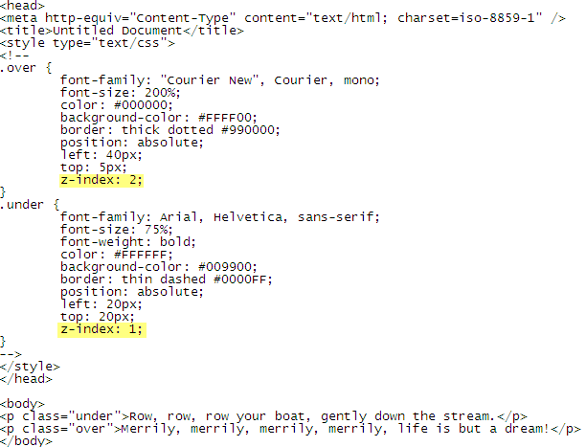
Layering Example 1
education for life www.rimt.ac.in

Slide 4
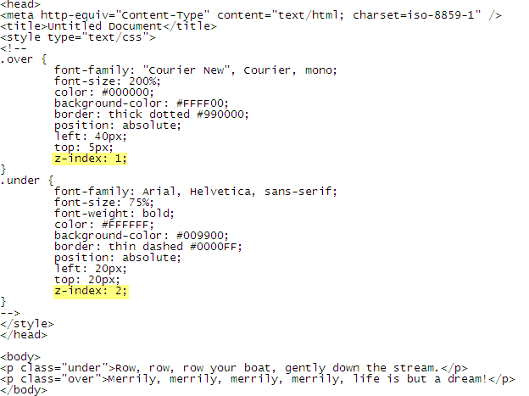
Layering Example 2
education for life www.rimt.ac.in

Slide 5
Float
If you want to wrap content around other content (such as text around a picture), you can use the float property.
The float property determines on which side of the bounding box the element aligns so that the other content wraps around it.
education for life www.rimt.ac.in

Slide 6
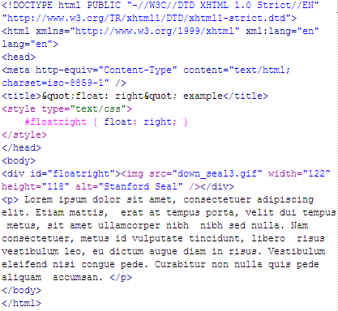
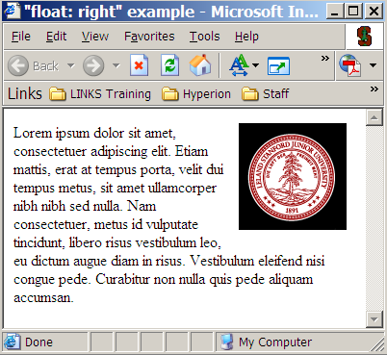
Float Example 1 – float: right
education for life www.rimt.ac.in

Slide 7
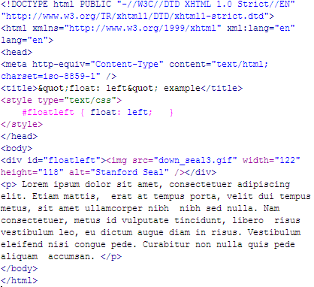
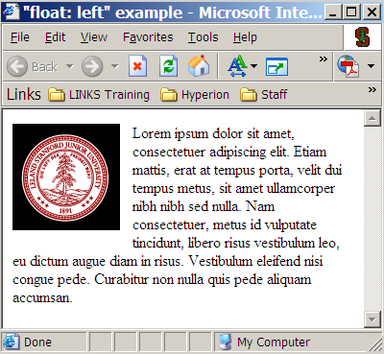
Float Example 2 – float: left
education for life www.rimt.ac.in

Slide 8
Resources
A List Apart – articles on practical issues and suggestions for working with CSS correctly http://www.alistapart.com/topics/code/css
Example XHTML Pages, with and without the CSS Style Sheet: http://techbriefings.stanford.edu/web_standards/example1.html http://techbriefings.stanford.edu/web_standards/example2.html http://techbriefings.stanford.edu/web_standards/example.css
The CSS Zen Garden shows some of the most advanced uses of CSS: http://www.csszengarden.com/
CSS in the real world: ajc.com's 'News Break': http://www.holovaty.com/blog/archive/2002/09/28/2340
Microsoft's CSS Information: http://msdn.microsoft.com/workshop/author/css/reference/attributes.asp
Microsoft's Style Sheet Demonstrations: http://www.microsoft.com/typography/css/gallery/extract1.htm http://www.microsoft.com/typography/css/gallery/slide1.htm
W3C Style Examples http://www.w3.org/Style/Examples/007
W3C CSS 2.1 Specifications: http://www.w3.org/TR/CSS21/
W3Schools CSS Tutorial: http://www.w3schools.com/css
W3Schools CSS Reference: http://www.w3schools.com/css/css_reference.asp
Webmonkey’s Cascading Style Sheet Guide: http://www.webmonkey.com/reference/stylesheet_guide/
Brian Wilson’s Cascading Style Sheet Reference Guide: http://www.blooberry.com/indexdot/css/index.html
education for life www.rimt.ac.in

