Slide 1
Engineering Mathematics-III (BMAT-1111)
Course Name: B.Tech (CSE) Semester: Ist
Prepared by: Sachin Syan
education for life www.rimt.ac.in
Department of Computer Science & Engineering

Slide 2
Topic Discussed
Examples of Exact Differential Equations
Equation Reducible to Exact Equations
Integrating Factor by Inspection Method
Rules for Find Integrating Factors
Clairaut’s Equation
education for life www.rimt.ac.in
Department of Computer Science & Engineering

Slide 3
Exact Equation
Example
Solve the initial value problem e^{x} (cos y dx – sin y dy) = 0 ; y (0) = 0
education for life www.rimt.ac.in
Department of Computer Science & Engineering

Slide 4
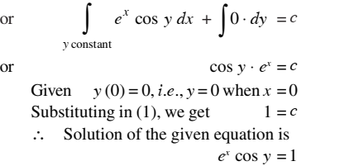
Exact Equation
education for life www.rimt.ac.in
Department of Computer Science & Engineering

Slide 5
Equation Reducible to Exact Equations
education for life www.rimt.ac.in
Department of Computer Science & Engineering

Slide 6
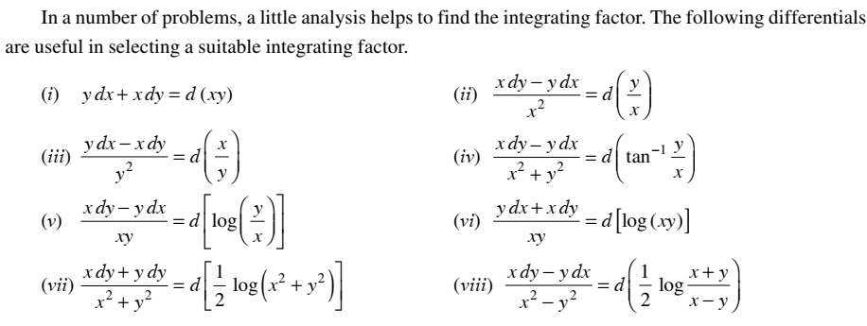
Integrating Factor by Inspection Method
education for life www.rimt.ac.in
Department of Computer Science & Engineering

Slide 7
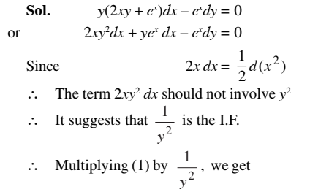
Integrating Factor by Inspection Method
Example Solve: y(2xy + e^{x})dx – e^{x}dy = 0.
education for life www.rimt.ac.in
Department of Computer Science & Engineering

Slide 8
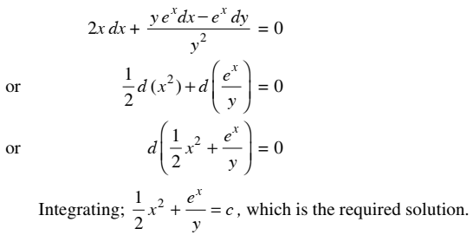
Integrating Factor by Inspection Method
education for life www.rimt.ac.in
Department of Computer Science & Engineering

Slide 9
Rules for finding Integrating Factor
Rules 1:
Rules 2:
If the equation M dx +N dy = 0 is of the form y f₁(xy) dx + x f₂ (xy) dy = 0, then is an I.F.
Rules 3:
Rules 4:
If the equation M dx +N dy = 0 is of the form xª y^{b} (m y dx + n x dy) + x^{c} y^{d} (p y dx + q x dy)
it has an I.F. of the form x^{h} y^{k}. where the values of h and k can also be determined from the relations
education for life www.rimt.ac.in
Department of Computer Science & Engineering

Slide 10
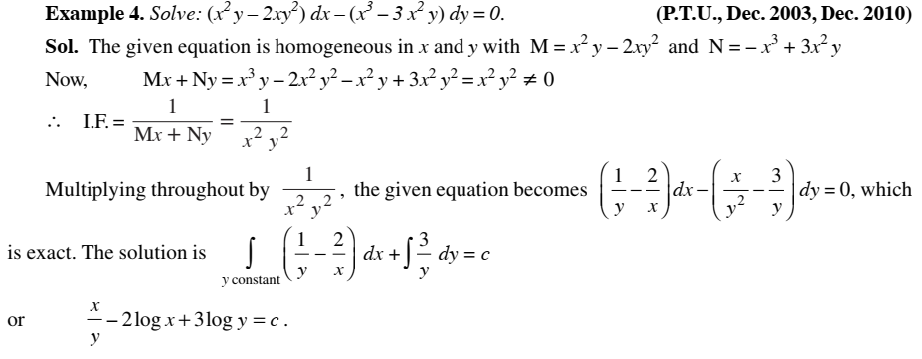
Integrating Factor
education for life www.rimt.ac.in
Department of Computer Science & Engineering

Slide 11
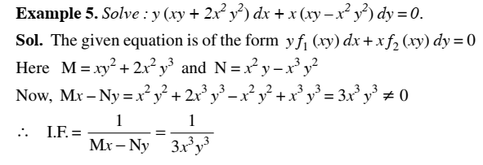
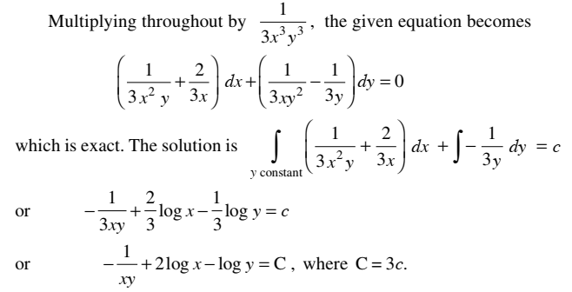
Integrating Factor
education for life www.rimt.ac.in
Department of Computer Science & Engineering

Slide 12
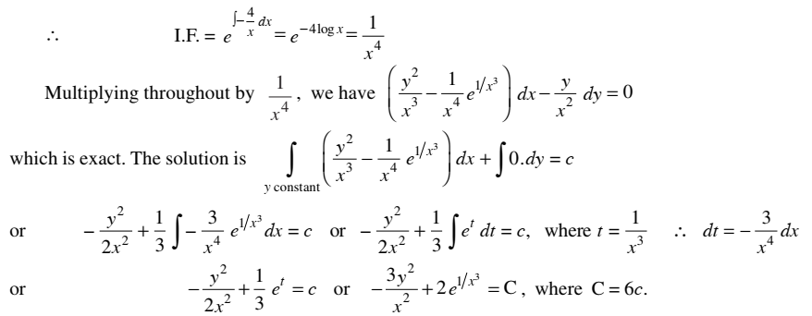
Integrating Factor
education for life www.rimt.ac.in
Department of Computer Science & Engineering

Slide 13
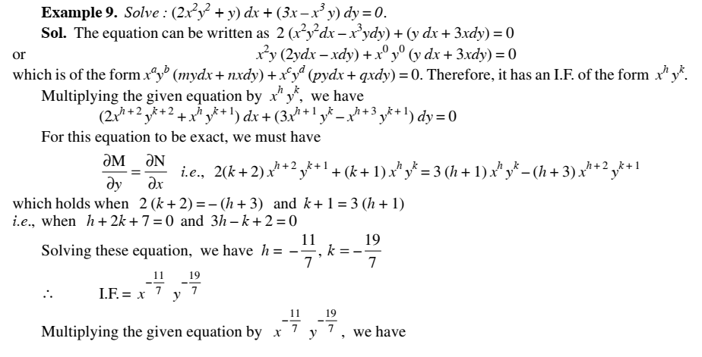
Integrating Factor
education for life www.rimt.ac.in
Department of Computer Science & Engineering

Slide 14
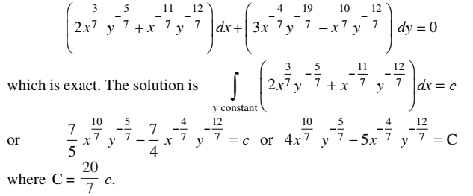
Integrating Factor
education for life www.rimt.ac.in
Department of Computer Science & Engineering

Slide 15
Clairaut’s Equation
An equation of the form y = px + f (p) is known as Clairaut’s equation
education for life www.rimt.ac.in
Department of Computer Science & Engineering

Slide 16
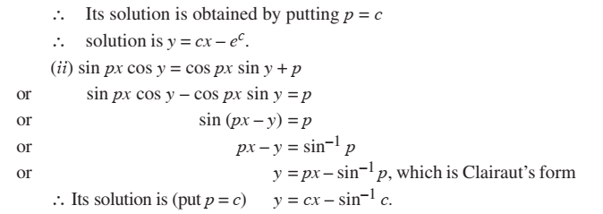
Clairaut’s Equation
Example: Solve
Sol. p = log (px – y)
or e^{p} = px – y or y = px – e ^{p}, which is Clairaut’s equation where f (p) = – e ^{p}
education for life www.rimt.ac.in
Department of Computer Science & Engineering

Slide 17
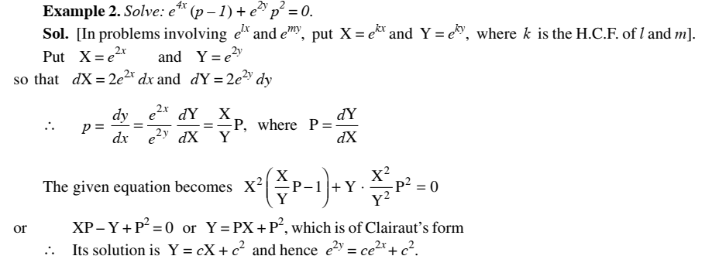
Clairaut’s Equation
education for life www.rimt.ac.in
Department of Computer Science & Engineering

Slide 18
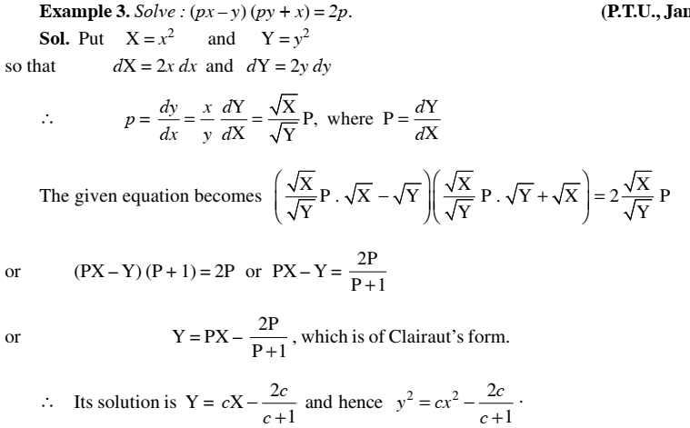
Clairaut’s Equation
education for life www.rimt.ac.in
Department of Computer Science & Engineering

Slide 19
Topics Discussed in Next Lecture
Equation Solvable for p
Equation Solvable for x
Equation Solvable for y
Linear Leibnitz Equation
Bernoulli’s Equation
education for life www.rimt.ac.in
Department of Computer Science & Engineering

