Slide 1
Web Development/BTCS-2410
Course Name: B.Tech CSE Semester:4th
Prepared by: Ms. Yogesh
education for life www.rimt.ac.in
Department of Computer Science & Engineering

Slide 2
Linking to a JavaScript file: script
<script src="filename" type="text/javascript"></script> HTML
script tag should be placed in HTML page's head
script code is stored in a separate .js file
JS code can be placed directly in the HTML file's body or head (like CSS)
but this is bad style (should separate content, presentation, and behavior
education for life www.rimt.ac.in

Slide 3
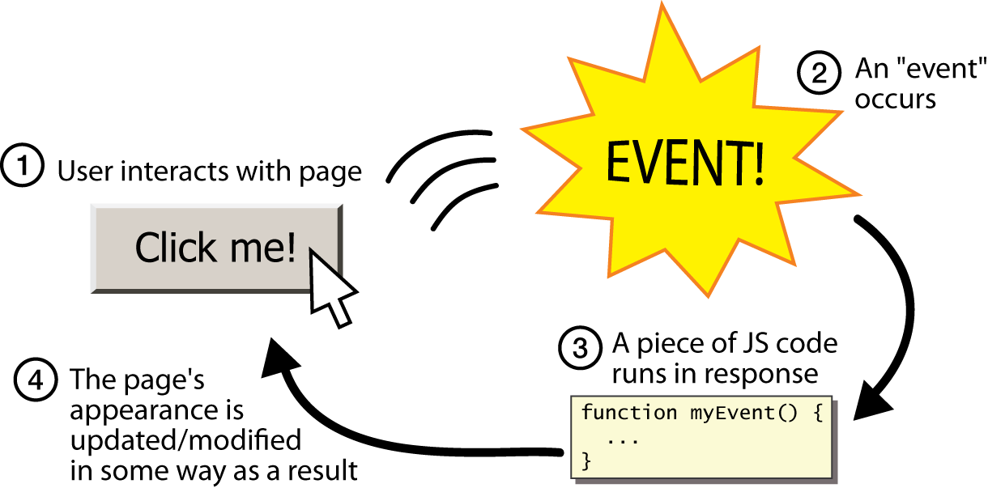
Event-driven programming
split breaks apart a string into an array using a delimiter
can also be used with regular expressions (seen later)
join merges an array into a single string, placing a delimiter between them
education for life www.rimt.ac.in

Slide 4
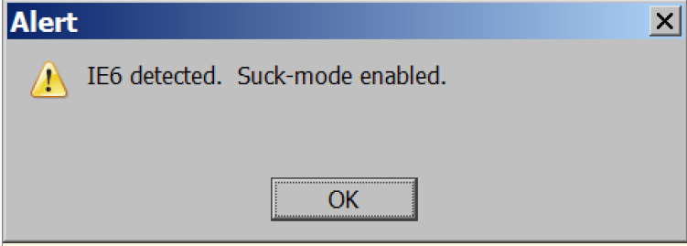
A JavaScript statement: alert
alert("IE6 detected. Suck-mode enabled."); JS
a JS command that pops up a dialog box with a message
education for life www.rimt.ac.in

Slide 5
Event-driven programming
you are used to programs start with a main method (or implicit main like in PHP)
JavaScript programs instead wait for user actions called events and respond to them
event-driven programming: writing programs driven by user events
Let's write a page with a clickable button that pops up a "Hello, World" window...
education for life www.rimt.ac.in

Slide 6
Buttons
<button>Click me!</button> HTML
button's text appears inside tag; can also contain images
To make a responsive button or other UI control:
choose the control (e.g. button) and event (e.g. mouse 1. click) of interest
write a JavaScript function to run when the event occurs
attach the function to the event on the control
education for life www.rimt.ac.in
Notes:
Reset is not working here! Debug! test1.html

