Slide 1
COMMUNICATIVE ENGLISH / BENG-1101
Course Name: B.Tech (Common to all branches) Semester: First
Prepared by: AMIT MOHAN
Head & Assistant Professor
education for life www.rimt.ac.in
Department of English

Slide 2
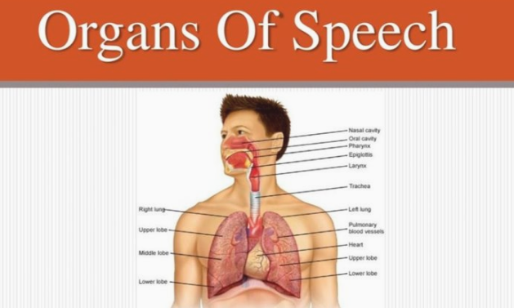
Topic Discussed
phonetics
education for life www.rimt.ac.in
Department of English

Slide 3
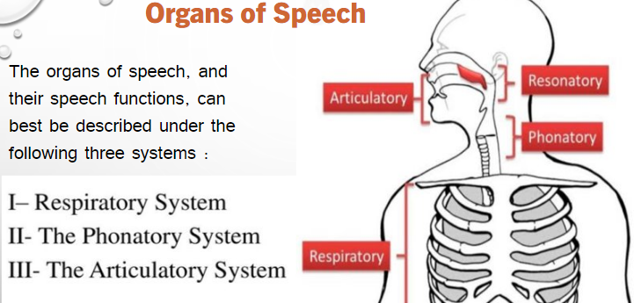
education for life www.rimt.ac.in
Department of English

Slide 4
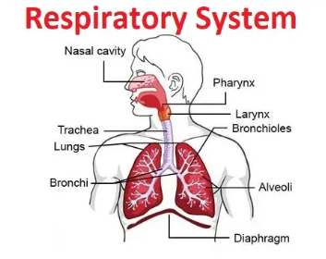
Respiratory System
The Respiratory system comprises the lungs, the muscles of the chest, and the wind pipe or trachea.
The primary function of the lungs is to enable us to breathe. The most usual source of energy for our vocal activity is provided by an air-stream expelled from the lungs. It is the secondary function of this system.
All the essential sounds of the English language require pulmonic (lungs) air-stream for their production.
education for life www.rimt.ac.in
Department of English

Slide 5
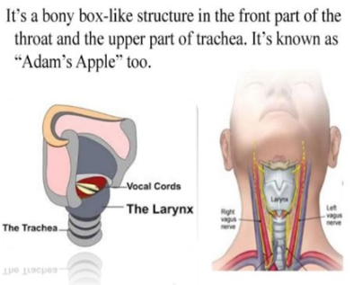
Phonatory system
The Phonatory system is formed by the organs exist in the throat, such as – Larynx (Voice box) and Vocal cords / folds.
The larynx is a little box that is popularly called – ‘the Adam’s apple’ , which is more prominent in men than in women.
The larynx contains a pair of muscular folds called the ‘vocal cords’.
education for life www.rimt.ac.in
Department of English

Slide 6
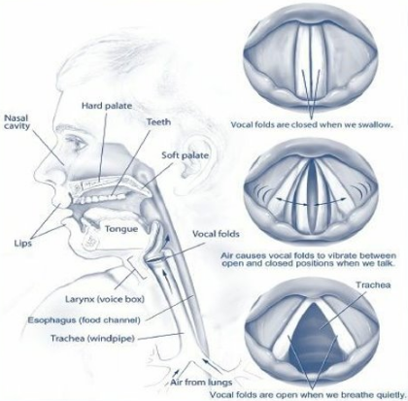
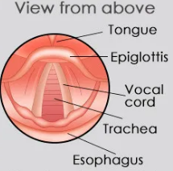
Positions of vocal cords
There are three important positions of the vocal cords:
Vocal cords drawn wide apart
Vocal cords held loosely together
Vocal cords held tightly together
education for life www.rimt.ac.in
Department of English

Slide 7
Topics Discussed in Next Lecture
Phonetics
Organs of Speech – Articulatory System
education for life www.rimt.ac.in
Department of English

