Slide 1
COMMUNICATIVE ENGLISH / BENG-1101
Course Name: B.Tech (Common to all branches) Semester: First
Prepared by: AMIT MOHAN
Head & Assistant Professor
education for life www.rimt.ac.in
Department of English

Slide 2
Topic Discussed
phonetics
education for life www.rimt.ac.in
Department of English

Slide 3
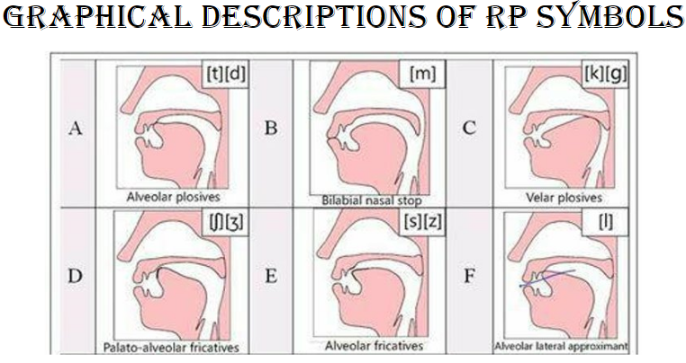
education for life www.rimt.ac.in
Department of English

Slide 4
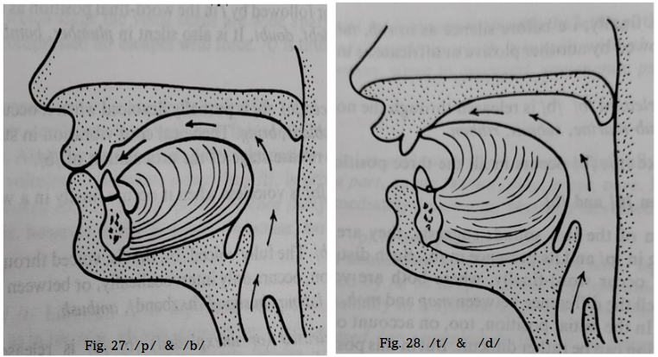
education for life www.rimt.ac.in
Department of English

Slide 5
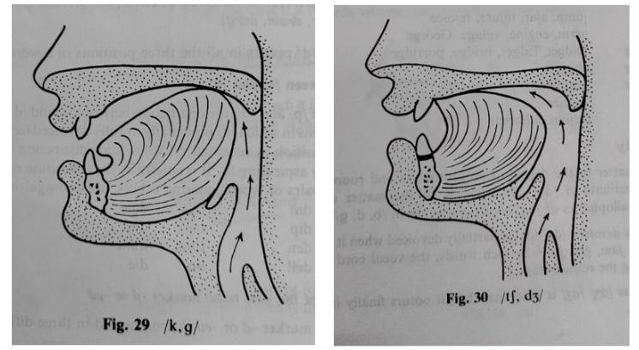
education for life www.rimt.ac.in
Department of English

Slide 6
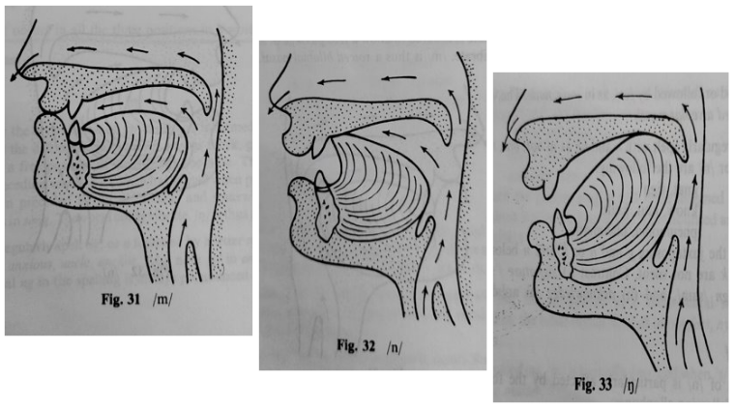
education for life www.rimt.ac.in
Department of English

Slide 7
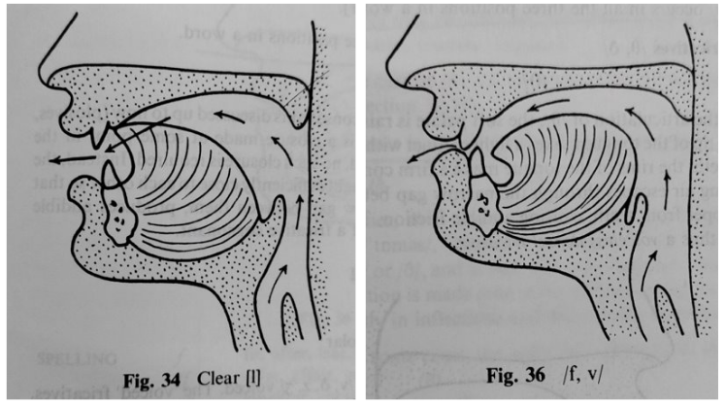
education for life www.rimt.ac.in
Department of English

Slide 8
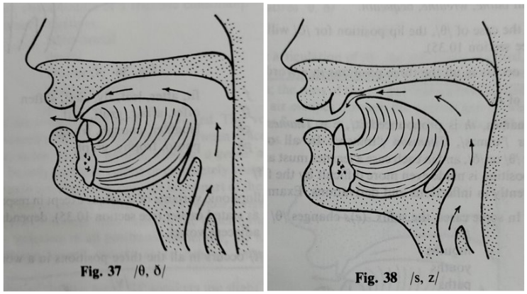
education for life www.rimt.ac.in
Department of English

Slide 9
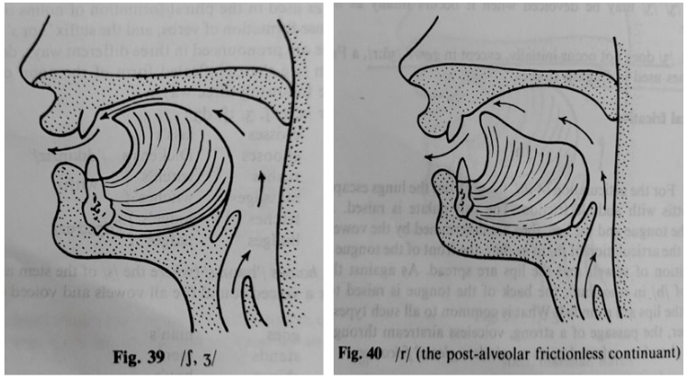
education for life www.rimt.ac.in
Department of English

Slide 10
Topics Discussed in Next Lecture
Phonetics
What is Group Discussion?
education for life www.rimt.ac.in
Department of English

