Slide 1
Operating System/ BTCS-2401
Course Name: B.Tech CSE Semester: 4th
Prepared by: Er. Jasdeep Singh
education for life www.rimt.ac.in
Department of Computer Science & Engineering

Slide 2
Topic 5th : Inter-process Communication
education for life www.rimt.ac.in

Slide 3
Topics To Be Covered
Interprocess Communication
Examples of IPC Systems
Communication in Client-Server Systems
education for life www.rimt.ac.in

Slide 4
Interprocess Communication
Processes within a system may be independent or cooperating
Cooperating process can affect or be affected by other processes, including sharing data
Reasons for cooperating processes:
Information sharing
Computation speedup
Modularity
Convenience
Cooperating processes need interprocess communication (IPC)
Two models of IPC
Shared memory
Message passing
education for life www.rimt.ac.in

Slide 5
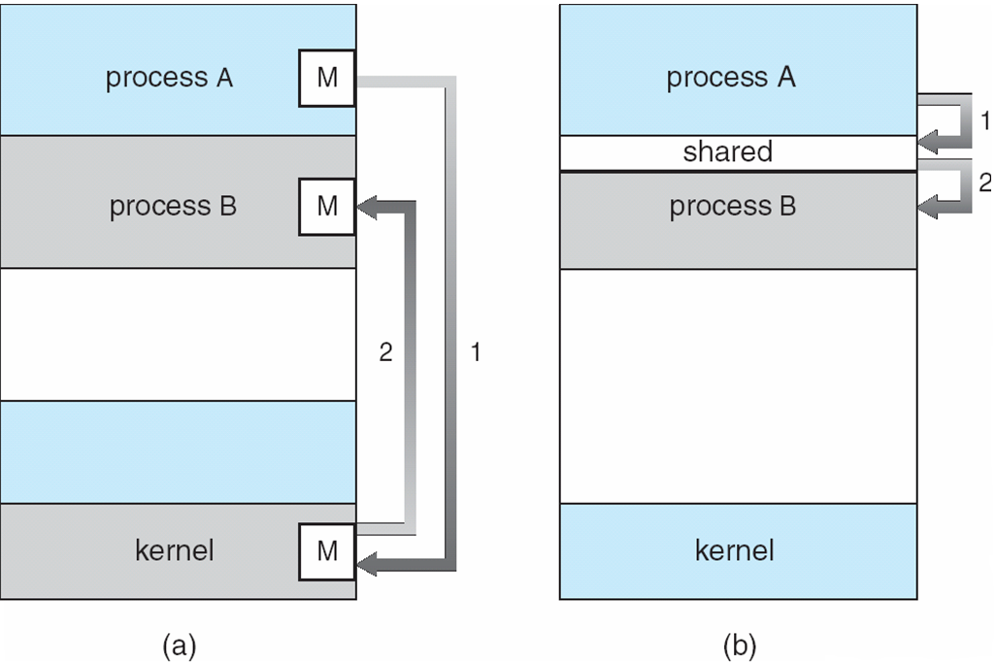
Communications Models
education for life www.rimt.ac.in

Slide 6
Cooperating Processes
Independent process cannot affect or be affected by the execution of another process
Cooperating process can affect or be affected by the execution of another process
Advantages of process cooperation
Information sharing
Computation speed-up
Modularity
Convenience
education for life www.rimt.ac.in

Slide 7
Producer-Consumer Problem
Paradigm for cooperating processes, producer process produces information that is consumed by a consumer process
unbounded-buffer places no practical limit on the size of the buffer
bounded-buffer assumes that there is a fixed buffer size
education for life www.rimt.ac.in

Slide 8
Interprocess Communication – Message Passing
Mechanism for processes to communicate and to synchronize their actions
Message system – processes communicate with each other without resorting to shared variables
IPC facility provides two operations:
send(message) – message size fixed or variable
receive(message)
If P and Q wish to communicate, they need to:
establish a communication link between them
exchange messages via send/receive
Implementation of communication link
physical (e.g., shared memory, hardware bus)
logical (e.g., logical properties)
education for life www.rimt.ac.in

Slide 9
Implementation Questions
How are links established?
Can a link be associated with more than two processes?
How many links can there be between every pair of communicating processes?
What is the capacity of a link?
Is the size of a message that the link can accommodate fixed or variable?
Is a link unidirectional or bi-directional?
education for life www.rimt.ac.in

Slide 10
Direct Communication
Processes must name each other explicitly:
send (P, message) – send a message to process P
receive(Q, message) – receive a message from process Q
Properties of communication link
Links are established automatically
A link is associated with exactly one pair of communicating processes
Between each pair there exists exactly one link
The link may be unidirectional, but is usually bi-directional
education for life www.rimt.ac.in

Slide 11
Indirect Communication
Messages are directed and received from mailboxes (also referred to as ports)
Each mailbox has a unique id
Processes can communicate only if they share a mailbox
Properties of communication link
Link established only if processes share a common mailbox
A link may be associated with many processes
Each pair of processes may share several communication links
Link may be unidirectional or bi-directional
education for life www.rimt.ac.in

Slide 12
Indirect Communication
Operations
create a new mailbox
send and receive messages through mailbox
destroy a mailbox
Primitives are defined as:
send(A, message) – send a message to mailbox A
receive(A, message) – receive a message from mailbox A
education for life www.rimt.ac.in

Slide 13
Synchronization
Message passing may be either blocking or non-blocking
Blocking is considered synchronous
Blocking send has the sender block until the message is received
Blocking receive has the receiver block until a message is available
Non-blocking is considered asynchronous
Non-blocking send has the sender send the message and continue
Non-blocking receive has the receiver receive a valid message or null
education for life www.rimt.ac.in

Slide 14
Buffering
Queue of messages attached to the link; implemented in one of three ways
1. Zero capacity – 0 messages Sender must wait for receiver (rendezvous)
2. Bounded capacity – finite length of n messages Sender must wait if link full
3. Unbounded capacity – infinite length Sender never waits
education for life www.rimt.ac.in

Slide 15
Examples of IPC Systems – Windows XP
Message-passing centric via local procedure call (LPC) facility
Only works between processes on the same system
Uses ports (like mailboxes) to establish and maintain communication channels
Communication works as follows:
The client opens a handle to the subsystem’s connection port object.
The client sends a connection request.
The server creates two private communication ports and returns the handle to one of them to the client.
The client and server use the corresponding port handle to send messages or callbacks and to listen for replies.
education for life www.rimt.ac.in

Slide 16
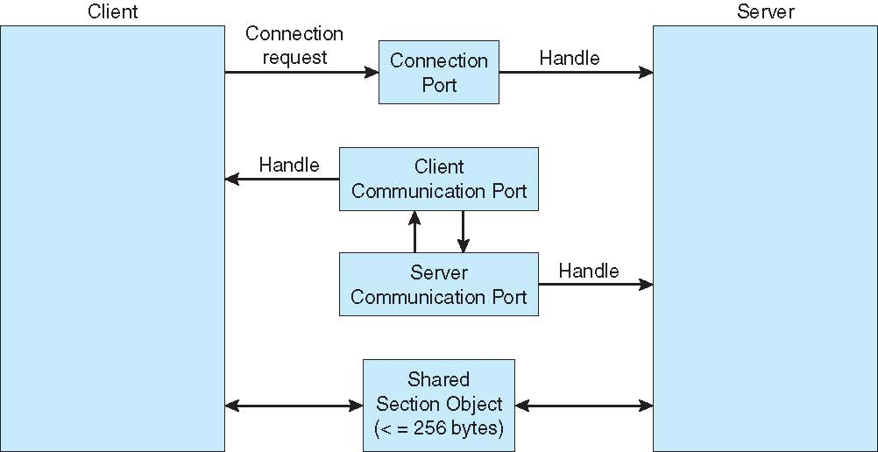
Local Procedure Calls in Windows XP
education for life www.rimt.ac.in

Slide 17
Communications in Client-Server Systems
Sockets
Remote Procedure Calls
Pipes
Remote Method Invocation (Java)
education for life www.rimt.ac.in

Slide 18
Sockets
A socket is defined as an endpoint for communication
Concatenation of IP address and port
The socket 161.25.19.8:1625 refers to port 1625 on host 161.25.19.8
Communication consists between a pair of sockets
education for life www.rimt.ac.in

Slide 19
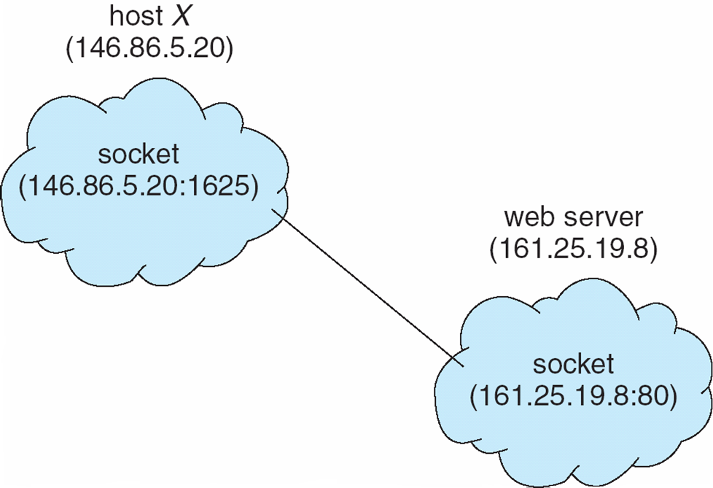
Socket Communication
education for life www.rimt.ac.in

Slide 20
Remote Procedure Calls
Remote procedure call (RPC) abstracts procedure calls between processes on networked systems
Stubs – client-side proxy for the actual procedure on the server
The client-side stub locates the server and marshalls the parameters
The server-side stub receives this message, unpacks the marshalled parameters, and performs the procedure on the server
education for life www.rimt.ac.in

Slide 21
Pipes
Acts as a conduit allowing two processes to communicate
Issues
Is communication unidirectional or bidirectional?
In the case of two-way communication, is it half or full-duplex?
Must there exist a relationship (i.e. parent-child) between the communicating processes?
Can the pipes be used over a network?
education for life www.rimt.ac.in

Slide 22
Ordinary Pipes
Ordinary Pipes allow communication in standard producer-consumer style
Producer writes to one end (the write-end of the pipe)
Consumer reads from the other end (the read-end of the pipe)
Ordinary pipes are therefore unidirectional
Require parent-child relationship between communicating processes
education for life www.rimt.ac.in

Slide 23
Summary
Interprocess Communication
Examples of IPC Systems
Communication in Client-Server Systems
education for life www.rimt.ac.in

Slide 24
Topics To Be Next Covered
Overview
Multithreading Models
Thread Libraries
Threading Issues
Operating System Examples
Windows XP Threads
Linux Threads
education for life www.rimt.ac.in

Slide 25
References
Silberschatz and Peter B. Calvin, “Operating System Concepts" Addison Wesley Publishing Company
Dhamdhere, “Systems Programming & Operating Systems Tata McGraw Hill
education for life www.rimt.ac.in

