Slide 1
Computer Peripherals and Interfaces BTCS-3505
Course Name: B.Tech CSE Semester: 5th
Prepared by: Er. Jasdeep Singh
education for life www.rimt.ac.in
Department of Computer Science & Engineering

Slide 2
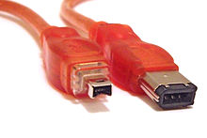
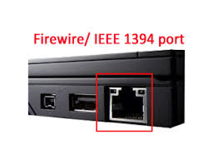
IEEE 1394
The IEEE 1394 interface is an electronic standard that is used to connect computers. It includes a plug-and-socket connection with a serial bus interface. Up to 63 devices may be connected at the same time with (relatively) high data transfer speeds.
It is a standard connection type for many electronic devices such as digital video cameras, printers and scanners, external hard drives, and other peripherals.
It is widely available in the market in the forms of coaxial, wireless and fiber optic cable.
The IEEE 1394 interface is commonly known as FireWire
education for life www.rimt.ac.in

Slide 3
IEEE 1394 features
Real-time data transferring for multimedia applications
100-800 Mb/s data transfer rate
Hot plugging is allowed (at a minimum ratio)
Line terminators are not required
Plug-and-play
Auto-configuration for many peripheral devices
Same connectors for multiple devices and components
education for life www.rimt.ac.in

Slide 4
FireWire vs USB
FireWire is made to handle more data than USB, particularly audio and visual information. USB data transfer rate of 480 Mbps, whereas an FireWire can take on 800 Mbps.
USB networking is based on the host, whereas FireWire networking is directly peer-to-peer.
USB can manage 127 devices while an 800 FireWire can only manage up to 63 devices.
education for life www.rimt.ac.in

Slide 5
Difference between Serial Port and Parallel Ports
Serial Port:
A serial port is an interface that is used for connecting the serial lines to attain the serial communication.
These ports can dock a 9-pin D-shaped connector that connects to the transmission line, is called DB-9 connectors
Serial communication gained by single wire and only the single stream of data is transferred from one end to other.
Serial ports are typically implemented in the modems, connecting devices, controllers, mouse and also in security cameras.
education for life www.rimt.ac.in

Slide 6
Parallel Port:
A parallel port can move a set of 8 bits at a time on eight different wires.
It uses a 25 pin connector that is called DB-25 connector.
Parallel ports are typically implemented in zip-drives, printers, hard drives, CD-ROM drives, etc.
education for life www.rimt.ac.in

