Slide 1
Computer Peripherals and Interfaces BTCS-3505
Course Name: B.Tech CSE Semester: 5th
Prepared by: Er. Jasdeep Singh
education for life www.rimt.ac.in
Department of Computer Science & Engineering

Slide 2
I/O INTERFACE
education for life www.rimt.ac.in

Slide 3
Interface
An interface may refer..
When referring to software, an interface is a program that allows a user to interact computers in person or over a network. One of the best examples of an interface is a GUI (Graphical User Interface). This type of interface is what you are using now to navigate your computer and how you got to this page.
When referring to hardware, an interface is a physical device, port, or connection that interacts with the computer or other hardware device. For example, IDE and SATA are disk drive interfaces for computer hard drives and ATAPI is an early interface for CD-ROM drives.
education for life www.rimt.ac.in

Slide 4
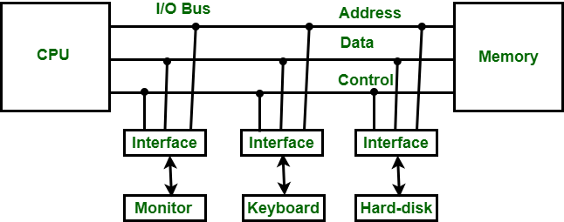
Input-Output Interface
Input-Output Interface is used as an method which helps in transferring of information between the internal storage devices i.e. memory and the external peripheral device .
For Example: A keyboard and mouse provide Input to the computer are called input devices while a monitor and printer that provide output to the computer are called output devices.
education for life www.rimt.ac.in

Slide 5
CPU
PERIPHERALS
DATA
DATA BUFFER
REGISTER
DATA
CONTROL
LOGIC
CONTROL
REGISTER
CONTROL
CONTROL
STATUS REGISTER
ADDRESS
DEVICE
RECOGNIZER
FUNCTIONAL BLOCK DIAGRAM OF INTERFACE
education for life www.rimt.ac.in

Slide 6
Buffer registers are a type of registers used to store a binary word. These can be constructed using a series of flip-flops.
Control logic is a key part of a software program that controls the operations of the program i.e controller that defines how a reactive system responds to events or conditional changes.
Control and Status Register (CSR) is a register in many central processing units that are used as storage devices for information about instructions received from machines.
education for life www.rimt.ac.in

Slide 7
Functions of Input-Output Interface:
It is used to synchronize the operating speed of CPU with respect to input-output devices.
It selects the input-output device which is appropriate for the interpretation of the input-output device.
It is capable of providing signals like control and timing signals.
In this data buffering can be possible through data bus.
There are various error detectors.
It converts serial data into parallel data and vice-versa.
It also convert digital data into analog signal and vice-versa.
education for life www.rimt.ac.in

