Slide 1
Web Development/BTCS-2410
Course Name: B.Tech CSE Semester:4th
Prepared by: Ms. Yogesh
education for life www.rimt.ac.in
Department of Computer Science & Engineering

Slide 2
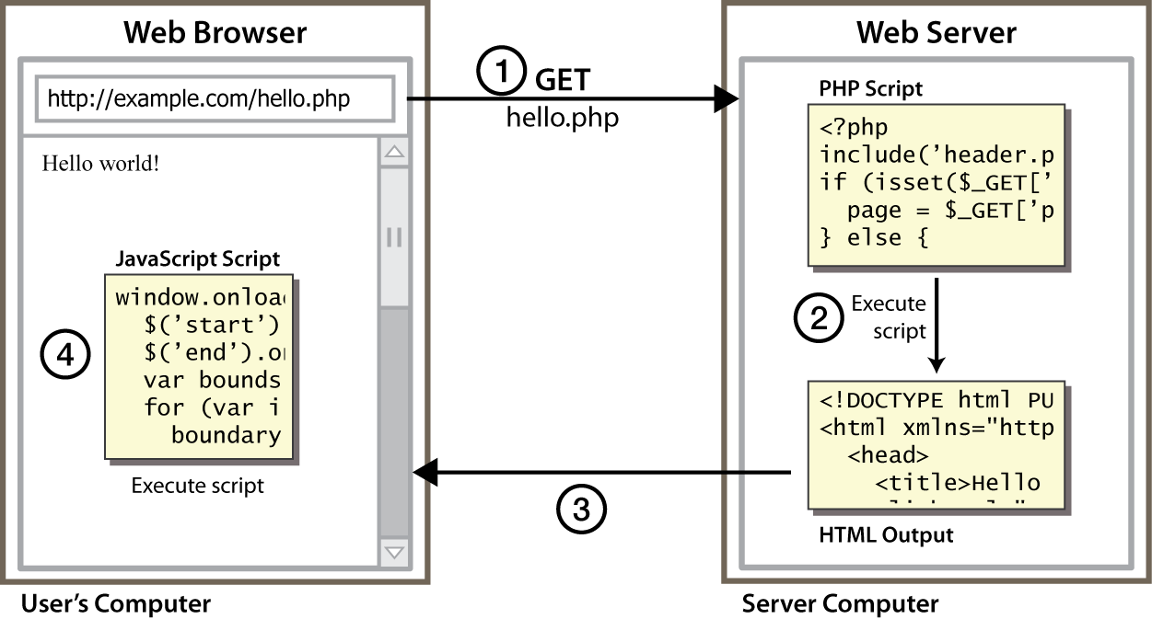
Client Side Scripting
education for life www.rimt.ac.in
Notes:
client-side script: code runs in browser after page is sent back from server
often this code manipulates the page or responds to user actions

Slide 3
Why use client-side programming?
PHP already allows us to create dynamic web pages. Why also use client-side scripting?
client-side scripting (JavaScript) benefits:
usability: can modify a page without having to post back to the server (faster UI)
efficiency: can make small, quick changes to page without waiting for server
event-driven: can respond to user actions like clicks and key presses
education for life www.rimt.ac.in

Slide 4
Why use client-side programming?
server-side programming (PHP) benefits:
security: has access to server's private data; client can't see source code
compatibility: not subject to browser compatibility issues
power: can write files, open connections to servers, connect to databases, ...
education for life www.rimt.ac.in

Slide 5
What is Javascript?
a lightweight programming language ("scripting language")
used to make web pages interactive
insert dynamic text into HTML (ex: user name)
react to events (ex: page load user click)
get information about a user's computer (ex: browser type)
perform calculations on user's computer (ex: form validation)
education for life www.rimt.ac.in

Slide 6
Javascript vs Java
interpreted, not compiled
more relaxed syntax and rules
fewer and "looser" data types
variables don't need to be declared
errors often silent (few exceptions)
key construct is the function rather than the class
"first-class" functions are used in many situations
contained within a web page and integrates with its HTML/CSS content
education for life www.rimt.ac.in

Slide 7
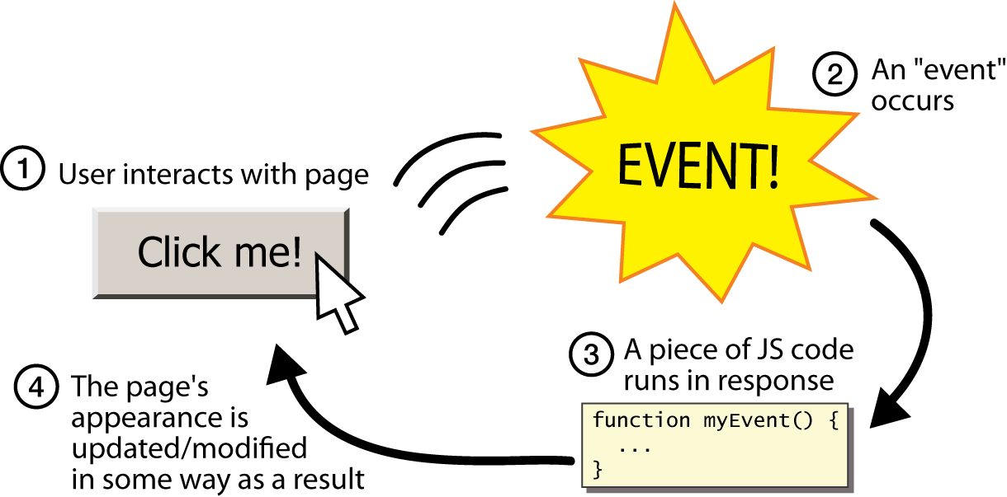
Event-driven programming
split breaks apart a string into an array using a delimiter
can also be used with regular expressions (seen later)
join merges an array into a single string, placing a delimiter between them
education for life www.rimt.ac.in

