Slide 1
Mathematics-III(BTCS-2302)
Course Name: B.Tech. (CSE) Semester: 3rd
Prepared by: Sachin Syan
education for life www.rimt.ac.in
Department of Computer Science & Engineering

Slide 2
Topic Discussed
Population or Universe
Sampling
Parameter of sampling
Standard Errors
Test of Significance
Critical Region
Level of Significance
Errors in Sampling
Steps in testing of Statistical Hypothesis
education for life www.rimt.ac.in
Department of Computer Science & Engineering

Slide 3
POPULATION OR UNIVERSE
An aggregate of objects (animate or inanimate) under study is called population or universe. their attributes (qualities) or of results of operations which can be It is thus a collection of individuals or of numerically specified.
Finite inverse:
A universe containing a finite number of individuals or members is called a finite inverse. For example, the universe of the weights of students in a particular class
Infinite Universe :A universe with infinite number of members is known as an infinite universe. For example, the universe of pressures at various points in the atmosphere
education for life www.rimt.ac.in
Department of Computer Science & Engineering

Slide 4
POPULATION OR UNIVERSE
Existent universe: The universe of concrete objects is an existent universe
Hypothetical universe: The collection of all possible ways in which a specified event can happen is called a hypothetical universe
education for life www.rimt.ac.in
Department of Computer Science & Engineering

Slide 5
POPULATION OR UNIVERSE
Existent universe: The universe of concrete objects is an existent universe
Hypothetical universe: The collection of all possible ways in which a specified event can happen is called a hypothetical universe
education for life www.rimt.ac.in
Department of Computer Science & Engineering

Slide 6
SAMPLING
Sample : A finite subset of a universe is called a sample
Sample size: The number of individuals in a sample is called the sample size
Sampling: The process of selecting a sample from a universe is called sampling.
education for life www.rimt.ac.in
Department of Computer Science & Engineering

Slide 7
PARAMETERS OF STATISTICS
Parameters : The statistical constants of the population such as mean, the variance, etc. are known as the parameters
Statistic: The statistical concepts of the sample from the members of the sample to estimate the parameters of the population from which the sample has been drawn is known as statistic
Note: Population mean and variance are denoted by μ and σ2, while those of the samples are given by x , s2
education for life www.rimt.ac.in
Department of Computer Science & Engineering

Slide 8
STANDARD ERROR
The standard deviation of the sampling distribution of a statistic is known as the standard error (S.E.). It plays an important role in the theory of large samples and it forms a basis of the testing of hypothesis. If t is any statistic, for large sample.
is normally distributed with mean 0 and variance unity
education for life www.rimt.ac.in
Department of Computer Science & Engineering

Slide 9
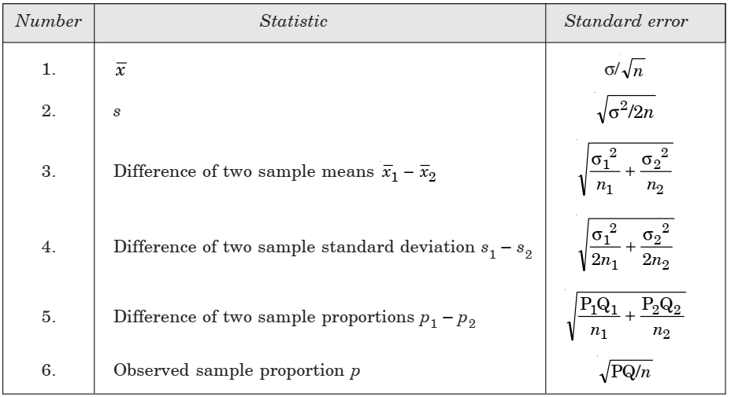
STANDARD ERROR
For large sample, the standard errors of some of the well known statistic are listed below: n—sample size; σ²—population variance; s²—sample variance; p—population proportion ; Q = 1 – p; n₁, n₂—are sizes of two independent random samples.
education for life www.rimt.ac.in
Department of Computer Science & Engineering

Slide 10
TEST OF SIGNIFICANCE
An important aspect of the sampling theory is to study the test of significance which will enable us to decide, on the basis of the results of the sample, whether (i) the deviation between the observed sample statistic and the hypothetical parameter value or (ii) the deviation between two sample statistics is significant or might be attributed due to chance or the fluctuations of the sampling.
For applying the tests of significance, we first set up a hypothesis which is a definite statement about the population parameter called Null hypothesis denoted by H₀.
Any hypothesis which is complementary to the null hypothesis (H₀) is called an Alternative hypothesis denoted by H₁
education for life www.rimt.ac.in
Department of Computer Science & Engineering

Slide 11
TEST OF SIGNIFICANCE
For example, if we want to test the null hypothesis that the population has a specified mean μ₀, then we have
H₀: μ = μ₀
Alternative hypothesis will be (i) H₁: μ ≠ μ₀ (μ > μ₀ or μ < μ₀) (two tailed alternative hypothesis). (ii) H₁: μ > μ₀ (right tailed alternative hypothesis (or) single tailed). (iii) H₁: μ < μ₀ (left tailed alternative hypothesis (or) single tailed). Hence alternative hypothesis helps to know whether the test is two tailed test or one tailed test.
education for life www.rimt.ac.in
Department of Computer Science & Engineering

Slide 12
CRITICAL REGION
A region corresponding to a statistic t, in the sample space S which amounts to rejection of the null hypothesis H0 is called as critical region or region of rejection.
The region of the sample space S which amounts to the acceptance of H₀ is called acceptance region
education for life www.rimt.ac.in
Department of Computer Science & Engineering

Slide 13
LEVEL OF SIGNIFICANCE
The probability of the value of the variate falling in the critical region is known as level of significance. The probability α that a random value of the statistic t belongs to the critical region is known as the level of significance. P(t ∈ ω| H₀) = α i.e., the level of significance is the size of the type I error or the maximum producer’s risk.
education for life www.rimt.ac.in
Department of Computer Science & Engineering

Slide 14
ERRORS IN SAMPLING
The main aim of the sampling theory is to draw a valid conclusion about the population parameters on the basis of the sample results. In doing this we may commit the following two types of errors: Type I Error: When H₀ is true, we may reject it. P(Reject H0 when it is true) = P(Reject H0/H0) = α α is called the size of the type I error also referred to as producer’s risk.
Type II Error: When H₀ is wrong we may accept it
P(Accept H0 when it is wrong) = P(Accept H0/H1) = β .
β is called the size of the type II error, also referred to as consumer’s risk
education for life www.rimt.ac.in
Department of Computer Science & Engineering

Slide 15
ERRORS IN SAMPLING
The main aim of the sampling theory is to draw a valid conclusion about the population parameters on the basis of the sample results. In doing this we may commit the following two types of errors: Type I Error: When H₀ is true, we may reject it. P(Reject H0 when it is true) = P(Reject H0/H0) = α α is called the size of the type I error also referred to as producer’s risk.
Type II Error: When H₀ is wrong we may accept it
P(Accept H0 when it is wrong) = P(Accept H0/H1) = β .
β is called the size of the type II error, also referred to as consumer’s risk
education for life www.rimt.ac.in
Department of Computer Science & Engineering

Slide 16
ERRORS IN SAMPLING
For larger samples corresponding to the statistic t, the variable
is normally distributed with mean 0 and variance 1. The value of z given above under the null hypothesis is known as test statistic. The critical value of z_{α} of the test statistic at level of significance α for a two-tailed test is given by
p(| z | > z_{α}) = α ____(1) i.e., z_{α} is the value of z so that the total area of the critical region on both tails is α. Since the normal curve is symmetrical, from equation (1), we get p(z > z_{α}) + p(z < – z_{α}) = α; i.e., 2p(z > z_{α}) = α; p(z > z_{α}) = α/2 i.e., the area of each tail is α/2
education for life www.rimt.ac.in
Department of Computer Science & Engineering

Slide 17
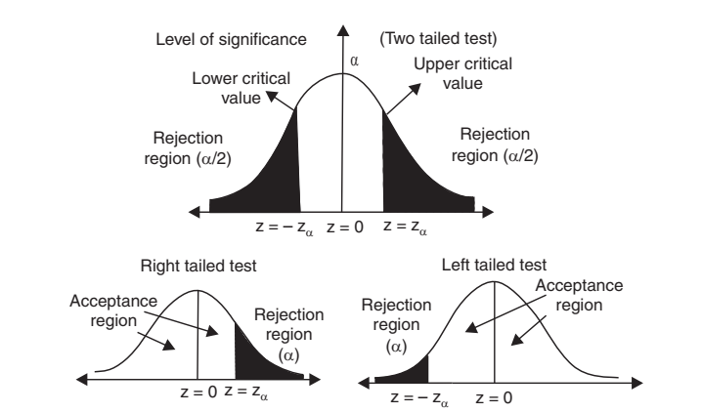
ERRORS IN SAMPLING
education for life www.rimt.ac.in
Department of Computer Science & Engineering

Slide 18
ERRORS IN SAMPLING
The critical value z_{α} is that value such that the area to the right of zα is α/2 and the area to the left of – z_{α} is α/2. In the case of the one-tailed test, p(z > z_{α}) = α if it is right-tailed; p(z < – z_{α}) = α if it is left-tailed
The critical value of z for a single-tailed test (right or left) at level of significance α is same as the critical value of z for two-tailed test at level of significance 2α.
Using the equation, also using the normal tables, the critical value of z at different levels of significance (α) for both single tailed and two tailed test are calculated and listed below. The equations are p(| z | > z_{α}) = α; p(z > z_{α}) = α; p(z < – z_{α}) = α
education for life www.rimt.ac.in
Department of Computer Science & Engineering

Slide 19
ERRORS IN SAMPLING
education for life www.rimt.ac.in
Department of Computer Science & Engineering

Slide 20
STEPS IN TESTING OF STATISTICAL
HYPOTHESIS
Step 1. Null hypothesis. Set up H₀ in clear terms.
Step 2. Alternative hypothesis. Set up H₁, so that we could decide whether we should use one tailed test or two tailed test.
Step 3. Level of significance. Select the appropriate level of significance in advance depending on the reliability of the estimates.
education for life www.rimt.ac.in
Department of Computer Science & Engineering

Slide 21
STEPS IN TESTING OF STATISTICAL
HYPOTHESIS
Step 4. Test statistic. Compute the test statistic under the null hypothesis.
Step 5. Conclusion. Compare the computed value of z with the critical value z_{α} at level of significance (α).
If | z | > z_{α}, we reject H₀ and conclude that there is significant difference.
If | z | < z_{α}, we accept H₀ and conclude that there is no significant difference.
education for life www.rimt.ac.in
Department of Computer Science & Engineering

Slide 22
Topics Discussed in Next Lecture
t-test
F-test
Chi-square test
education for life www.rimt.ac.in
Department of Computer Science & Engineering

