Slide 1
Operating System/ BTCS-2401
Course Name: B.Tech CSE Semester: 4th
Prepared by: Er. Jasdeep Singh
education for life www.rimt.ac.in
Department of Computer Science & Engineering

Slide 2
Topic 19th : File-System Interface
education for life www.rimt.ac.in

Slide 3
Topics To Be Covered
Free-Space Management
Efficiency and Performance
Recovery
NFS
Example: WAFL File System
education for life www.rimt.ac.in

Slide 4
Free-Space Management
File system maintains free space list to track available blocks/clusters
(Using term “block” for simplicity) Bit vector or bit map (n blocks)
0
1
2
n-1
…

1 ⇒ block[i] free
0 ⇒ block[i] occupied
bit[i] =
Block number calculation
(number of bits per word) *
(number of 0-value words) +
offset of first 1 bit
CPUs have instructions to return offset within word of first “1” bit
education for life www.rimt.ac.in

Slide 5
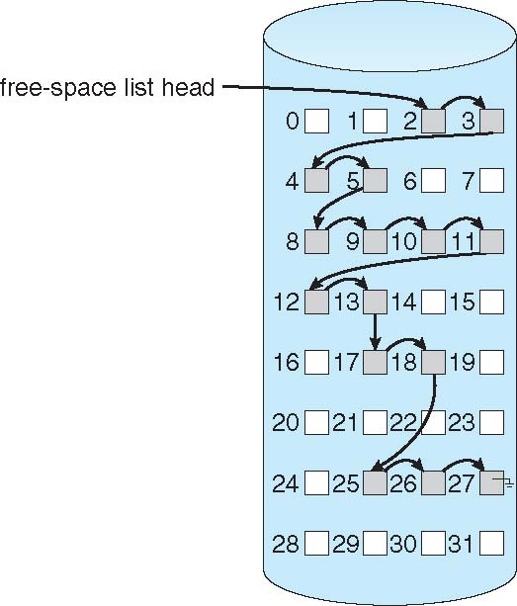
Linked Free Space List on Disk
education for life www.rimt.ac.in

Slide 6
Free-Space Management (Cont.)
Grouping
Modify linked list to store address of next n-1 free blocks in first free block, plus a pointer to next block that contains free-block-pointers (like this one)
Counting
Because space is frequently contiguously used and freed, with contiguous-allocation allocation, extents, or clustering
Keep address of first free block and count of following free blocks
Free space list then has entries containing addresses and counts
education for life www.rimt.ac.in

Slide 7
Efficiency and Performance
Efficiency dependent on:
Disk allocation and directory algorithms
Types of data kept in file’s directory entry
Pre-allocation or as-needed allocation of metadata structures
Fixed-size or varying-size data structures
education for life www.rimt.ac.in

Slide 8
Page Cache
A page cache caches pages rather than disk blocks using virtual memory techniques and addresses
Memory-mapped I/O uses a page cache
Routine I/O through the file system uses the buffer (disk) cache
This leads to the following figure
education for life www.rimt.ac.in

Slide 9
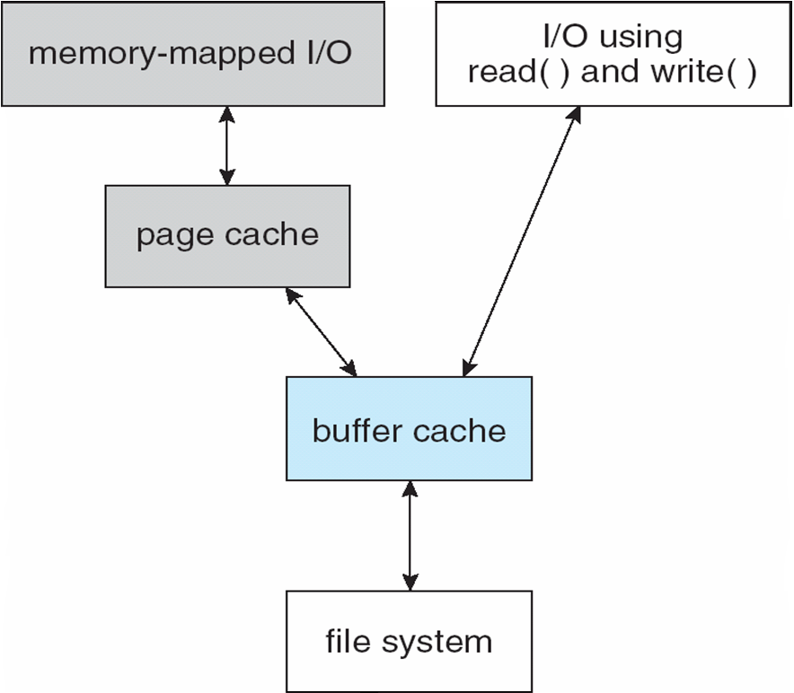
I/O Without a Unified Buffer Cache
education for life www.rimt.ac.in

Slide 10
Unified Buffer Cache
A unified buffer cache uses the same page cache to cache both memory-mapped pages and ordinary file system I/O to avoid double caching
But which caches get priority, and what replacement algorithms to use?
education for life www.rimt.ac.in

Slide 11
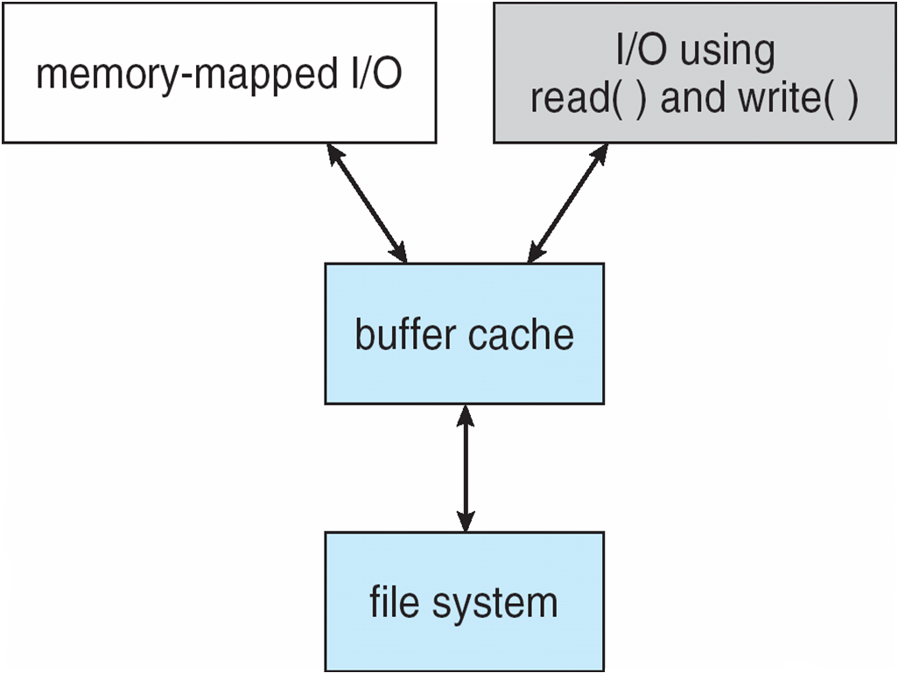
I/O Using a Unified Buffer Cache
education for life www.rimt.ac.in

Slide 12
Recovery
Consistency checking – compares data in directory structure with data blocks on disk, and tries to fix inconsistencies
Can be slow and sometimes fails
Use system programs to back up data from disk to another storage device (magnetic tape, other magnetic disk, optical)
Recover lost file or disk by restoring data from backup
education for life www.rimt.ac.in

Slide 13
Log Structured File Systems
Log structured (or journaling) file systems record each metadata update to the file system as a transaction
All transactions are written to a log
A transaction is considered committed once it is written to the log (sequentially)
Sometimes to a separate device or section of disk
However, the file system may not yet be updated
The transactions in the log are asynchronously written to the file system structures
When the file system structures are modified, the transaction is removed from the log
If the file system crashes, all remaining transactions in the log must still be performed
Faster recovery from crash, removes chance of inconsistency of metadata
education for life www.rimt.ac.in

Slide 14
The Sun Network File System (NFS)
An implementation and a specification of a software system for accessing remote files across LANs (or WANs)
The implementation is part of the Solaris and SunOS operating systems running on Sun workstations using an unreliable datagram protocol (UDP/IP protocol and Ethernet
education for life www.rimt.ac.in

Slide 15
NFS (Cont.)
Interconnected workstations viewed as a set of independent machines with independent file systems, which allows sharing among these file systems in a transparent manner
A remote directory is mounted over a local file system directory
The mounted directory looks like an integral subtree of the local file system, replacing the subtree descending from the local directory
Specification of the remote directory for the mount operation is nontransparent; the host name of the remote directory has to be provided
Files in the remote directory can then be accessed in a transparent manner
Subject to access-rights accreditation, potentially any file system (or directory within a file system), can be mounted remotely on top of any local directory
education for life www.rimt.ac.in

Slide 16
NFS (Cont.)
NFS is designed to operate in a heterogeneous environment of different machines, operating systems, and network architectures; the NFS specifications independent of these media
This independence is achieved through the use of RPC primitives built on top of an External Data Representation (XDR) protocol used between two implementation-independent interfaces
The NFS specification distinguishes between the services provided by a mount mechanism and the actual remote-file-access services
education for life www.rimt.ac.in

Slide 17
NFS Protocol
Provides a set of remote procedure calls for remote file operations. The procedures support the following operations:
searching for a file within a directory
reading a set of directory entries
manipulating links and directories
accessing file attributes
reading and writing files
NFS servers are stateless; each request has to provide a full set of arguments (NFS V4 is just coming available – very different, stateful)
Modified data must be committed to the server’s disk before results are returned to the client (lose advantages of caching)
The NFS protocol does not provide concurrency-control mechanisms
education for life www.rimt.ac.in

Slide 18
Three Major Layers of NFS Architecture
UNIX file-system interface (based on the open, read, write, and close calls, and file descriptors)
Virtual File System (VFS) layer – distinguishes local files from remote ones, and local files are further distinguished according to their file-system types
The VFS activates file-system-specific operations to handle local requests according to their file-system types
Calls the NFS protocol procedures for remote requests
NFS service layer – bottom layer of the architecture
Implements the NFS protocol
education for life www.rimt.ac.in

Slide 19
NFS Remote Operations
Nearly one-to-one correspondence between regular UNIX system calls and the NFS protocol RPCs (except opening and closing files)
NFS adheres to the remote-service paradigm, but employs buffering and caching techniques for the sake of performance
File-blocks cache – when a file is opened, the kernel checks with the remote server whether to fetch or revalidate the cached attributes
Cached file blocks are used only if the corresponding cached attributes are up to date
File-attribute cache – the attribute cache is updated whenever new attributes arrive from the server
Clients do not free delayed-write blocks until the server confirms that the data have been written to disk
education for life www.rimt.ac.in

Slide 20
Example: WAFL File System
Used on Network Appliance “Filers” – distributed file system appliances
“Write-anywhere file layout”
Serves up NFS, CIFS, http, ftp
Random I/O optimized, write optimized
NVRAM for write caching
Similar to Berkeley Fast File System, with extensive modifications
education for life www.rimt.ac.in

Slide 21
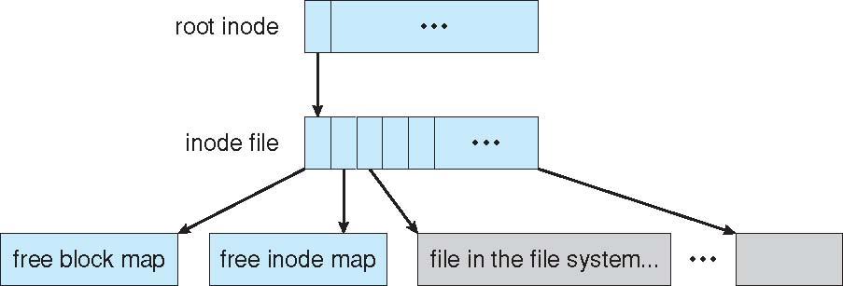
The WAFL File Layout
education for life www.rimt.ac.in

Slide 22
Summary
Free-Space Management
Efficiency and Performance
Recovery
NFS
Example: WAFL File System
education for life www.rimt.ac.in

Slide 23
Topics To Be NextCovered
Overview of Mass Storage Structure
Disk Structure
Disk Attachment
Disk Scheduling
Disk Management
Swap-Space Management
RAID Structure
Disk Attachment
Stable-Storage Implementation
Tertiary Storage Devices
Operating System Issues
Performance Issues
education for life www.rimt.ac.in

Slide 24
References
Silberschatz and Peter B. Calvin, “Operating System Concepts" Addison Wesley Publishing Company
Dhamdhere, “Systems Programming & Operating Systems Tata McGraw Hill
education for life www.rimt.ac.in

