Slide 1
Engineering Mathematics-III (BMAT-1111)
Course Name: B.Tech (CSE) Semester: Ist
Prepared by: Sachin Syan
education for life www.rimt.ac.in
Department of Computer Science & Engineering

Slide 2
Topic Discussed
Introduction
Differential Equation
Kinds of Differential Equation
Order and Degree of Differential Equation
Formation of ODE
Solution of ODE
Exact Differential Equation
Theorem on Exactness
education for life www.rimt.ac.in
Department of Computer Science & Engineering

Slide 3
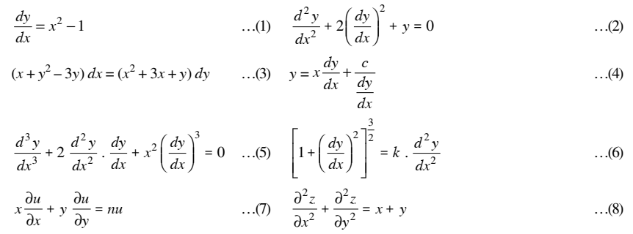
Introduction
A differential equation is an equation involving differentials or differential coefficients. Thus
are all differential equations.
education for life www.rimt.ac.in
Department of Computer Science & Engineering

Slide 4
There are two kinds of differential equations
i) Ordinary differential equations Differential equations which involve only one independent variable and the differential coefficients with respect to it are called ordinary differential equations
ii) Partial Differential Equations Differential equations which involve two or more independent variables and partial derivatives with respect to them are called partial differential equations
education for life www.rimt.ac.in
Department of Computer Science & Engineering

Slide 5
Order and Degree of Differential Equation
Order
The order of a differential equation is the order of the highest order derivative occurring in the differential equation.
Degree
The degree of a differential equation is the degree of the highest order derivative which occurs in the differential equation provided the equation has been made free of the radicals and fractions as far as the derivatives are concerned. .
education for life www.rimt.ac.in
Department of Computer Science & Engineering

Slide 6
Order and Degree of Differential Equation
Differential Equation | Order | Degree
 | 2 | 1
 | 3 | 1
 | 2 | 2
education for life www.rimt.ac.in
Department of Computer Science & Engineering

Slide 7
Formation of Differential Equation
Differential equations are formed by elimination of arbitrary constants. To eliminate two arbitrary constants, we require two more equations besides the given relation, leading us to second order derivatives and hence a differential equation of the second order. Elimination of n arbitrary constants leads us to nth order derivatives and hence a differential equation of the nth order.
Let ……(1)
be an equation containing n arbitrary constants c₁, c₂, ..., c_{n} (sometimes called parameters)
education for life www.rimt.ac.in
Department of Computer Science & Engineering

Slide 8
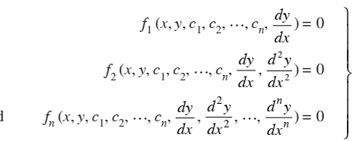
Formation of Differential Equation
Differentiating (1) w.r.t. x successively n times, we get
…(2)
Eliminating c₁, c₂,…, c_{n} from (1) and (2), we get
which is required nth order differential equation.
education for life www.rimt.ac.in
Department of Computer Science & Engineering

Slide 9
Formation of Differential Equation
Example : Eliminate the constants from the equations:
Sol.
There are two arbitrary constants A and B in equation (1) Differentiating (1) w.r.t. x, we have
education for life www.rimt.ac.in
Department of Computer Science & Engineering

Slide 10
Formation of Differential Equation
Differentiating again w.r.t. x, we have
which is the required differential equation
education for life www.rimt.ac.in
Department of Computer Science & Engineering

Slide 11
Solution of a Differential Equation
A solution (or integral) of a differential equation is a relation,
Free from derivatives, between the variables which satisfies the given equation.
Thus if y = f (x) be the solution, then by replacing y and its derivatives with respect to x, the given differential equation will reduce to an identity
For example, y = c₁ cos x + c₂ sin x is the solution of the differential equation of
education for life www.rimt.ac.in
Department of Computer Science & Engineering

Slide 12
Solution of a Differential Equation
There can be three types of solution of a differential equation: i General solution (or complete integral or complete primitive) II. Particular Solution
III. Singular Solution
i General solution (or complete integral or complete primitive) A relation in x and y satisfying a given differential equation and involving exactly same number of arbitrary constants as order of differential equation.
education for life www.rimt.ac.in
Department of Computer Science & Engineering

Slide 13
Solution of a Differential Equation
ii Particular Solution A solution obtained by assigning values to one or more than one arbitrary constant of general solution.
iii Singular Solution It is not obtainable from general solution. Geometrically, General solution acts as an envelope to singular solution.
education for life www.rimt.ac.in
Department of Computer Science & Engineering

Slide 14
SOLUTION OF DIFFERENTIAL EQUATIONS OF THE FIRST ORDER AND FIRST DEGREE
All differential equations of the first order and first degree cannot be solved. Only those among them which belong to (or can be reduced to) one of the following categories can be solved by the standard methods. (i) Equations in which variables are separable. (ii) Differential equation of the form dy/dx = f (ax + by + c). (iii) Homogeneous equations.
(iv) Linear equations.
(v) Exact equations.
education for life www.rimt.ac.in
Department of Computer Science & Engineering

Slide 15
Exact Differential Equations
Definition : A differential equation obtained from its primitive directly by differentiation, without any operation of multiplication, elimination or reduction etc. is said to be an exact differential equation.
Thus a differential equation of the form M (x, y) dx + N (x, y) dy = 0 is an exact differential equation if it can be obtained directly by differentiating the equation u (x, y) = C which is its primitive i.e., if du = M dx + N dy
education for life www.rimt.ac.in
Department of Computer Science & Engineering

Slide 16
Exact Differential Equations
Theorem
The necessary and sufficient condition for the differential equation Mdx + Ndy = 0 to be exact is
Proof. The condition is necessary
The equation Mdx + Ndy = 0 will be exact, if du = Mdx + Ndy
education for life www.rimt.ac.in
Department of Computer Science & Engineering

Slide 17
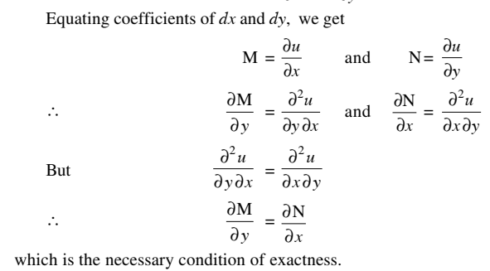
Exact Differential Equations
education for life www.rimt.ac.in
Department of Computer Science & Engineering

Slide 18
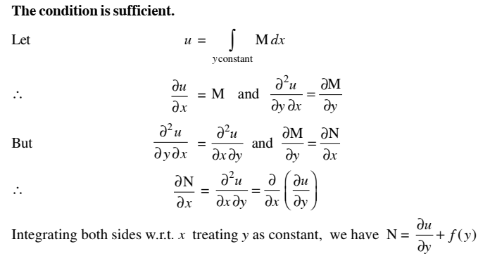
Exact Differential Equations
education for life www.rimt.ac.in
Department of Computer Science & Engineering

Slide 19
Exact Differential Equations
education for life www.rimt.ac.in
Department of Computer Science & Engineering

Slide 20
Topics Discussed in Next Lecture
Examples of Exact Differential Equations
Equation Reducible to Exact Equations
Integrating Factor by Inspection Method
Rules for Find Integrating Factors
Clairaut’s Equation
education for life www.rimt.ac.in
Department of Computer Science & Engineering

