Slide 1
Engineering Mathematics-I (BMAT-1111)
Course Name: B.Tech (CSE) Semester: Ist
Prepared by: Sachin Syan
education for life www.rimt.ac.in
Department of Computer Science & Engineering

Slide 2
Topic Discussed
Expansion of Cos nθ and Sin nθ
Expansion of tan nθ
Expansion of tan (θ₁ + θ₂ + θ₃ + …+ θ_{n} )
Exponential Function of a Complex Variable
Circular Functions of a Complex Variable
Logarithmic of Complex Numbers
General Exponential Function
education for life www.rimt.ac.in
Department of Computer Science & Engineering

Slide 3
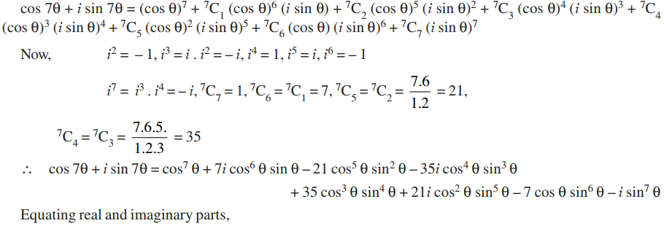
Expansion of Cos nθ and Sin nθ
education for life www.rimt.ac.in
Department of Computer Science & Engineering

Slide 4
Expansion of Cos nθ and Sin nθ
education for life www.rimt.ac.in
Department of Computer Science & Engineering

Slide 5
Expansion of tan nθ
Expansion of tan (θ₁ + θ₂ + θ₃ + …+ θ_{n} )
education for life www.rimt.ac.in
Department of Computer Science & Engineering

Slide 6
Expansion of tan (θ₁ + θ₂ + θ₃ + …+ θ_{n} )
education for life www.rimt.ac.in
Department of Computer Science & Engineering

Slide 7
Expansion of tan (θ₁ + θ₂ + θ₃ + …+ θ_{n} )
education for life www.rimt.ac.in
Department of Computer Science & Engineering

Slide 8
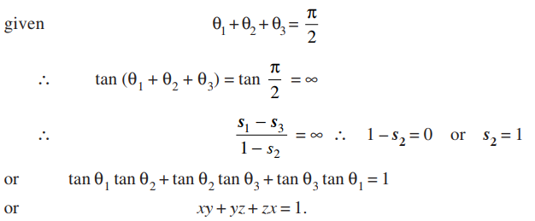
Expansion of tan (θ₁ + θ₂ + θ₃ + …+ θ_{n} )
education for life www.rimt.ac.in
Department of Computer Science & Engineering

Slide 9
Exponential Function of a Complex Variable
education for life www.rimt.ac.in
Department of Computer Science & Engineering

Slide 10
Exponential Function of a Complex Variable
education for life www.rimt.ac.in
Department of Computer Science & Engineering

Slide 11
Circular Functions of a Complex Variable
education for life www.rimt.ac.in
Department of Computer Science & Engineering

Slide 12
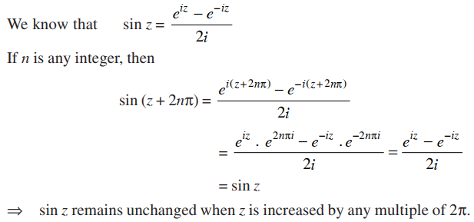
Circular Functions of a Complex Variable
education for life www.rimt.ac.in
Department of Computer Science & Engineering

Slide 13
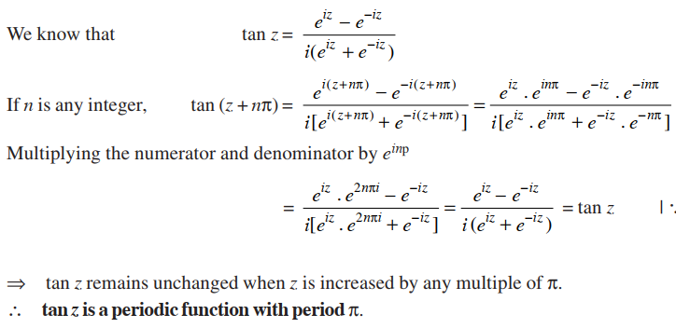
Circular Functions of a Complex Variable
education for life www.rimt.ac.in
Department of Computer Science & Engineering

Slide 14
Circular Functions of a Complex Variable
education for life www.rimt.ac.in
Department of Computer Science & Engineering

Slide 15
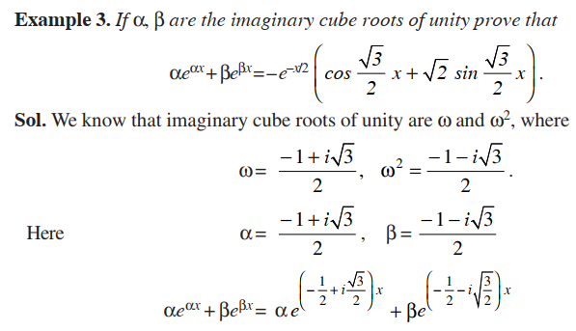
Circular Functions of a Complex Variable
education for life www.rimt.ac.in
Department of Computer Science & Engineering

Slide 16
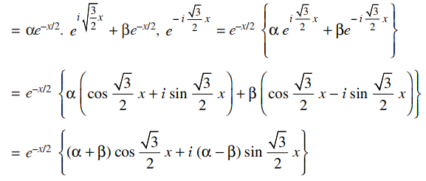
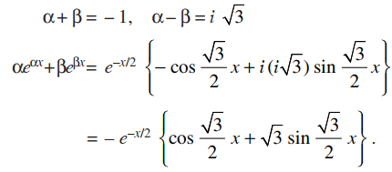
Circular Functions of a Complex Variable
education for life www.rimt.ac.in
Department of Computer Science & Engineering

Slide 17
Logarithms of Complex Numbers
education for life www.rimt.ac.in
Department of Computer Science & Engineering

Slide 18
Logarithms of Complex Numbers
education for life www.rimt.ac.in
Department of Computer Science & Engineering

Slide 19
General Exponential Function
education for life www.rimt.ac.in
Department of Computer Science & Engineering

Slide 20
Topics Discussed in Next Lecture
Hyperbolic Functions
Inverse Trigonometric Functions
Inverse Hyperbolic Functions
C + i S Method of Summation
education for life www.rimt.ac.in
Department of Computer Science & Engineering

