Slide 1
Operating System/ BTCS-2401
Course Name: B.Tech CSE Semester: 4th
Prepared by: Er. Jasdeep Singh
education for life www.rimt.ac.in
Department of Computer Science & Engineering

Slide 2
Topic 4th : Processes
education for life www.rimt.ac.in

Slide 3
Topics To Be Covered
Operating System Generation
System Boot
Process Concept
Process Scheduling
education for life www.rimt.ac.in

Slide 4
Objectives
To introduce the notion of a process -- a program in execution, which forms the basis of all computation
To describe the various features of processes, including scheduling, creation and termination, and communication
To describe communication in client-server systems
education for life www.rimt.ac.in

Slide 5
Operating System Generation
Operating systems are designed to run on any of a class of machines; the system must be configured for each specific computer site
SYSGEN program obtains information concerning the specific configuration of the hardware system
Booting – starting a computer by loading the kernel
Bootstrap program – code stored in ROM that is able to locate the kernel, load it into memory, and start its execution
education for life www.rimt.ac.in

Slide 6
System Boot
Operating system must be made available to hardware so hardware can start it
Small piece of code – bootstrap loader, locates the kernel, loads it into memory, and starts it
Sometimes two-step process where boot block at fixed location loads bootstrap loader
When power initialized on system, execution starts at a fixed memory location
Firmware used to hold initial boot code
education for life www.rimt.ac.in

Slide 7
Process Concept
An operating system executes a variety of programs:
Batch system – jobs
Time-shared systems – user programs or tasks
Textbook uses the terms job and process almost interchangeably
Process – a program in execution; process execution must progress in sequential fashion
A process includes:
program counter
stack
data section
education for life www.rimt.ac.in

Slide 8
The Process
Multiple parts
The program code, also called text section
Current activity including program counter, processor registers
Stack containing temporary data
Function parameters, return addresses, local variables
Data section containing global variables
Heap containing memory dynamically allocated during run time
Program is passive entity, process is active
Program becomes process when executable file loaded into memory
Execution of program started via GUI mouse clicks, command line entry of its name, etc
One program can be several processes
Consider multiple users executing the same program
education for life www.rimt.ac.in

Slide 9
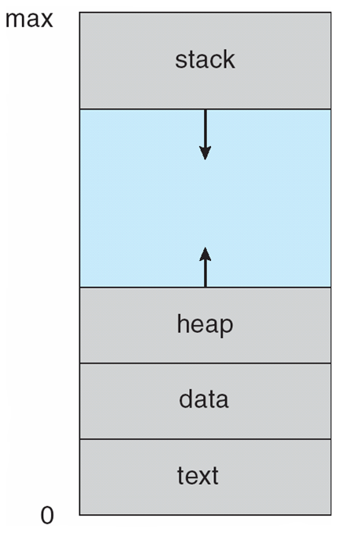
Process in Memory
education for life www.rimt.ac.in

Slide 10
Process State
As a process executes, it changes state
new: The process is being created
running: Instructions are being executed
waiting: The process is waiting for some event to occur
ready: The process is waiting to be assigned to a processor
terminated: The process has finished execution
education for life www.rimt.ac.in

Slide 11
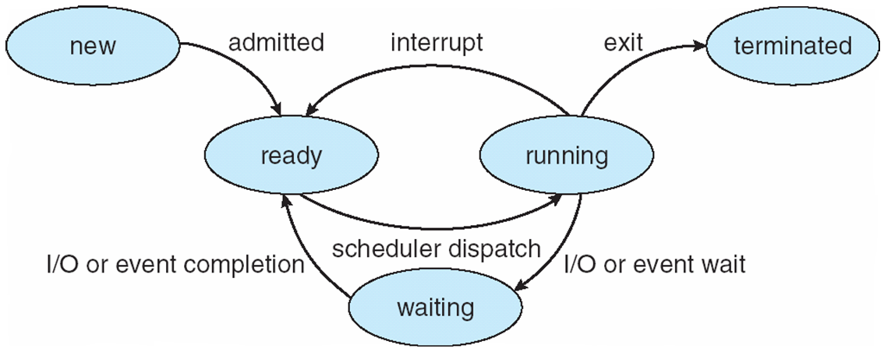
Diagram of Process State
education for life www.rimt.ac.in

Slide 12
Process Control Block (PCB)
Information associated with each process
Process state
Program counter
CPU registers
CPU scheduling information
Memory-management information
Accounting information
I/O status information
education for life www.rimt.ac.in

Slide 13
Process Scheduling
Maximize CPU use, quickly switch processes onto CPU for time sharing
Process scheduler selects among available processes for next execution on CPU
Maintains scheduling queues of processes
Job queue – set of all processes in the system
Ready queue – set of all processes residing in main memory, ready and waiting to execute
Device queues – set of processes waiting for an I/O device
Processes migrate among the various queues
education for life www.rimt.ac.in

Slide 14
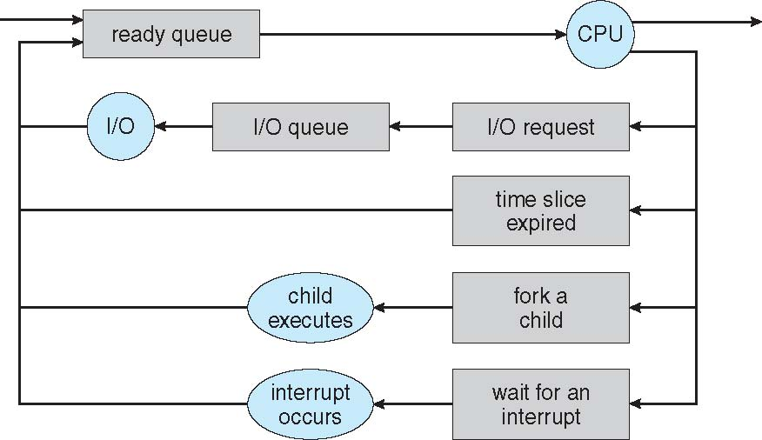
Representation of Process Scheduling
education for life www.rimt.ac.in

Slide 15
Schedulers
Long-term scheduler (or job scheduler) – selects which processes should be brought into the ready queue
Short-term scheduler (or CPU scheduler) – selects which process should be executed next and allocates CPU
Sometimes the only scheduler in a system
education for life www.rimt.ac.in

Slide 16
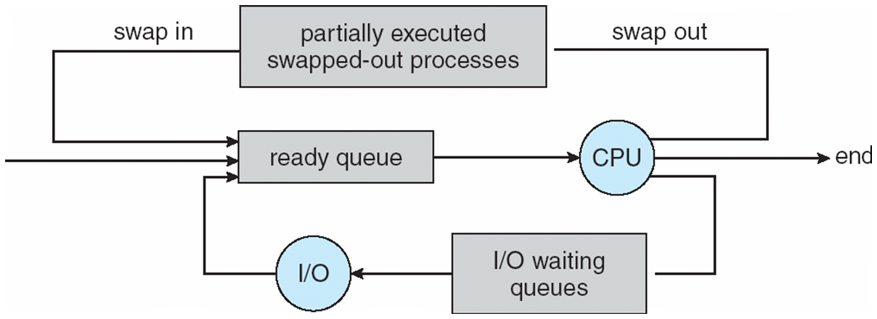
Addition of Medium Term Scheduling
education for life www.rimt.ac.in

Slide 17
Context Switch
When CPU switches to another process, the system must save the state of the old process and load the saved state for the new process via a context switch.
Context of a process represented in the PCB
Context-switch time is overhead; the system does no useful work while switching
The more complex the OS and the PCB -> longer the context switch
Time dependent on hardware support
Some hardware provides multiple sets of registers per CPU -> multiple contexts loaded at once
education for life www.rimt.ac.in

Slide 18
Process Creation
Parent process create children processes, which, in turn create other processes, forming a tree of processes
Generally, process identified and managed via a process identifier
Resource sharing
Parent and children share all resources
Children share subset of parent’s resources
Parent and child share no resources
Execution
Parent and children execute concurrently
Parent waits until children terminate
education for life www.rimt.ac.in

Slide 19
Process Creation (Cont.)
Address space
Child duplicate of parent
Child has a program loaded into it
UNIX examples
fork system call creates new process
exec system call used after a fork to replace the process’ memory space with a new program
education for life www.rimt.ac.in

Slide 20
Process Creation
education for life www.rimt.ac.in

Slide 21
Process Termination
Process executes last statement and asks the operating system to delete it (exit)
Output data from child to parent (via wait)
Process’ resources are deallocated by operating system
Parent may terminate execution of children processes (abort)
Child has exceeded allocated resources
Task assigned to child is no longer required
If parent is exiting
Some operating systems do not allow child to continue if its parent terminates
All children terminated - cascading termination
education for life www.rimt.ac.in

Slide 22
Named Pipes
Named Pipes are more powerful than ordinary pipes
Communication is bidirectional
No parent-child relationship is necessary between the communicating processes
Several processes can use the named pipe for communication
Provided on both UNIX and Windows systems
education for life www.rimt.ac.in

Slide 23
Summary
Operating System Generation
System Boot
Process Concept
Process Scheduling
education for life www.rimt.ac.in

Slide 24
Topics To Be Next Covered
Interprocess Communication
Examples of IPC Systems
Communication in Client-Server Systems
education for life www.rimt.ac.in

Slide 25
References
Silberschatz and Peter B. Calvin, “Operating System Concepts" Addison Wesley Publishing Company
Dhamdhere, “Systems Programming & Operating Systems Tata McGraw Hill
education for life www.rimt.ac.in

