Slide 1
PROGRAMMING FOR PROBLEM SOLVING BCSE-1201
Course Name: B. Tech (CSE) Semester: 2nd
Prepared by: Sahilpreet Singh
education for life www.rimt.ac.in
Department of Computer Science & Engineering

Slide 2
TOPIC:-FRIEND FUNCTION
education for life www.rimt.ac.in

Slide 3
INTRODUCTION
A function that is declared outside a class but is capable of accessing the private and protected members of the class.
Generally, non-member functions cannot access the private members of a particular class. Once declared as a friend function, the function is able to access the private and the protected members of these classes.
SYNTAX- You can declare the friend function using the keyword “friend” inside the body of the class.
class class_name
{ friend data_type function_name(arguments/s);.
};
education for life www.rimt.ac.in

Slide 4
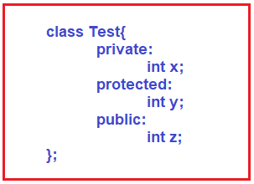
It is having a private member that is integer x, a protected member that is integer y, and a public member that is integer z.
education for life www.rimt.ac.in

Slide 5
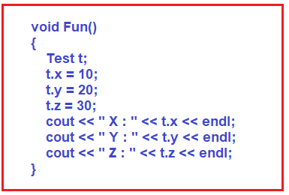
Inside the function, we have created the object t of class Test. Then we are assigning the value of x, y, and z members of the class Test.
education for life www.rimt.ac.in

Slide 6
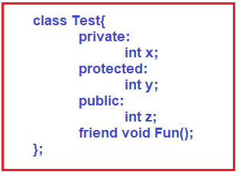
Though the function doesn’t belong to the class Test so we have to add the keyword friend.
By using the keyword friend compiler knows the given function is a friend function. For accessing the data members, the declaration of a friend function in C++ must be done inside the body of a class starting with the keyword friend.
education for life www.rimt.ac.in

Slide 7
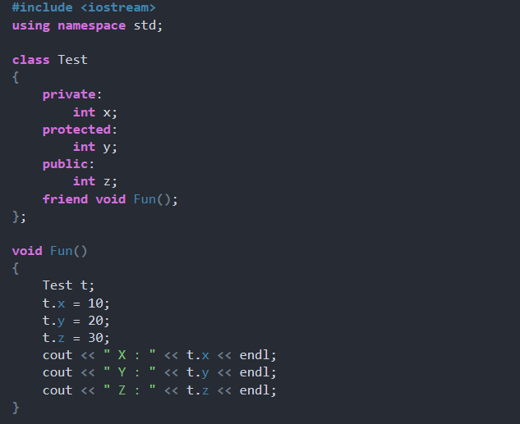
education for life www.rimt.ac.in

Slide 8
#include <iostream>
using namespace std;
class Test
{
private: int x;
protected: int y;
public: int z;
friend void Fun();
};
void Fun()
{
Test t;
t.x = 10;
t.y = 20;
t.z = 30;
cout << " X : " << t.x << endl;
cout << " Y : " << t.y << endl;
cout << " Z : " << t.z << endl;
}
int main()
{
Fun();
return 0;
}
education for life www.rimt.ac.in

