Slide 1
Applied Thermodynamics(BMEC-2304)
Course Name: B.Tech- Mechanical Engineering Semester: 3rd
Prepared by: Ajay Singh Rana
education for life www.rimt.ac.in
Department of Mechanical Engineering

Slide 2
Topic Discussed
Introduction
Carnot vapour power cycle
Drawbacks as a reference cycle
Simple Rankine cycle; description, T-s diagram, analysis for performance
Comparison of Carnot and Rankine cycles
Effects of pressure and temperature on Rankine cycle performance
Actual vapour power cycles
Ideal and practical regenerative Rankine cycles, open and closed feed water heaters
Reheat Rankine cycle
education for life www.rimt.ac.in
Department of Mechanical Engineering

Slide 3
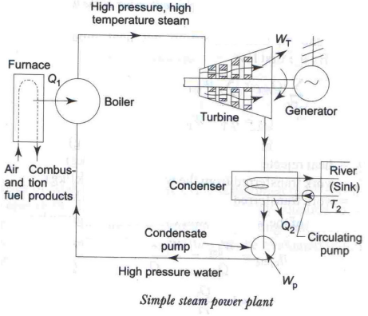
VAPOUR POWER CYCLES
Vapour power cycles are used in steam power plants. In a power cycle heat energy (released by the burning of fuel) is converted into work (shaft work), in which a working fluid repeatedly performs a succession of processes. In a vapour power cycle, the working fluid is water, which undergoes a change of phase.
education for life www.rimt.ac.in
Department of Mechanical Engineering

Slide 4
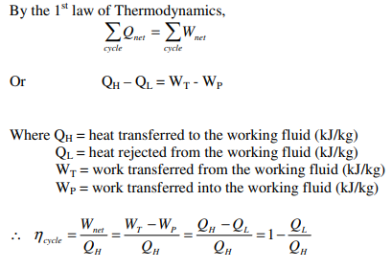
Heat is transferred to the water in the boiler (QH) from an external source. (Furnace, where fuel is continuously burnt) to raise steam, the high pressure high temperature steam leaving the boiler expands in the turbine to produce shaft work (WT), the steam leaving the turbine condenses into water in the condenser (where cooling water circulates), rejecting heat (QL), and then the water is pumped back (WP) to the boiler. Since the fluid is undergoing a cyclic process, the net energy transferred as heat during the cycle must equal the net energy transfer as work from the fluid.
education for life www.rimt.ac.in
Department of Mechanical Engineering

Slide 5
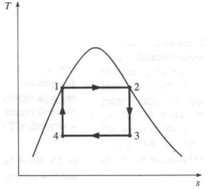
Idealized steam power cycles:
We know that the efficiency of a Carnot engine is maximum and it does not depend on the working fluid. It is, therefore, natural to examine of a steam power plant can be operated on the Carnot cycle.
Figure shows the Carnot cycle on the T-S diagram. Heat addition at constant pressure P2, can be achieved isothermally in the process 1-2 in a boiler. The decrease in pressure from P2 to P3 in the process 2-3 can also be attained through the performance of work in a steam turbine. But in order to bring back the saturated liquid water to the boiler at the state 1, the condensation process 3-4 in the condenser must be terminated at the state 4, where the working fluid is a mixture of liquid water and vapour. But it is practically impossible to attain a condensation of this kind. Difficulty is also experienced in compressing isentropically the binary mixture from state 4 to the initial state 1, where the working fluid is entirely in the liquid state. Due to these inherent practical difficulties, Carnot cycle remains an ideal one.
education for life www.rimt.ac.in
Department of Mechanical Engineering

Slide 6
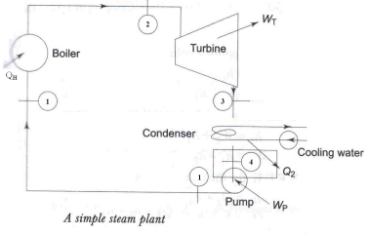
Rankine Cycle: The simplest way of overcoming the inherent practical difficulties of the Carnot cycle without deviating too much from it is to keep the processes 1-2 and 2-3 of the latter unchanged and to continue the process 3-4 in the condenser until all the vapour has been converted into liquid water. Water is then pumped into the boiler upto the pressure corresponding to the state 1 and the cycle is completed. Such a cycle is known as the Rankine cycle. This theoretical cycle is free of all the practical limitations of the Carnot cycle.
Figure shows the schematic diagram for a simple steam power cycle which works on the principle of a Rankine cycle. The Rankine cycle comprises the following processes:
Process 1-2: Constant pressure heat transfer process in the boiler
Process 2-3: Reversible adiabatic expansion process in the steam turbine
Process 3-4: Constant pressure heat transfer process in the condenser and
Process 4-1: Reversible adiabatic compression process in the pump.
education for life www.rimt.ac.in
Department of Mechanical Engineering

Slide 7
education for life www.rimt.ac.in
Department of Mechanical Engineering

Slide 8
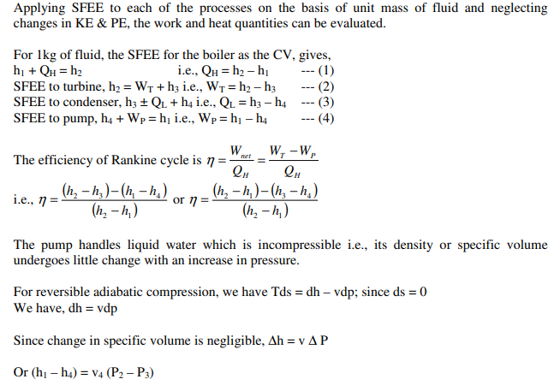
education for life www.rimt.ac.in
Department of Mechanical Engineering

Slide 9
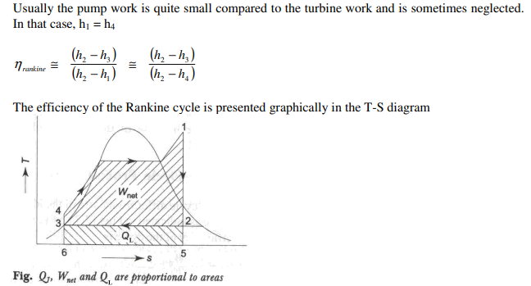
education for life www.rimt.ac.in
Department of Mechanical Engineering

Slide 10
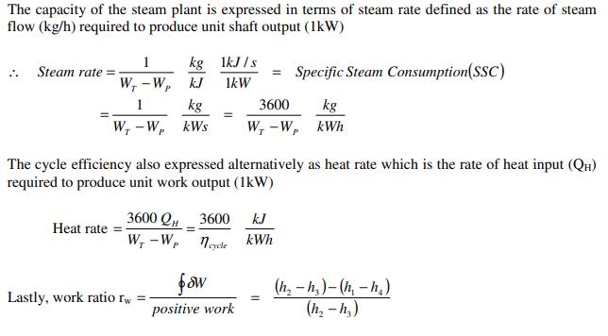
education for life www.rimt.ac.in
Department of Mechanical Engineering

Slide 11
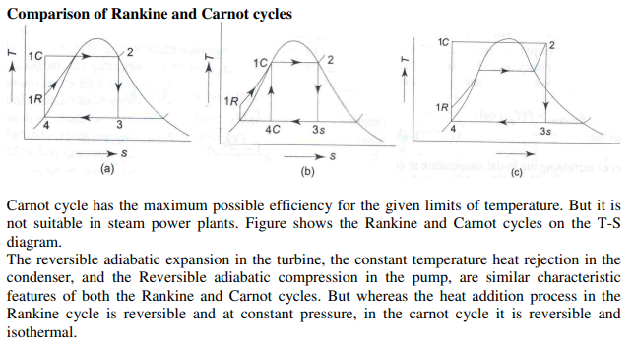
education for life www.rimt.ac.in
Department of Mechanical Engineering

Slide 12
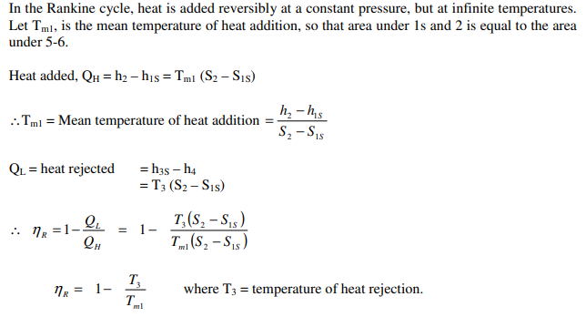
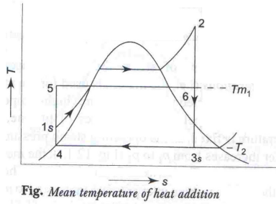
Mean temperature of Heat addition
education for life www.rimt.ac.in
Department of Mechanical Engineering

Slide 13
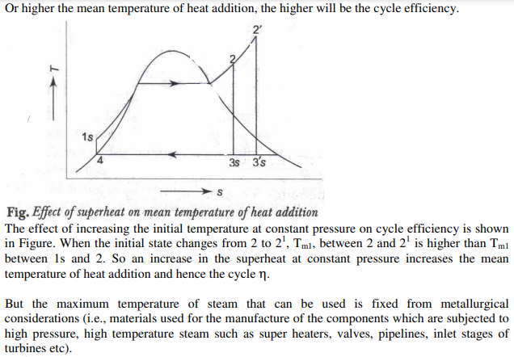
education for life www.rimt.ac.in
Department of Mechanical Engineering

Slide 14
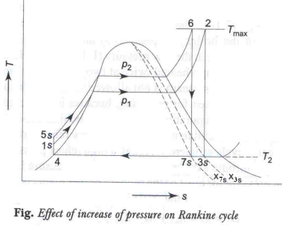
education for life www.rimt.ac.in
Department of Mechanical Engineering

Slide 15
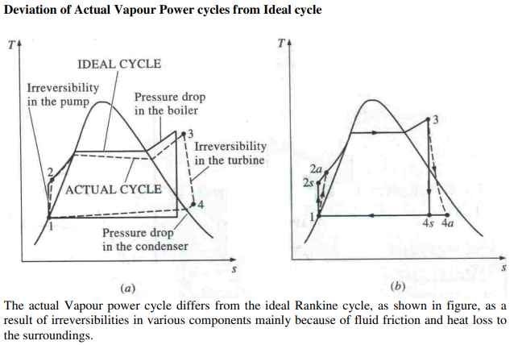
education for life www.rimt.ac.in
Department of Mechanical Engineering

Slide 16
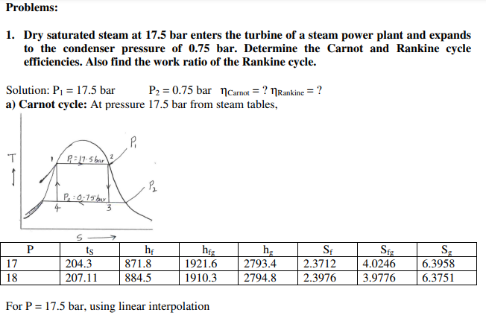
education for life www.rimt.ac.in
Department of Mechanical Engineering

Slide 17
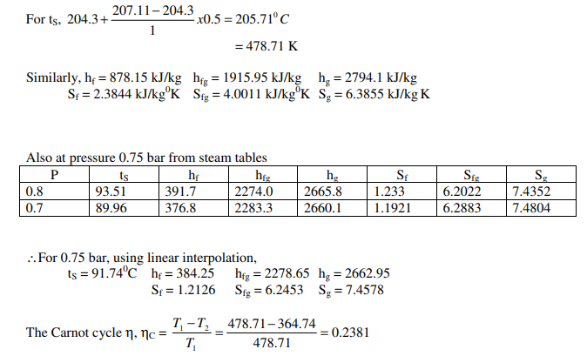
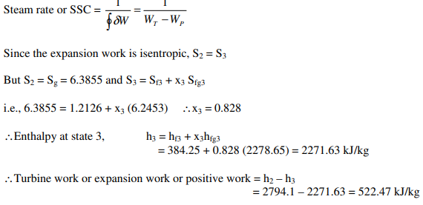
education for life www.rimt.ac.in
Department of Mechanical Engineering

Slide 18
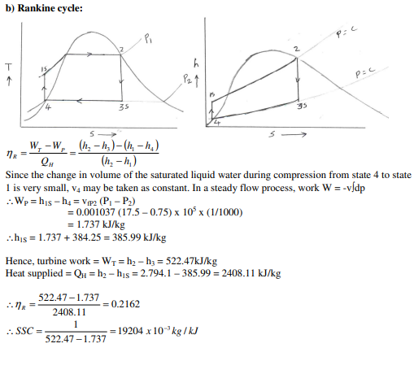
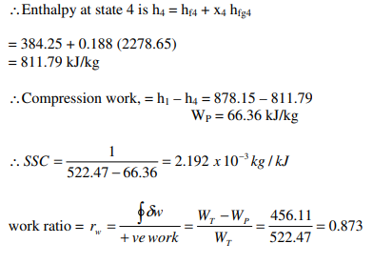
education for life www.rimt.ac.in
Department of Mechanical Engineering

Slide 19
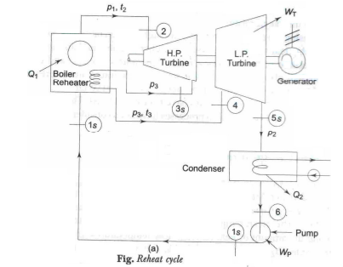
Ideal Reheat cycle:
We know that, the efficiency of the Rankine cycle could be increased by increasing steam pressure in the boiler and superheating the steam. But this increases the moisture content of the steam in the lower pressure stages in the turbine, which may lead to erosion of the turbine blade. ∴The reheat cycle has been developed to take advantage of the increased pressure of the boiler, avoiding the excessive moisture of the steam in the low pressure stages. In the reheat cycle, steam after partial expansion in the turbine is brought back to the boiler, reheated by combustion gases and then fed back to the turbine for further expansion.
education for life www.rimt.ac.in
Department of Mechanical Engineering

Slide 20
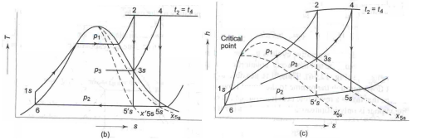
In the reheat cycle the expansion of steam from the initial state (2) to the condenser pressure is carried out in two or more steps, depending upon the number of reheats used. In the first step, steam expands in HP turbine from state 2 to approximate the saturated vapour line (process 2-3s). The steam is then reheated (or resuperheated) at constant pressure in the boiler (or in a reheater) process 3s-4 and the remaining expansion process 4s-5 is carried out in the LP turbine.
Note: 1) To protect the reheater tubes, steam is not allowed to expand deep into the two-phase region before it is taken for reheating, because in that case the moisture particles in steam while evaporating would leave behind solid deposits in the form of scale which is difficult to remove. Also a low reheat pressure may bring down Tm1 and hence cycle η. Again a high reheat pressure increases the moisture content at turbine exhaust. Thus reheat pressure is optimized. Optimum reheat pressure is about 0.2 to 0.25 of initial pressure.
education for life www.rimt.ac.in
Department of Mechanical Engineering

Slide 21
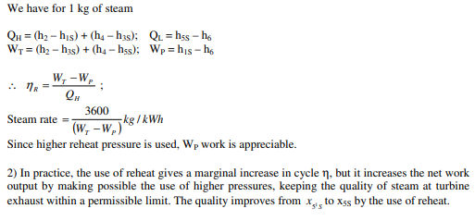
education for life www.rimt.ac.in
Department of Mechanical Engineering

Slide 22
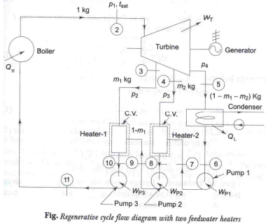
Regenerative cycle:
education for life www.rimt.ac.in
Department of Mechanical Engineering

Slide 23
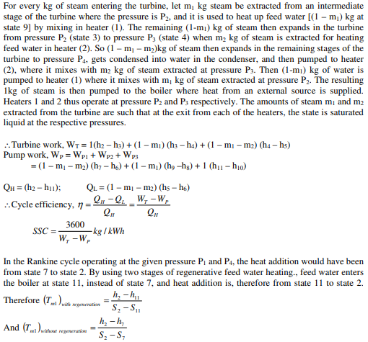
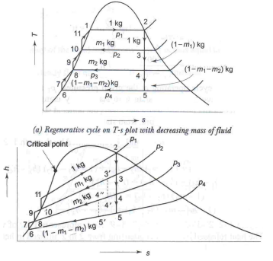
education for life www.rimt.ac.in
Department of Mechanical Engineering

Slide 24
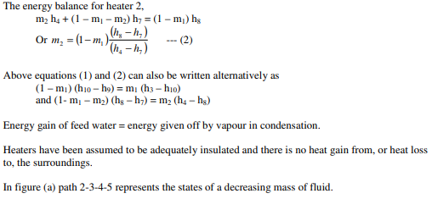
education for life www.rimt.ac.in
Department of Mechanical Engineering

Slide 25
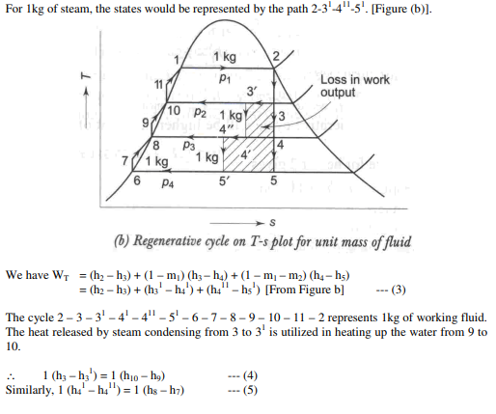
education for life www.rimt.ac.in
Department of Mechanical Engineering

Slide 26
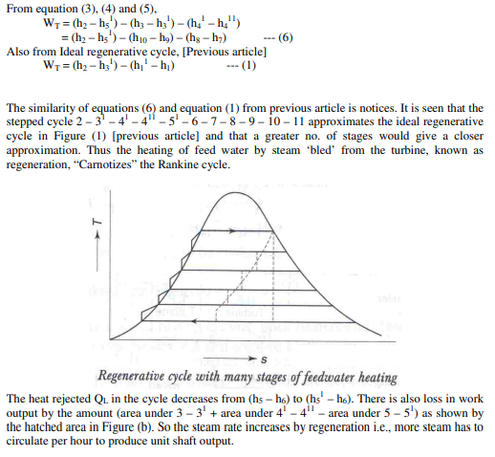
education for life www.rimt.ac.in
Department of Mechanical Engineering

Slide 27
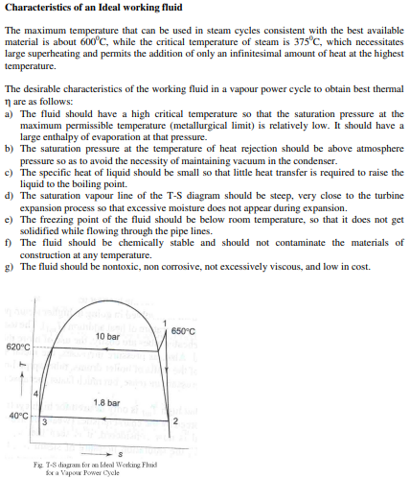
education for life www.rimt.ac.in
Department of Mechanical Engineering

Slide 28
education for life www.rimt.ac.in
Department of Mechanical Engineering

