Slide 1
AUTOMOBILE ENGINEERING (BTME-3504)
Course Name: B.Tech-ME Semester: 5th
Prepared by: Er. Amrinder Singh Pannu
education for life www.rimt.ac.in
Department of Mechanical Engineering

Slide 2
UNIT: I
education for life www.rimt.ac.in
Department of Mechanical Engineering

Slide 3
UNIT: I
education for life www.rimt.ac.in
Department of Mechanical Engineering

Slide 4
UNIT: I
education for life www.rimt.ac.in
Department of Mechanical Engineering

Slide 5
UNIT: I
education for life www.rimt.ac.in
Department of Mechanical Engineering

Slide 6
UNIT: I
education for life www.rimt.ac.in
Department of Mechanical Engineering

Slide 7
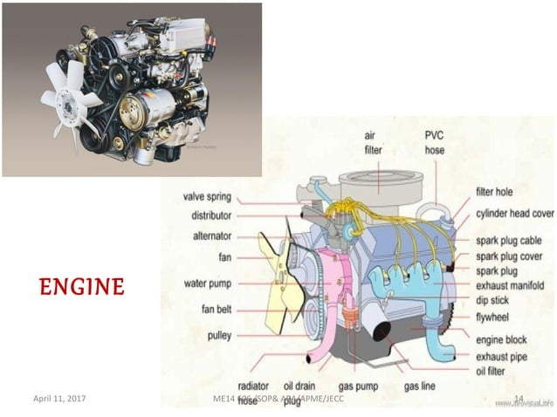
UNIT: I
education for life www.rimt.ac.in
Department of Mechanical Engineering

Slide 8
UNIT: I
education for life www.rimt.ac.in
Department of Mechanical Engineering

Slide 9
UNIT: I
education for life www.rimt.ac.in
Department of Mechanical Engineering

Slide 10
UNIT: I
education for life www.rimt.ac.in
Department of Mechanical Engineering

Slide 11
UNIT: I
education for life www.rimt.ac.in
Department of Mechanical Engineering

Slide 12
UNIT: I
education for life www.rimt.ac.in
Department of Mechanical Engineering

Slide 13
UNIT: I
education for life www.rimt.ac.in
Department of Mechanical Engineering

Slide 14
UNIT: I
education for life www.rimt.ac.in
Department of Mechanical Engineering

Slide 15
UNIT: I
education for life www.rimt.ac.in
Department of Mechanical Engineering

Slide 16
UNIT: I
education for life www.rimt.ac.in
Department of Mechanical Engineering

Slide 17
UNIT: I
education for life www.rimt.ac.in
Department of Mechanical Engineering

Slide 18
UNIT: I
education for life www.rimt.ac.in
Department of Mechanical Engineering

Slide 19
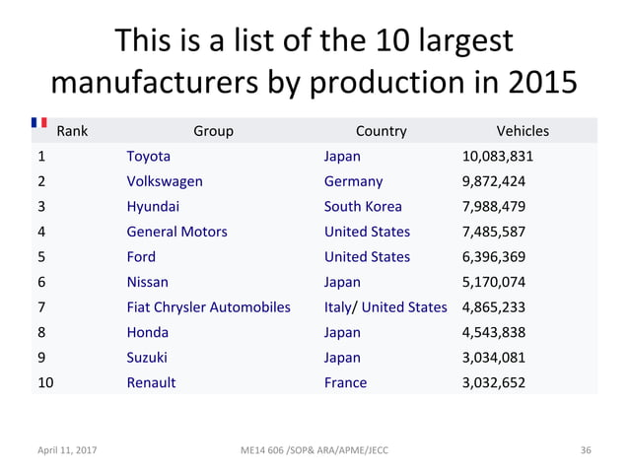
UNIT: I
education for life www.rimt.ac.in
Department of Mechanical Engineering

Slide 20
UNIT: I
education for life www.rimt.ac.in
Department of Mechanical Engineering

Slide 21
UNIT: I
education for life www.rimt.ac.in
Department of Mechanical Engineering

Slide 22
UNIT: I
education for life www.rimt.ac.in
Department of Mechanical Engineering

Slide 23
UNIT: I
education for life www.rimt.ac.in
Department of Mechanical Engineering

