Slide 1
COMPUTER ARCHITECTURE BTCS-2301
Course Name: B.Tech (CSE) Semester: 3rd
Prepared by: Sahilpreet Singh
education for life www.rimt.ac.in
Department of Computer Science & Engineering

Slide 2
Topic:-Parallelism
education for life www.rimt.ac.in

Slide 3
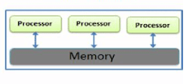
INTRODUCTION
Parallel processing can be described as a class of techniques which enables the system to achieve simultaneous data-processing tasks to increase the computational speed of a computer system.
A parallel processing system can carry out simultaneous data-processing to achieve faster execution time.
The primary purpose of parallel processing is to enhance the computer processing capability and increase itsthroughput
education for life www.rimt.ac.in

Slide 4
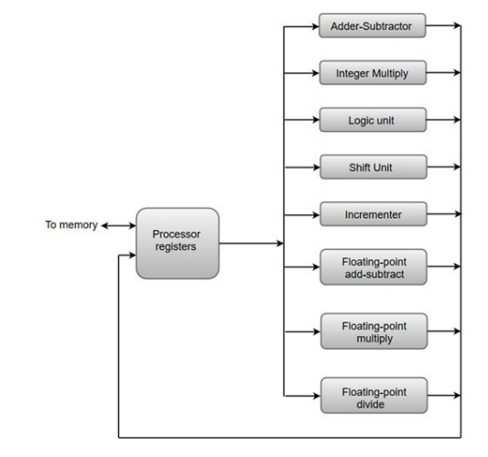
The adder and integer multiplier performs the arithmetic operation with integer numbers.
The floating-point operation separated into three circuits operating in parallel.
The logic, shift, and increment operations can be performed concurrently on different data.
All units are independent of each other, so one number can be shifted while another number is being incremented.
education for life www.rimt.ac.in

Slide 5
Why Parallel Architecture?
Parallel computer architecture adds a new dimension in the development of computer system by using more and more number of processors.
In principle, performance achieved by utilizing large number of processors is higher than the performance of a single processor at a given point of time.
education for life www.rimt.ac.in

Slide 6
Advantages
It saves time and money as many resources working together will reduce the time and cut potential costs.
It can be impractical to solve larger problems on Serial Computing.
It can take advantage of non-local resources when the local resources are finite.
Serial Computing ‘wastes’ the potential computing power, thus Parallel Computing makes better work of hardware.
education for life www.rimt.ac.in

Slide 7
Types of Parallelism
INSTRUCTION LEVEL
PROCESSOR LEVEL
education for life www.rimt.ac.in

