Slide 1
BASIC OF ELECTRICAL & ELECTRONICS ENGINEERING
Course Name: B.Tech (Applied Sciences) Semester: 1st
Prepared by: Er. Komal Mehra
education for life www.rimt.ac.in
Department of Applied Sciences

Slide 2
DC CIRCUITS
(Basic Laws)
education for life www.rimt.ac.in
Department of Applied Sciences

Slide 3
Basic Terms
Linear elements : In an electric circuit, a linear element is an electrical element with a linear relationship between current and voltage. Resistors are the most common example of a linear element; other examples include capacitors, inductors, and transformers. Nonlinear Elements : A nonlinear element is one which does not have a linear input/output relation. In a diode, for example, the current is a non-linear function of the voltage.Most semiconductor devices have non-linear characteristics. Active Elements : The elements which generates or produces electrical energy are called active elements. Some of the examples are batteries, generators,transistors,operational amplifiers,vacuum tubes etc. Passive Elements : All elements which consume rather than produce energy are called passive elements, like resistors,inductors and capacitors.
education for life www.rimt.ac.in
Department of Applied Sciences

Slide 4
In unilateral element, voltage – current relation is not same for both the direction. Example: Diode, Transistors.
In bilateral element, voltage – current relation is same for both the direction. Example: Resistor
The voltage generated by the source does not vary with any circuit quantity. It is only a function of time. Such a source is called an ideal voltage Source.
The current generated by the source does not vary with any circuit quantity. It is only a function of time. Such a source is called as an ideal current source.
Resistance : It is the property of a substance which opposes the flow of current through it. The resistance of element is denoted by the symbol “R”. It is measured in Ohms. R = PL / A Ω
education for life www.rimt.ac.in
Department of Applied Sciences

Slide 5
Ohm’s Law:
The current flowing through the electric circuit is directly proportional to the potential difference across the circuit and inversely proportional to the resistance of the circuit, provided the temperature remains constant.
(2.1)
(2.2)
education for life www.rimt.ac.in
Department of Applied Sciences

Slide 6
Basic Laws of Circuits
Ohm’s Law:
As Directly proportional means a straight line relationship.
v(t)
R
v(t) = Ri(t)
i(t)
The resistor is a model and will not produce a straight line for all conditions of operation.
education for life www.rimt.ac.in
Department of Applied Sciences

Slide 7
Basic Laws of Circuits
Ohm’s Law:
About Resistors:
The unit of resistance is ohms( Ω).
A mathematical expression for resistance is
(2.3)
education for life www.rimt.ac.in
Department of Applied Sciences

Slide 8
Basic Laws of Circuits
Ohm’s Law:
About Resistors:
We remember that resistance has units of ohms. The reciprocal of
resistance is conductance. At one time, conductance commonly had units
of mhos (resistance spelled backwards).
In recent years the units of conductance has been established as seimans (S).
Thus, we express the relationship between conductance and resistance as
(S)
(2.4)
We will see later than when resistors are in parallel, it is convenient
to use Equation (2.4) to calculate the equivalent resistance.
education for life www.rimt.ac.in
Department of Applied Sciences

Slide 9
Basic Laws of Circuits
Ohm’s Law:
Ohm’s Law: Example 2.1.
Consider the following circuit.
Determine the resistance of the 100 Watt bulb.
(2.5)
A suggested assignment is to measure the resistance of a 100 watt light
bulb with an ohmmeter. Debate the two answers.
education for life www.rimt.ac.in
Department of Applied Sciences

Slide 10
Circuit Definitions
Node – any point where 2 or more circuit elements are connected together
Wires usually have negligible resistance
Each node has one voltage (w.r.t. ground)
Branch – a circuit element between two nodes
Loop – a collection of branches that form a closed path returning to the same node without going through any other nodes or branches twice
education for life www.rimt.ac.in
Department of Applied Sciences

Slide 11
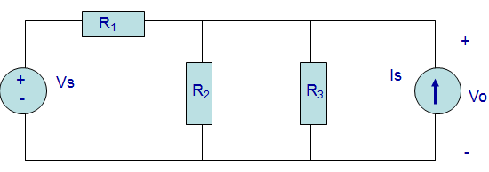
Example How many nodes, branches & loops?
education for life www.rimt.ac.in
Department of Applied Sciences

Slide 12
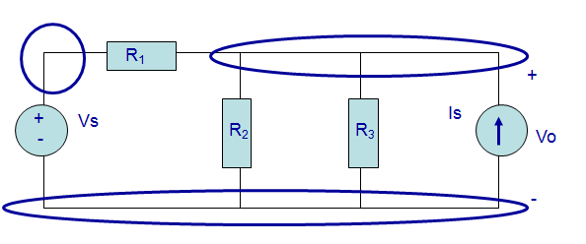
Three nodes
education for life www.rimt.ac.in
Department of Applied Sciences

Slide 13
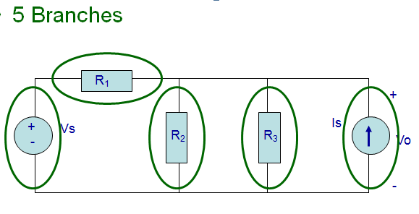
education for life www.rimt.ac.in
Department of Applied Sciences

Slide 14
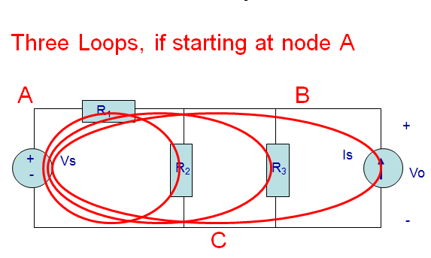
education for life www.rimt.ac.in
Department of Applied Sciences

Slide 15
Basic Laws of Circuits
Kirchhoff’s Current Law
As a consequence of the Law of the conservation of charge, we have:
•
The sum of the current entering a
node (junction point) equal to the
sum of the currents leaving.
education for life www.rimt.ac.in
Department of Applied Sciences

Slide 16
Basic Laws of Circuits
Kirchhoff’s Current Law
•
The algebraic sum of the currents entering a node equal to zero.
education for life www.rimt.ac.in
Department of Applied Sciences

Slide 17
Basic Laws of Circuits
Kirchhoff’s Current Law
•
The algebraic sum of the currents leaving a node equal to zero.
education for life www.rimt.ac.in
Department of Applied Sciences

Slide 18
Basic Laws of Circuits
Kirchhoff’s Current Law: Example 2.2.
Find the current I _{x}.
Ans: I_{X} =
22 A
14
Department of Applied Sciences
education for life www.rimt.ac.in

Slide 19
Basic Laws of Circuits
Kirchhoff’s Current Law
Kirchhoff’s current law can be generalized to include a surface.
We assume the elements within the surface are interconnected.
A closed 3D surface
We can now apply Kirchhoff’s current law in the 3 forms we discussed
with a node. The appearance might be as follows:
Currents entering and
leaving a closed surface
that contains interconnected
circuit elements
education for life www.rimt.ac.in
Department of Applied Sciences

Slide 20
Kirchoff’s Voltage Law (KVL)
The algebraic sum of voltages around each loop is zero
Beginning with one node, add voltages across each branch in the loop
(if you encounter a + sign first) and subtract voltages (if you encounter a – sign first)
Σ voltage drops - Σ voltage rises = 0
Or Σ voltage drops = Σ voltage rises
education for life www.rimt.ac.in
Department of Applied Sciences

Slide 21
Circuit Analysis
When given a circuit with sources and resistors having fixed values, you can use Kirchoff’s two laws and Ohm’s law to determine all branch voltages and currents
+ V_{AB} -
A
I
7Ω
B
+
V_{BC}
-
+
12 v
-
3Ω
C
education for life www.rimt.ac.in
Department of Applied Sciences

Slide 22
Circuit Analysis
By Ohm’s law: V_{AB} = I·7Ω and V_{BC} = I·3Ω
By KVL: V_{AB} + V_{BC} – 12 v = 0
Substituting: I·7Ω + I·3Ω -12 v = 0
Solving: I = 1.2 A
+ V_{AB} -
A
I
7Ω
B
+
V_{BC}
-
+
12 v
-
3Ω
C
education for life www.rimt.ac.in
Department of Applied Sciences

Slide 23
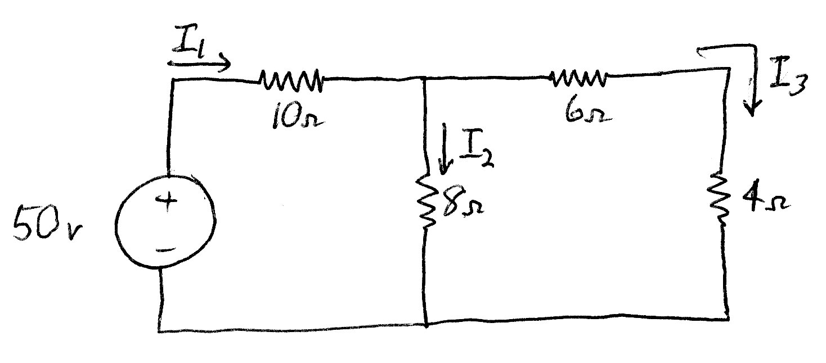
Example Circuit
Solve for the currents through each resistor
And the voltages across each resistor
education for life www.rimt.ac.in
Department of Applied Sciences

Slide 24
Example Circuit
+ I₁∙10Ω -
+ I₃∙6Ω -
+
I₃∙4Ω
-
+
I₂∙8Ω
-
Using Ohm’s law, add polarities and
expressions for each resistor voltage
education for life www.rimt.ac.in
Department of Applied Sciences

Slide 25
Example Circuit
+ I₁∙10Ω -
+ I₃∙6Ω -
+
I₃∙4Ω
-
+
I₂∙8Ω
-
Write 1st Kirchoff’s voltage law equation
-50 v + I₁∙10Ω + I₂∙8Ω = 0
education for life www.rimt.ac.in
Department of Applied Sciences

Slide 26
Example Circuit
+ I₁∙10Ω -
+ I₃∙6Ω -
+
I₃∙4Ω
-
+
I₂∙8Ω
-
Write 2nd Kirchoff’s voltage law equation
-I₂∙8Ω + I₃∙6Ω + I₃∙4Ω = 0
or I₂ = I₃ ∙(6+4)/8 = 1.25 ∙ I₃
education for life www.rimt.ac.in
Department of Applied Sciences

Slide 27
Example Circuit
We now have 3 equations in 3 unknowns, so we can solve for the currents through each resistor, that are used to find the voltage across each resistor
Since I₁ - I₂ - I₃ = 0, I₁ = I₂ + I₃
Substituting into the 1st KVL equation
-50 v + (I₂ + I₃)∙10Ω + I₂∙8Ω = 0
or I₂∙18 Ω + I₃∙ 10 Ω = 50 volts
education for life www.rimt.ac.in
Department of Applied Sciences

Slide 28
Example Circuit
But from the 2nd KVL equation, I₂ = 1.25∙I₃
Substituting into 1st KVL equation:
(1.25 ∙ I₃)∙18 Ω + I₃ ∙ 10 Ω = 50 volts
Or: I₃ ∙ 22.5 Ω + I₃ ∙ 10 Ω = 50 volts
Or: I₃∙ 32.5 Ω = 50 volts
Or: I₃ = 50 volts/32.5 Ω
Or: I₃ = 1.538 amps
education for life www.rimt.ac.in
Department of Applied Sciences

Slide 29
Example Circuit
Since I₃ = 1.538 amps
I₂ = 1.25∙I₃ = 1.923 amps
Since I₁ = I₂ + I_{3,} I₁ = 3.461 amps
The voltages across the resistors:
I₁∙10Ω = 34.61 volts
I₂∙8Ω = 15.38 volts
I₃∙6Ω = 9.23 volts
I₃∙4Ω = 6.15 volts
education for life www.rimt.ac.in
Department of Applied Sciences

