Slide 1
COMPUTER NETWORKS-II / BTCS-3501
Course Name: B.Tech CSE Semester: 5th
Prepared by: Er. Jasdeep Singh
education for life www.rimt.ac.in
Department of Computer Science & Engineering

Slide 2
Topics to be covered
Improving coverage and capacity in cellular systems
education for life www.rimt.ac.in

Slide 3
Improving Cellular System Capacity
A cellular design eventually (hopefully!) becomes insufficient to support the growing number of users.
Need to provide more channels per unit coverage area
Would like to have orderly growth
Would like to upgrade the system instead of rebuild
Would like to use existing towers as much as possible
education for life www.rimt.ac.in

Slide 4
Cell Splitting
subdivide congested cell into several smaller cells
increases number of times channels are reused in an area
must decrease antenna height & Tx power
so smaller coverage per cell results
and the co-channel interference level is held constant
education for life www.rimt.ac.in

Slide 5
each smaller cell keeps ≈ same # of channels as the larger cell, since each new smaller cell uses the same number of frequencies
this means that we keep that same cluster size
capacity ↑ because channel reuse ↑ per unit area
smaller cells → “micro-cells”
education for life www.rimt.ac.in

Slide 6
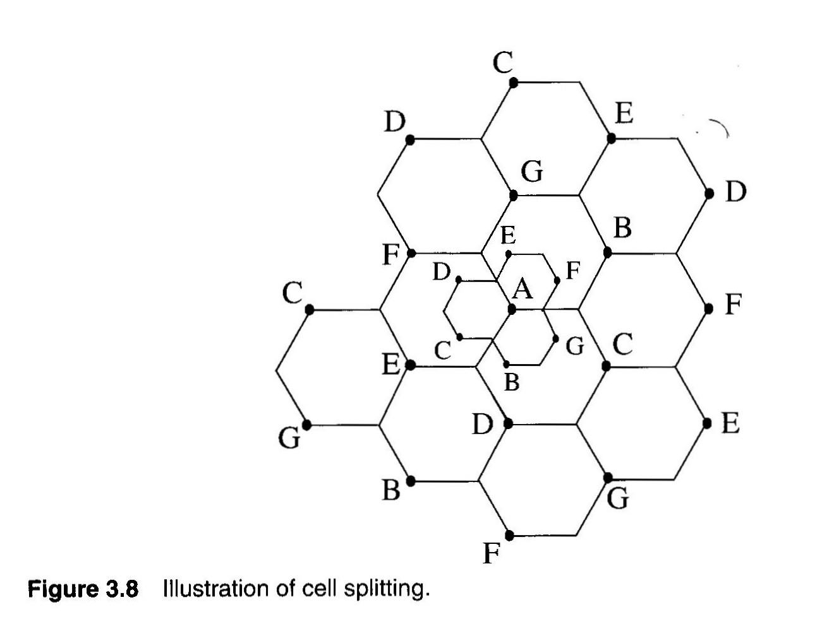
Illustration is for towers at the corners
education for life www.rimt.ac.in

Slide 7
advantages include:
only needed for cells that reach max. capacity → not all cells
implement when Pr [blocked call] > acceptable GOS
system capacity can gradually expand as demand ↑
disadvantages include:
# handoffs/unit area increases
umbrella cell for high velocity traffic may be needed
more base stations → $$ for real estate, towers, etc.
education for life www.rimt.ac.in

Slide 8
complicated design process
new base stations use lower power and antenna height
What about existing base stations?
If kept at the same power, they would overpower new microcells.
If reduced in power, they would not cover their own cells.
One solution: Use separate groups of channels.
One group at the original power and another group at the lower power.
New microcells only use lower power channels.
As load growth continues, more and more channels are moved to lower power.
education for life www.rimt.ac.in

Slide 9
Sectoring
cell splitting keeps D / R unchanged (same cluster size and CCI) but increases frequency reuse/area
alternate way to ↑ capacity is to _____ CCI (increase S / I ratio)
education for life www.rimt.ac.in
Notes:
reduce

Slide 10
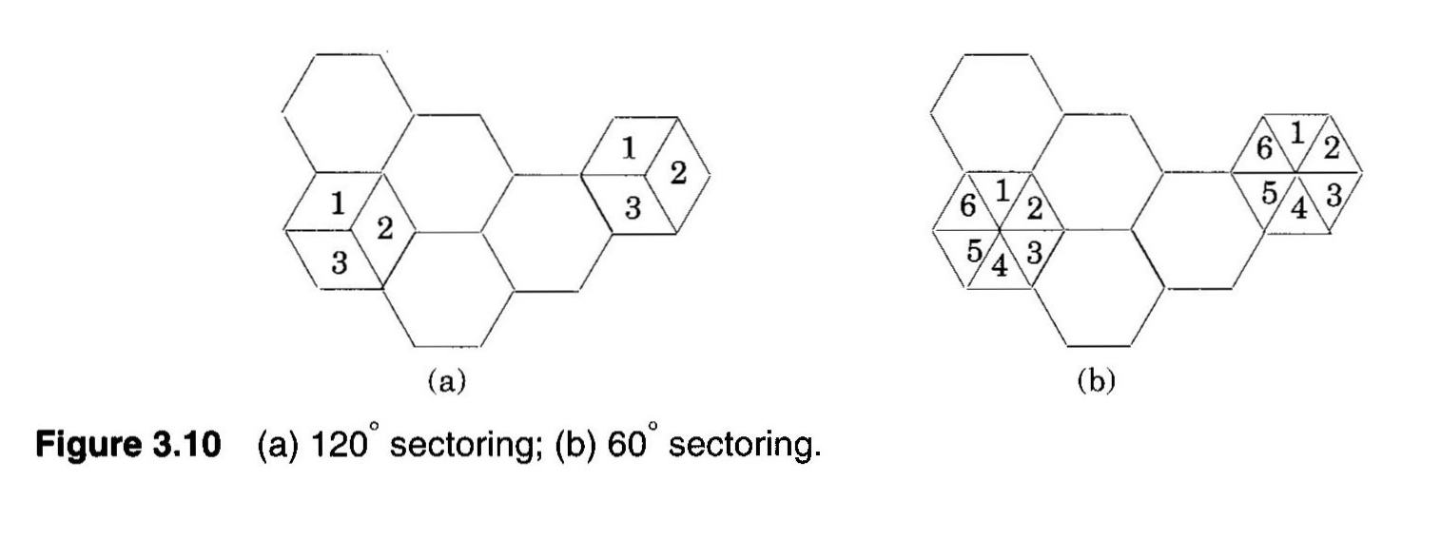
replace omni-directional antennas at base station with several directional antennas
3 sectors → 3 120° antennas
6 sectors → 6 60° antennas
education for life www.rimt.ac.in

Slide 11
cell channels broken down into sectored groups
CCI reduced because only some of neighboring co-channel cells radiate energy in direction of main cell
center cell labeled "5" has all co-channel cells illustrated
only 2 co-channel cells will interfere if all are using 120° sectoring
only 1 co-channel cell would interfere when using 60° sectoring
education for life www.rimt.ac.in

Slide 12
education for life www.rimt.ac.in

Slide 13
Disadvantage of Sectoring
primary disadvantage is that the available channels in a cell are subdivided into sectored groups
trunked channel pool ↓, therefore trunking efficiency ↓
There are more channels per cell, because of smaller cluster sizes, but those channels are broken into sectors.
education for life www.rimt.ac.in

Slide 14
Disadvantage of Sectoring
other disadvantages:
must design network coverage with sectoring decided in advance
can’t effectively use sectoring to increase capacity after setting cluster size N
can’t be used to gradually expand capacity as traffic ↑ like cell splitting
More Handoffs
More antenna, more cost
education for life www.rimt.ac.in

