Slide 1
Operating System/ BTCS-2401
Course Name: B.Tech CSE Semester: 4th
Prepared by: Er. Jasdeep Singh
education for life www.rimt.ac.in
Department of Computer Science & Engineering

Slide 2
Topic 7th :CPU Scheduling
education for life www.rimt.ac.in

Slide 3
Topics To Be Covered
Basic Concepts
Scheduling Criteria
Scheduling Algorithms
education for life www.rimt.ac.in

Slide 4
Objectives
To introduce CPU scheduling, which is the basis for multiprogrammed operating systems
To describe various CPU-scheduling algorithms
To discuss evaluation criteria for selecting a CPU-scheduling algorithm for a particular system
education for life www.rimt.ac.in

Slide 5
Basic Concepts
Maximum CPU utilization obtained with multiprogramming
CPU–I/O Burst Cycle – Process execution consists of a cycle of CPU execution and I/O wait
CPU burst distribution
education for life www.rimt.ac.in

Slide 6
CPU Scheduler
Selects from among the processes in ready queue, and allocates the CPU to one of them
Queue may be ordered in various ways
CPU scheduling decisions may take place when a process:
1. Switches from running to waiting state
2. Switches from running to ready state
3. Switches from waiting to ready
Terminates
Scheduling under 1 and 4 is non preemptive
All other scheduling is preemptive
Consider access to shared data
Consider preemption while in kernel mode
Consider interrupts occurring during crucial OS activities
education for life www.rimt.ac.in

Slide 7
Dispatcher
Dispatcher module gives control of the CPU to the process selected by the short-term scheduler; this involves:
switching context
switching to user mode
jumping to the proper location in the user program to restart that program
Dispatch latency – time it takes for the dispatcher to stop one process and start another running
education for life www.rimt.ac.in

Slide 8
Scheduling Criteria
CPU utilization – keep the CPU as busy as possible
Throughput – # of processes that complete their execution per time unit
Turnaround time – amount of time to execute a particular process
Waiting time – amount of time a process has been waiting in the ready queue
Response time – amount of time it takes from when a request was submitted until the first response is produced, not output (for time-sharing environment)
education for life www.rimt.ac.in

Slide 9
Scheduling Algorithm Optimization Criteria
Max CPU utilization
Max throughput
Min turnaround time
Min waiting time
Min response time
education for life www.rimt.ac.in

Slide 10
First-Come, First-Served (FCFS) Scheduling
Process Burst Time
P₁ 24
P₂ 3
P₃ 3
Suppose that the processes arrive in the order: P₁ , P₂ , P₃ The Gantt Chart for the schedule is:
Waiting time for P₁ = 0; P₂ = 24; P₃ = 27
Average waiting time: (0 + 24 + 27)/3 = 17
P₁
P₂
P₃
0
24
27
30
education for life www.rimt.ac.in

Slide 11
Shortest-Job-First (SJF) Scheduling
Associate with each process the length of its next CPU burst
Use these lengths to schedule the process with the shortest time
SJF is optimal – gives minimum average waiting time for a given set of processes
The difficulty is knowing the length of the next CPU request
Could ask the user
education for life www.rimt.ac.in

Slide 12
Example of SJF
ProcessArriva l Time Burst Time
P₁ 0.0 6
P₂ 2.0 8
P₃ 4.0 7
P₄ 5.0 3
SJF scheduling chart
Average waiting time = (3 + 16 + 9 + 0) / 4 = 7
P₄
P₁
P₃
P₂
0
3
9
16
24
education for life www.rimt.ac.in

Slide 13
Determining Length of Next CPU Burst
Can only estimate the length – should be similar to the previous one
Then pick process with shortest predicted next CPU burst
Can be done by using the length of previous CPU bursts, using exponential averaging
Commonly, α set to ½
Preemptive version called shortest-remaining-time-first
education for life www.rimt.ac.in

Slide 14
Example of Shortest-remaining-time-first
Now we add the concepts of varying arrival times and preemption to the analysis
ProcessA arri Arrival TimeT Burst Time
P₁ 0 8
P₂ 1 4
P₃ 2 9
P₄ 3 5
Preemptive SJF Gantt Chart
Average waiting time = [(10-1)+(1-1)+(17-2)+5-3)]/4 = 26/4 = 6.5 msec
P₁
P₂
P₄
P₁
P₃
0
1
5
10
17
26
education for life www.rimt.ac.in

Slide 15
Priority Scheduling
A priority number (integer) is associated with each process
The CPU is allocated to the process with the highest priority (smallest integer ≡ highest priority)
Preemptive
Nonpreemptive
SJF is priority scheduling where priority is the inverse of predicted next CPU burst time
Problem ≡ Starvation – low priority processes may never execute
Solution ≡ Aging – as time progresses increase the priority of the process
education for life www.rimt.ac.in

Slide 16
Multilevel Queue
Ready queue is partitioned into separate queues, eg:
foreground (interactive)
background (batch)
Process permanently in a given queue
Each queue has its own scheduling algorithm:
foreground – RR
background – FCFS
Scheduling must be done between the queues:
Fixed priority scheduling; (i.e., serve all from foreground then from background). Possibility of starvation.
Time slice – each queue gets a certain amount of CPU time which it can schedule amongst its processes; i.e., 80% to foreground in RR
20% to background in FCFS
education for life www.rimt.ac.in

Slide 17
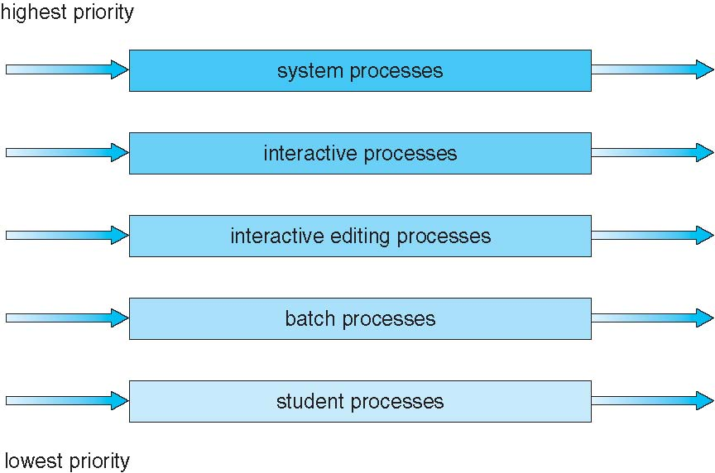
Multilevel Queue Scheduling
education for life www.rimt.ac.in

Slide 18
Multilevel Feedback Queue
A process can move between the various queues; aging can be implemented this way
Multilevel-feedback-queue scheduler defined by the following parameters:
number of queues
scheduling algorithms for each queue
method used to determine when to upgrade a process
method used to determine when to demote a process
method used to determine which queue a process will enter when that process needs service
education for life www.rimt.ac.in

Slide 19
Example of Multilevel Feedback Queue
Three queues:
Q₀ – RR with time quantum 8 milliseconds
Q₁ – RR time quantum 16 milliseconds
Q₂ – FCFS
Scheduling
A new job enters queue Q₀ which is served FCFS
When it gains CPU, job receives 8 milliseconds
If it does not finish in 8 milliseconds, job is moved to queue Q₁
At Q₁ job is again served FCFS and receives 16 additional milliseconds
If it still does not complete, it is preempted and moved to queue Q₂
education for life www.rimt.ac.in

Slide 20
Summary
Basic Concepts
Scheduling Criteria
Scheduling Algorithms
education for life www.rimt.ac.in

Slide 21
Topics To Be Next Covered
Thread Scheduling
Multiple-Processor Scheduling
Operating Systems Examples
Algorithm Evaluation
education for life www.rimt.ac.in

Slide 22
References
Silberschatz and Peter B. Calvin, “Operating System Concepts" Addison Wesley Publishing Company
Dhamdhere, “Systems Programming & Operating Systems Tata McGraw Hill
education for life www.rimt.ac.in

