Slide 1
AUTOMOBILE ENGINEERING (BTME-3504)
Course Name: B.Tech-ME Semester: 5th
Prepared by: Er. Amrinder Singh Pannu
education for life www.rimt.ac.in
Department of Mechanical Engineering

Slide 2
UNIT: IV
education for life www.rimt.ac.in
Department of Mechanical Engineering

Slide 3
UNIT: IV
education for life www.rimt.ac.in
Department of Mechanical Engineering

Slide 4
UNIT: IV
education for life www.rimt.ac.in
Department of Mechanical Engineering

Slide 5
UNIT: IV
education for life www.rimt.ac.in
Department of Mechanical Engineering

Slide 6
UNIT: IV
education for life www.rimt.ac.in
Department of Mechanical Engineering

Slide 7
UNIT: IV
education for life www.rimt.ac.in
Department of Mechanical Engineering

Slide 8
UNIT: IV
education for life www.rimt.ac.in
Department of Mechanical Engineering

Slide 9
UNIT: IV
education for life www.rimt.ac.in
Department of Mechanical Engineering

Slide 10
UNIT: IV
education for life www.rimt.ac.in
Department of Mechanical Engineering

Slide 11
UNIT: IV
education for life www.rimt.ac.in
Department of Mechanical Engineering

Slide 12
UNIT: IV
education for life www.rimt.ac.in
Department of Mechanical Engineering

Slide 13
UNIT: IV
education for life www.rimt.ac.in
Department of Mechanical Engineering

Slide 14
UNIT: IV
education for life www.rimt.ac.in
Department of Mechanical Engineering

Slide 15
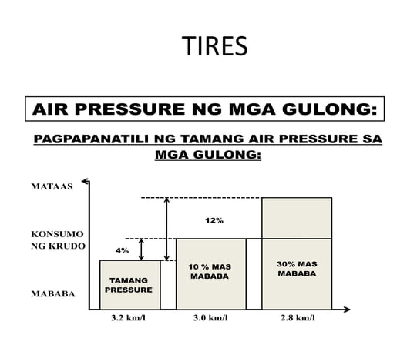
UNIT: IV
education for life www.rimt.ac.in
Department of Mechanical Engineering

Slide 16
UNIT: IV
education for life www.rimt.ac.in
Department of Mechanical Engineering

Slide 17
UNIT: IV
education for life www.rimt.ac.in
Department of Mechanical Engineering

