Slide 1
COMPUTER NETWORKS-II / BTCS-3501
Course Name: B.Tech CSE Semester: 5th
Prepared by: Er. Jasdeep Singh
education for life www.rimt.ac.in
Department of Computer Science & Engineering

Slide 2
Topics to be covered
Introduction to wireless communication system
education for life www.rimt.ac.in

Slide 3
1.1 Evolution of Mobile Radio Communications
Major Mobile Radio Systems
1934 - Police Radio uses conventional AM mobile communication system.
1935 - Edwin Armstrong demonstrate FM
1946 - First public mobile telephone service - push-to-talk
1960 - Improved Mobile Telephone Service, IMTS - full duplex
1960 - Bell Lab introduce the concept of Cellular mobile system
1968 - AT&T propose the concept of Cellular mobile system to FCC.
1976 - Bell Mobile Phone service, poor service due to call blocking
1983 - Advanced Mobile Phone System (AMPS), FDMA, FM
1991 - Global System for Mobile (GSM), TDMA, GMSK
1991 - U.S. Digital Cellular (USDC) IS-54, TDMA, DQPSK
1993 - IS-95, CDMA, QPSK, BPSK
education for life www.rimt.ac.in

Slide 4
1.2 Example of Mobile Radio Systems
Examples
Cordless phone
Remote controller
Hand-held walkie-talkies
Pagers
Cellular telephone
Wireless LAN
Mobile - any radio terminal that could be moves during operation
Portable - hand-held and used at walking speed
Subscriber - mobile or portable user
education for life www.rimt.ac.in

Slide 5
Classification of mobile radio transmission system
Simplex: communication in only one direction
Half-duplex: same radio channel for both transmission and reception (push-to-talk)
Full-duplex: simultaneous radio transmission and reception (FDD, TDD)
Frequency division duplexing uses two radio channel
Forward channel: base station to mobile user
Reverse channel: mobile user to base station
Time division duplexing shares a single radio channel in time.
education for life www.rimt.ac.in

Slide 6
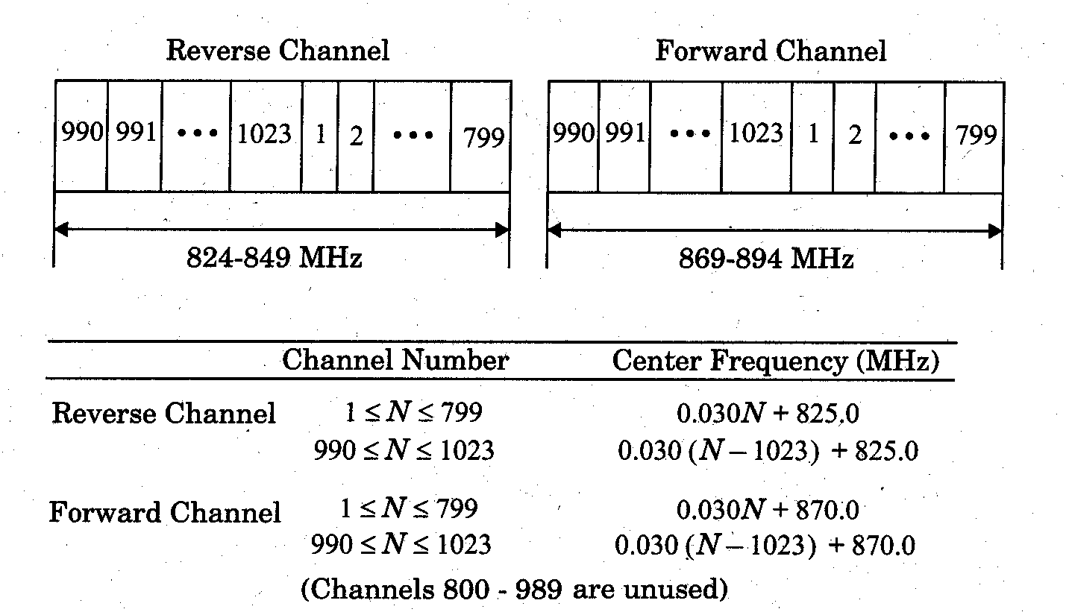
education for life www.rimt.ac.in

Slide 7
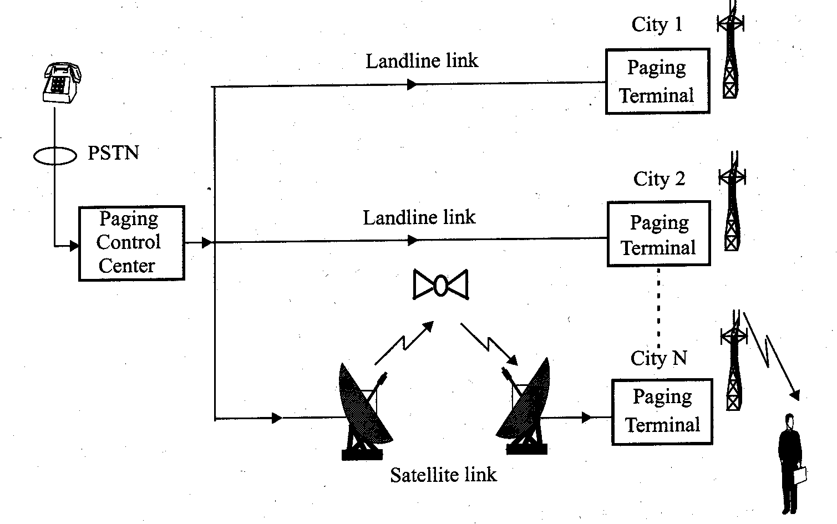
1.2.2 Paging Systems
Conventional paging system send brief messages to a subscriber
Modern paging system: news headline, stock quotations, faxes, etc.
Simultaneously broadcast paging message from each base station (simulcasting)
Large transmission power to cover wide area.
education for life www.rimt.ac.in

Slide 8
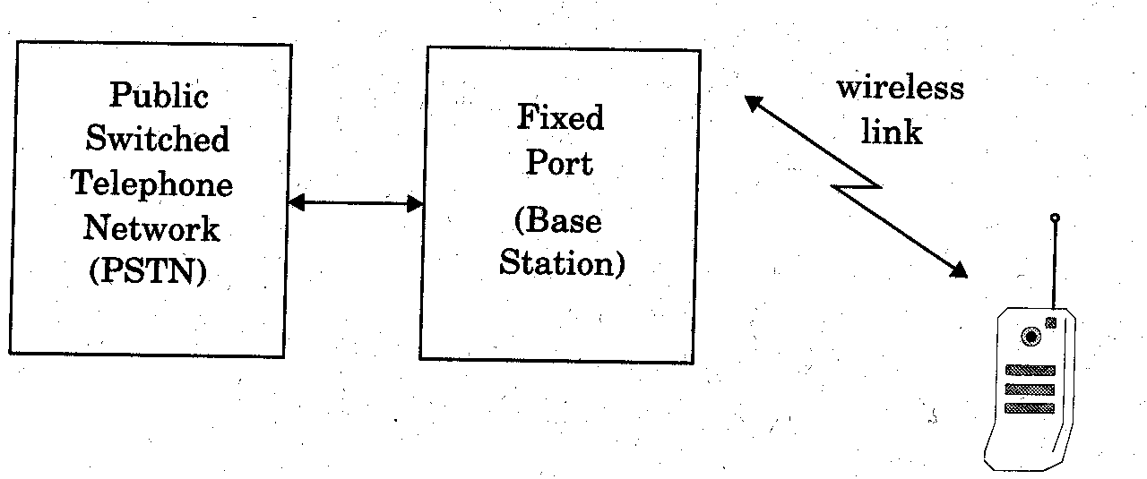
1.2.3 Cordless Telephone System
Cordless telephone systems are full duplex communication systems.
First generation cordless phone
in-home use
communication to dedicated base unit
few tens of meters
Second generation cordless phone
outdoor
combine with paging system
few hundred meters per station
education for life www.rimt.ac.in

Slide 9
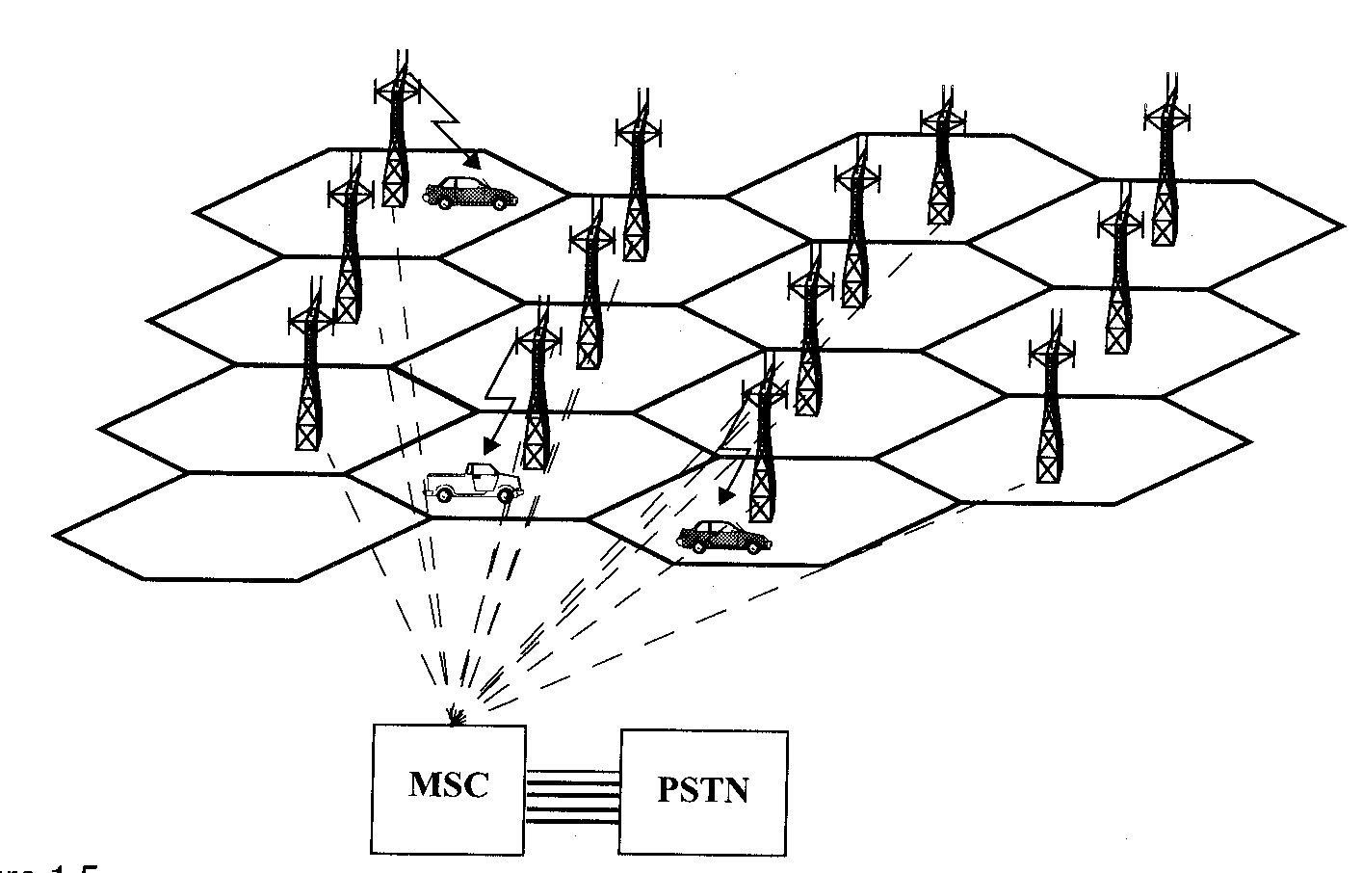
1.2.4 Cellular Telephone Systems
Provide connection to the PSTN for any user location within the radio range of the system.
Characteristic
Large number of users
Large Geographic area
Limited frequency spectrum
Reuse of the radio frequency by the concept of “cell’’.
Basic cellular system: mobile stations, base stations, and mobile switching center.
education for life www.rimt.ac.in

Slide 10
Communication between the base station and mobiles is defined by the standard common air interface (CAI)
forward voice channel (FVC): voice transmission from base station to mobile
reverse voice channel (RVC): voice transmission from mobile to base station
forward control channels (FCC): initiating mobile call from base station to mobile
reverse control channel (RCC): initiating mobile call from mobile to base station
education for life www.rimt.ac.in

Slide 11
Topics to be covered in next lecture
Evolution of wireless communication
Examples of wireless communication systems
education for life www.rimt.ac.in

