Slide 1
Mathematics-III(BTME-3500)
Course Name: B.Tech. (ME) Semester: 5th
Prepared by: Sachin Syan
education for life www.rimt.ac.in
Mechanical Engineering

Slide 2
Topic Discussed
Homogeneous Partial Differential Equations with constant coefficients
Complete Solution
Particular Integral
education for life www.rimt.ac.in
Mechanical Engineering

Slide 3
education for life www.rimt.ac.in
Mechanical Engineering

Slide 4
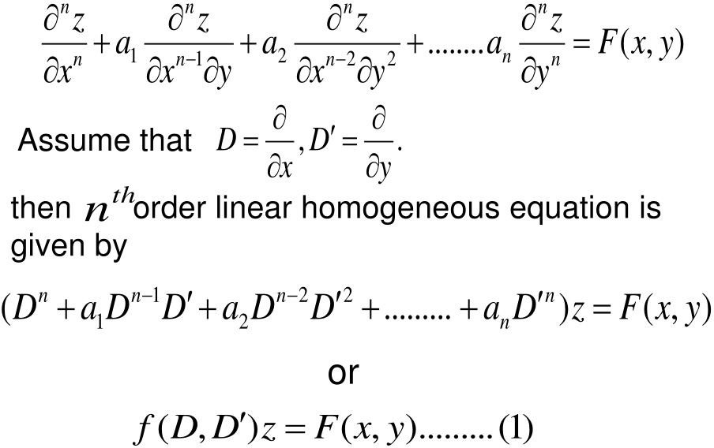
education for life www.rimt.ac.in
Mechanical Engineering

Slide 5
education for life www.rimt.ac.in
Mechanical Engineering

Slide 6
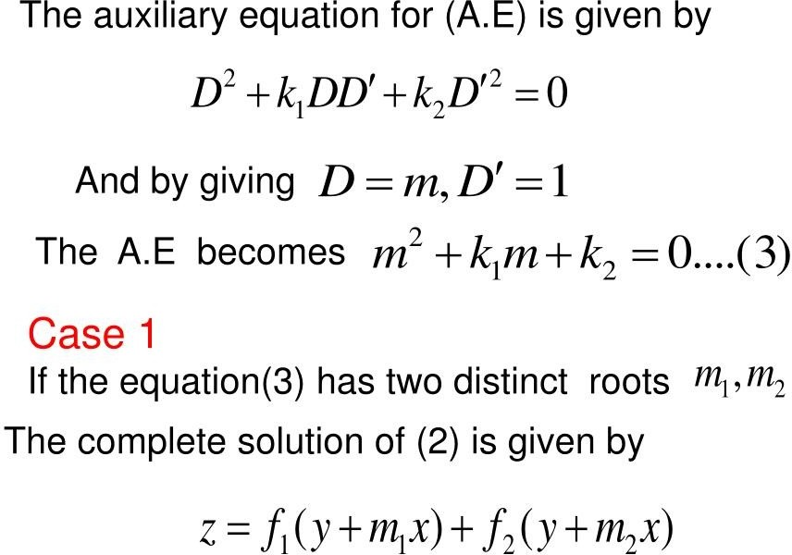
education for life www.rimt.ac.in
Mechanical Engineering

Slide 7
education for life www.rimt.ac.in
Mechanical Engineering

Slide 8
education for life www.rimt.ac.in
Mechanical Engineering

Slide 9
education for life www.rimt.ac.in
Mechanical Engineering

Slide 10
education for life www.rimt.ac.in
Mechanical Engineering

Slide 11
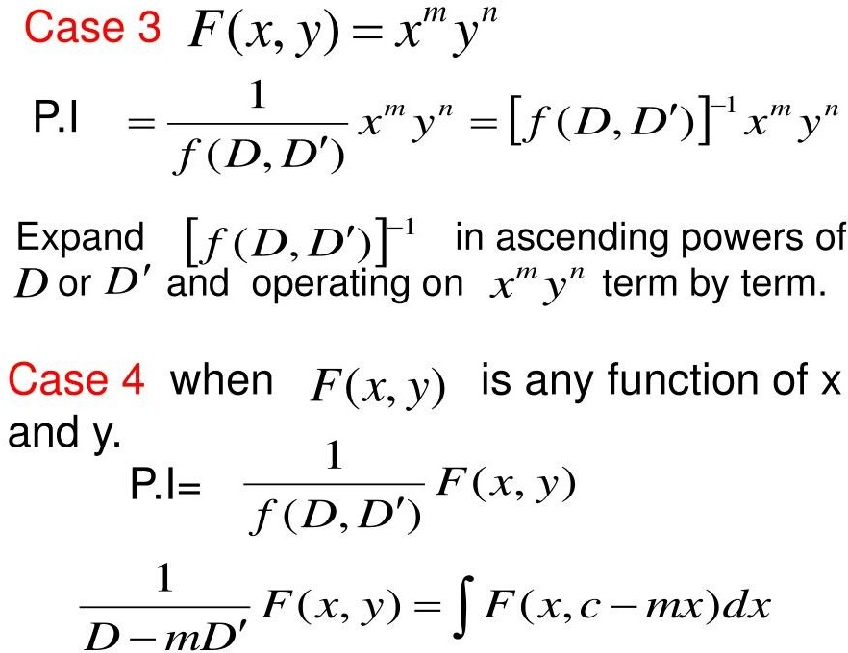
education for life www.rimt.ac.in
Mechanical Engineering

Slide 12
education for life www.rimt.ac.in
Mechanical Engineering

Slide 13
education for life www.rimt.ac.in
Mechanical Engineering

Slide 14
education for life www.rimt.ac.in
Mechanical Engineering

Slide 15
education for life www.rimt.ac.in
Mechanical Engineering

Slide 16
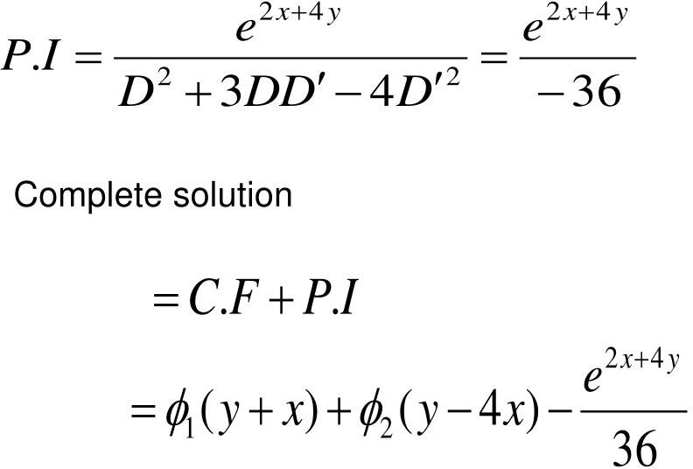
education for life www.rimt.ac.in
Mechanical Engineering

Slide 17
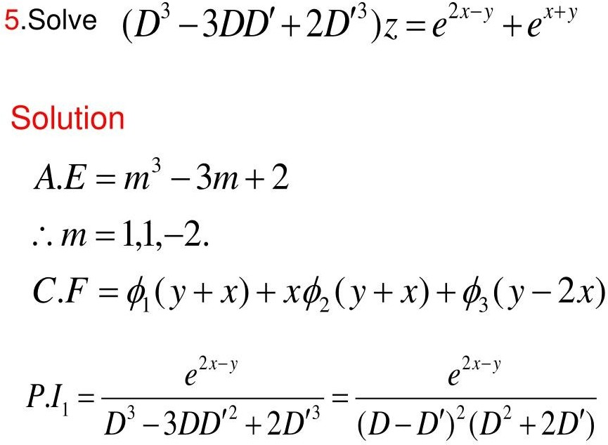
education for life www.rimt.ac.in
Mechanical Engineering

Slide 18
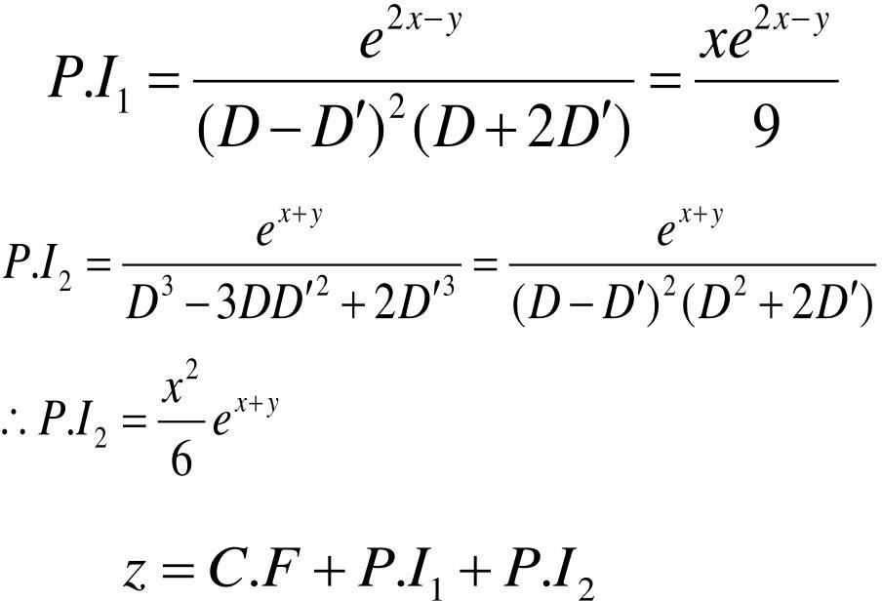
education for life www.rimt.ac.in
Mechanical Engineering

Slide 19
education for life www.rimt.ac.in
Mechanical Engineering

Slide 20
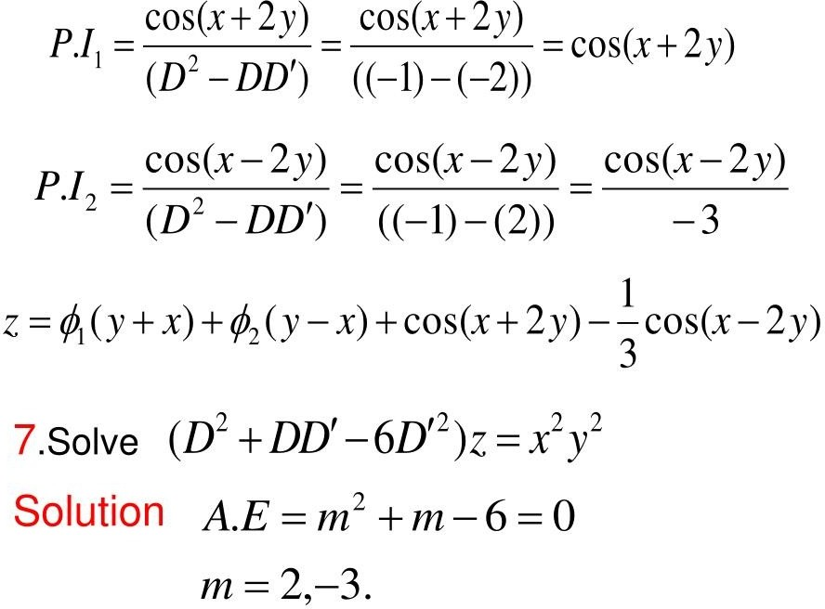
education for life www.rimt.ac.in
Mechanical Engineering

Slide 21
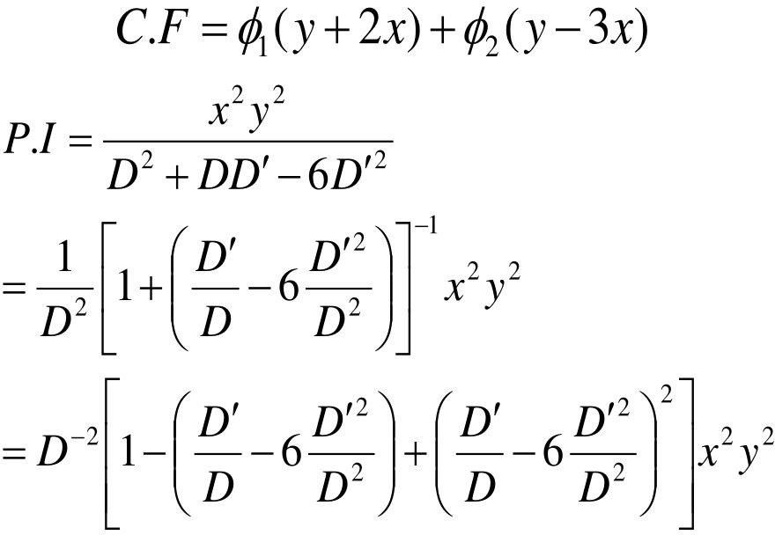
education for life www.rimt.ac.in
Mechanical Engineering

Slide 22
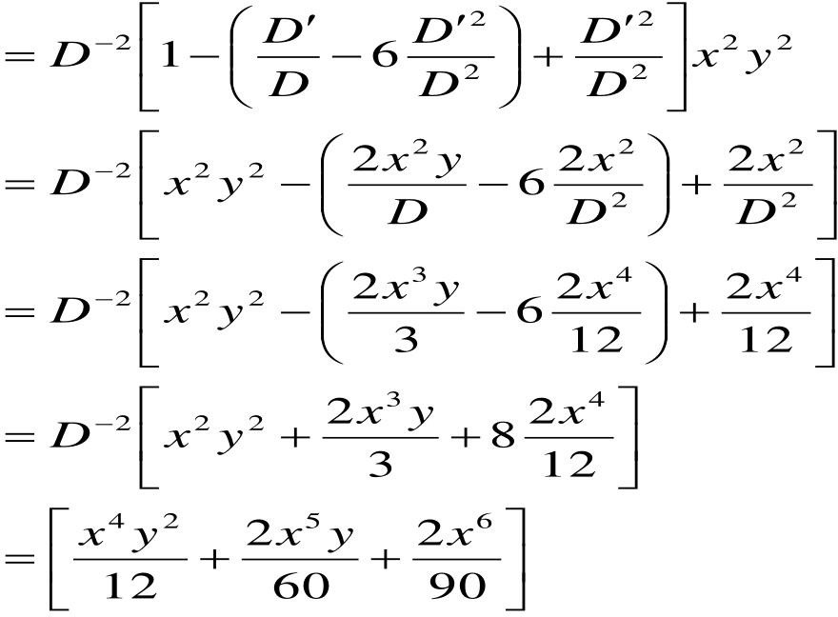
education for life www.rimt.ac.in
Mechanical Engineering

Slide 23
Topics Discussed in Next Lecture
Content
Complex Number
Complex Variable
Basic Definition
Limits
Continuity
Differentiability
education for life www.rimt.ac.in
Mechanical Engineering

