Slide 1
Operating System/ BTCS-2401
Course Name: B.Tech CSE Semester: 4th
Prepared by: Er. Jasdeep Singh
education for life www.rimt.ac.in
Department of Computer Science & Engineering

Slide 2
Topic 3rd : Operating-System Structures
education for life www.rimt.ac.in

Slide 3
Topics To Be Covered
Operating System Design and Implementation
Operating System Structure
Virtual Machines
Operating System Debugging
Operating System Generation
System Boot
education for life www.rimt.ac.in

Slide 4
Operating System Design and Implementation
Design and Implementation of OS not “solvable”, but some approaches have proven successful
Internal structure of different Operating Systems can vary widely
Start by defining goals and specifications
Affected by choice of hardware, type of system
User goals and System goals
User goals – operating system should be convenient to use, easy to learn, reliable, safe, and fast
System goals – operating system should be easy to design, implement, and maintain, as well as flexible, reliable, error-free, and efficient
education for life www.rimt.ac.in

Slide 5
Operating System Design and Implementation (Cont.)
Important principle to separate
Policy: What will be done? Mechanism: How to do it?
Mechanisms determine how to do something, policies decide what will be done
The separation of policy from mechanism is a very important principle, it allows maximum flexibility if policy decisions are to be changed later
education for life www.rimt.ac.in

Slide 6
Simple Structure
MS-DOS – written to provide the most functionality in the least space
Not divided into modules
Although MS-DOS has some structure, its interfaces and levels of functionality are not well separated
education for life www.rimt.ac.in

Slide 7
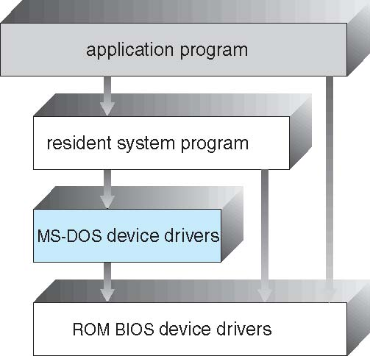
MS-DOS Layer Structure
education for life www.rimt.ac.in

Slide 8
Layered Approach
The operating system is divided into a number of layers (levels), each built on top of lower layers. The bottom layer (layer 0), is the hardware; the highest (layer N) is the user interface.
With modularity, layers are selected such that each uses functions (operations) and services of only lower-level layers
education for life www.rimt.ac.in

Slide 9
UNIX
UNIX – limited by hardware functionality, the original UNIX operating system had limited structuring. The UNIX OS consists of two separable parts
Systems programs
The kernel
Consists of everything below the system-call interface and above the physical hardware
Provides the file system, CPU scheduling, memory management, and other operating-system functions; a large number of functions for one level
education for life www.rimt.ac.in

Slide 10
Microkernel System Structure
Moves as much from the kernel into “user” space
Communication takes place between user modules using message passing
Benefits:
Easier to extend a microkernel
Easier to port the operating system to new architectures
More reliable (less code is running in kernel mode)
More secure
Detriments:
Performance overhead of user space to kernel space communication
education for life www.rimt.ac.in

Slide 11
Modules
Most modern operating systems implement kernel modules
Uses object-oriented approach
Each core component is separate
Each talks to the others over known interfaces
Each is loadable as needed within the kernel
Overall, similar to layers but with more flexible
education for life www.rimt.ac.in

Slide 12
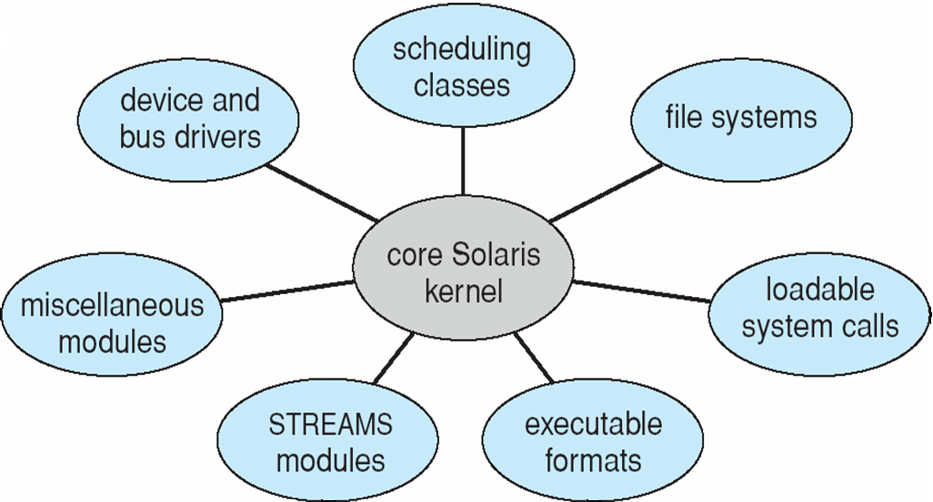
Solaris Modular Approach
education for life www.rimt.ac.in

Slide 13
Virtual Machines
A virtual machine takes the layered approach to its logical conclusion. It treats hardware and the operating system kernel as though they were all hardware.
A virtual machine provides an interface identical to the underlying bare hardware.
The operating system host creates the illusion that a process has its own processor and (virtual memory).
Each guest provided with a (virtual) copy of underlying computer.
education for life www.rimt.ac.in

Slide 14
Virtual Machines History and Benefits
First appeared commercially in IBM mainframes in 1972
Fundamentally, multiple execution environments (different operating systems) can share the same hardware
Protect from each other
Some sharing of file can be permitted, controlled
Commutate with each other, other physical systems via networking
Useful for development, testing
“Open Virtual Machine Format”, standard format of virtual machines, allows a VM to run within many different virtual machine (host) platforms
education for life www.rimt.ac.in

Slide 15
Virtualization Implementation
Difficult to implement – must provide an exact duplicate of underlying machine
Typically runs in user mode, creates virtual user mode and virtual kernel mode
Timing can be an issue – slower than real machine
Hardware support needed
More support-> better virtualization
i.e. AMD provides “host” and “guest” modes
education for life www.rimt.ac.in

Slide 16
Operating-System Debugging
is finding and fixing errors, or bugs
Failure of an application can generate core dump file capturing memory of the process
Operating system failure can generate crash dump file containing kernel memory
Beyond crashes, performance tuning can optimize system performance
Kernighan’s Law: “Debugging is twice as hard as writing the code in the first place. Therefore, if you write the code as cleverly as possible, you are, by definition, not smart enough to debug it.”
education for life www.rimt.ac.in

Slide 17
Operating System Generation
Operating systems are designed to run on any of a class of machines; the system must be configured for each specific computer site
SYSGEN program obtains information concerning the specific configuration of the hardware system
Booting – starting a computer by loading the kernel
Bootstrap program – code stored in ROM that is able to locate the kernel, load it into memory, and start its execution
education for life www.rimt.ac.in

Slide 18
System Boot
Operating system must be made available to hardware so hardware can start it
Small piece of code – bootstrap loader, locates the kernel, loads it into memory, and starts it
Sometimes two-step process where boot block at fixed location loads bootstrap loader
When power initialized on system, execution starts at a fixed memory location
Firmware used to hold initial boot code
education for life www.rimt.ac.in

Slide 19
Summary
Operating System Design and Implementation
Operating System Structure
Virtual Machines
Operating System Debugging
Operating System Generation
System Boot
education for life www.rimt.ac.in

Slide 20
Topics To Be Next Covered
Operating System Generation
System Boot
Process Concept
Process Scheduling
education for life www.rimt.ac.in

Slide 21
References
Silberschatz and Peter B. Calvin, “Operating System Concepts" Addison Wesley Publishing Company
Dhamdhere, “Systems Programming & Operating Systems Tata McGraw Hill
education for life www.rimt.ac.in

