Slide 1
Mathematics-III(BTME-3500)
Course Name: B.Tech. (ME) Semester: 5th
Prepared by: Sachin Syan
education for life www.rimt.ac.in
Mechanical Engineering

Slide 2
Topic Discussed
Inverse Laplace Transform
Convolution theorem
Application of Laplace Transform
education for life www.rimt.ac.in
Mechanical Engineering

Slide 3
INVERSE LAPLACE TRANSFORM
education for life www.rimt.ac.in
Mechanical Engineering

Slide 4
INVERSE LAPLACE TRANSFORM
education for life www.rimt.ac.in
Mechanical Engineering

Slide 5
INVERSE LAPLACE TRANSFORM
education for life www.rimt.ac.in
Mechanical Engineering

Slide 6
INVERSE LAPLACE TRANSFORM
education for life www.rimt.ac.in
Mechanical Engineering

Slide 7
INVERSE LAPLACE TRANSFORM
education for life www.rimt.ac.in
Mechanical Engineering

Slide 8
INVERSE LAPLACE TRANSFORM
education for life www.rimt.ac.in
Mechanical Engineering

Slide 9
INVERSE LAPLACE TRANSFORM
education for life www.rimt.ac.in
Mechanical Engineering

Slide 10
INVERSE LAPLACE TRANSFORM
education for life www.rimt.ac.in
Mechanical Engineering

Slide 11
INVERSE LAPLACE TRANSFORM
Remark
education for life www.rimt.ac.in
Mechanical Engineering

Slide 12
INVERSE LAPLACE TRANSFORM
Example
education for life www.rimt.ac.in
Mechanical Engineering

Slide 13
INVERSE LAPLACE TRANSFORM
education for life www.rimt.ac.in
Mechanical Engineering

Slide 14
INVERSE LAPLACE TRANSFORM
Corollary
education for life www.rimt.ac.in
Mechanical Engineering

Slide 15
INVERSE LAPLACE TRANSFORM
Properties of Convolution Theorem
education for life www.rimt.ac.in
Mechanical Engineering

Slide 16
INVERSE LAPLACE TRANSFORM
Properties of Convolution Theorem
education for life www.rimt.ac.in
Mechanical Engineering

Slide 17
INVERSE LAPLACE TRANSFORM
EXAMPLE
Solution
education for life www.rimt.ac.in
Mechanical Engineering

Slide 18
INVERSE LAPLACE TRANSFORM
education for life www.rimt.ac.in
Mechanical Engineering

Slide 19
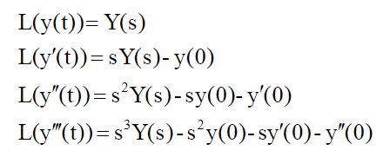
Applications of Inverse Laplace Transform
EXAMPLE
Solution :
education for life www.rimt.ac.in
Mechanical Engineering

Slide 20
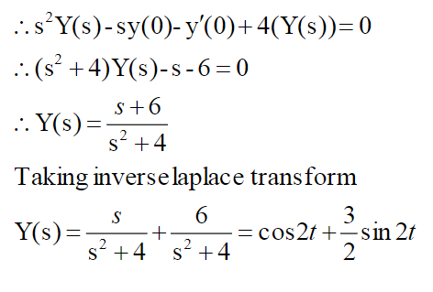
Applications of Inverse Laplace Transform
education for life www.rimt.ac.in
Mechanical Engineering

Slide 21
Applications of Inverse Laplace Transform
education for life www.rimt.ac.in
Mechanical Engineering

Slide 22
Applications of Inverse Laplace Transform
education for life www.rimt.ac.in
Mechanical Engineering

Slide 23
Topics Discussed in Next Lecture
Formation of PDE
Different Integral of PDE
Lagranges Method
education for life www.rimt.ac.in
Mechanical Engineering

