Slide 1
Mathematics-III(BTME-3500)
Course Name: B.Tech. (ME) Semester: 5th
Prepared by: Sachin Syan
education for life www.rimt.ac.in
Mechanical Engineering

Slide 2
Topic Discussed
Formation of PDE
Different Integral of PDE
Lagranges Method
education for life www.rimt.ac.in
Mechanical Engineering

Slide 3
education for life www.rimt.ac.in
Mechanical Engineering

Slide 4
education for life www.rimt.ac.in
Mechanical Engineering

Slide 5
education for life www.rimt.ac.in
Mechanical Engineering

Slide 6
education for life www.rimt.ac.in
Mechanical Engineering

Slide 7
education for life www.rimt.ac.in
Mechanical Engineering

Slide 8
education for life www.rimt.ac.in
Mechanical Engineering

Slide 9
education for life www.rimt.ac.in
Mechanical Engineering

Slide 10
education for life www.rimt.ac.in
Mechanical Engineering

Slide 11
education for life www.rimt.ac.in
Mechanical Engineering

Slide 12
education for life www.rimt.ac.in
Mechanical Engineering

Slide 13
education for life www.rimt.ac.in
Mechanical Engineering

Slide 14
education for life www.rimt.ac.in
Mechanical Engineering

Slide 15
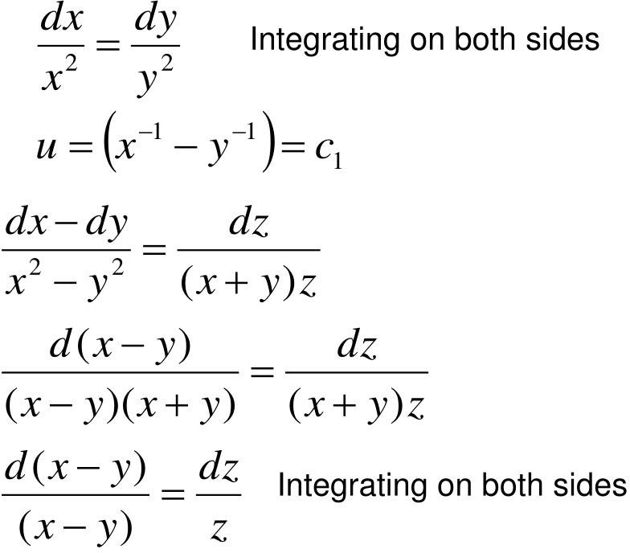
education for life www.rimt.ac.in
Mechanical Engineering

Slide 16
education for life www.rimt.ac.in
Mechanical Engineering

Slide 17
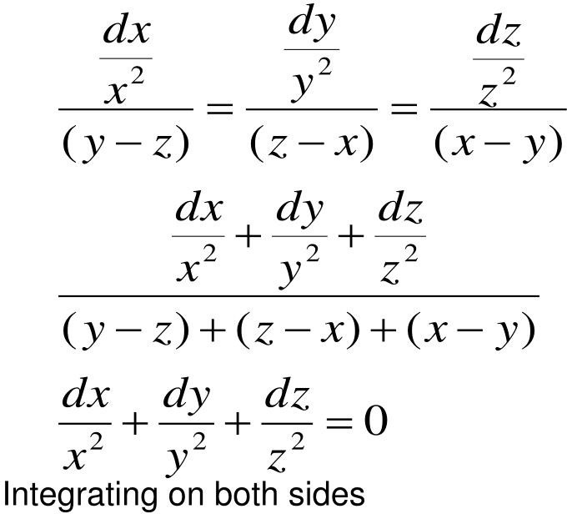
education for life www.rimt.ac.in
Mechanical Engineering

Slide 18
education for life www.rimt.ac.in
Mechanical Engineering

Slide 19
education for life www.rimt.ac.in
Mechanical Engineering

Slide 20
Topics Discussed in Next Lecture
Homogeneous linear equation with constant coefficients
education for life www.rimt.ac.in
Mechanical Engineering

