Slide 1
Mathematics-III(BTME-3500)
Course Name: B.Tech. (ME) Semester: 5th
Prepared by: Sachin Syan
education for life www.rimt.ac.in
Department of Mechanical Engineering

Slide 2
Topic Discussed
Contour Integrals
education for life www.rimt.ac.in
Department of Mechanical Engineering

Slide 3
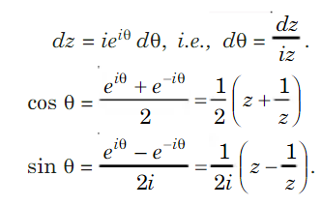
Contour Integration
education for life www.rimt.ac.in
Department of Mechanical Engineering

Slide 4
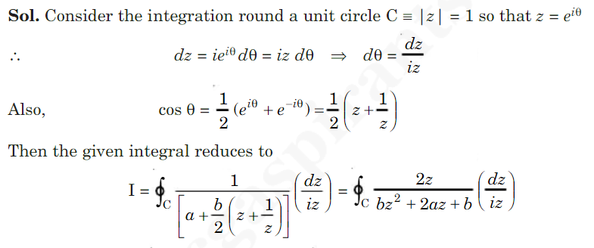
Contour Integration
education for life www.rimt.ac.in
Department of Mechanical Engineering

Slide 5
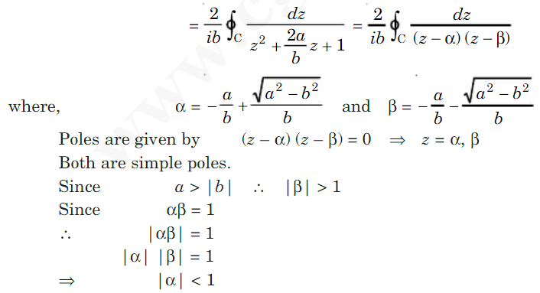
Contour Integration
education for life www.rimt.ac.in
Department of Mechanical Engineering

Slide 6
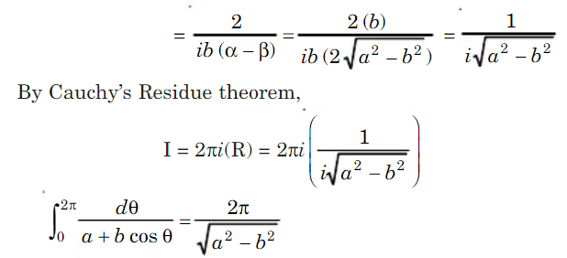
Contour Integration
education for life www.rimt.ac.in
Department of Mechanical Engineering

Slide 7
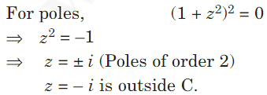
Contour Integration
education for life www.rimt.ac.in
Department of Mechanical Engineering

Slide 8
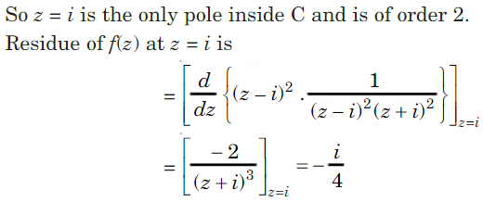
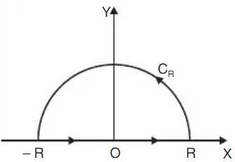
Contour Integration
education for life www.rimt.ac.in
Department of Mechanical Engineering

Slide 9
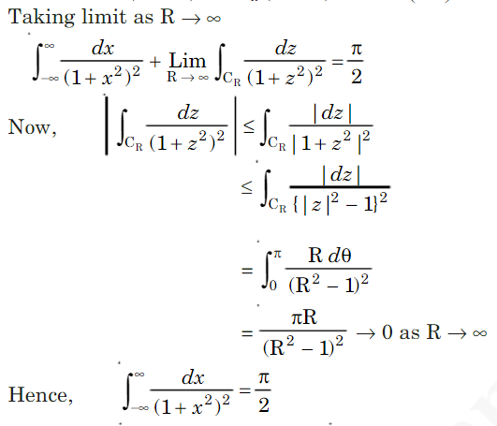
Contour Integration
education for life www.rimt.ac.in
Department of Mechanical Engineering

Slide 10
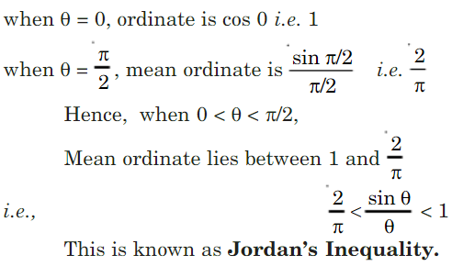
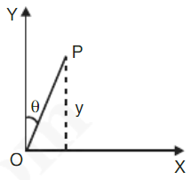
Contour Integration
education for life www.rimt.ac.in
Department of Mechanical Engineering

Slide 11
Contour Integration
education for life www.rimt.ac.in
Department of Mechanical Engineering

Slide 12
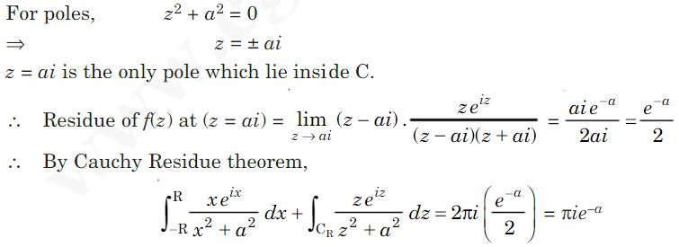
Contour Integration
education for life www.rimt.ac.in
Department of Mechanical Engineering

Slide 13
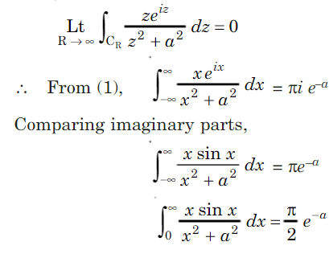
Contour Integration
education for life www.rimt.ac.in
Department of Mechanical Engineering

Slide 14
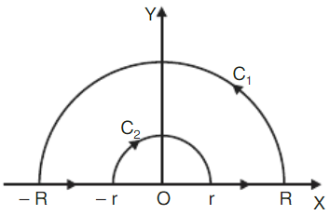
Contour Integration
education for life www.rimt.ac.in
Department of Mechanical Engineering

Slide 15
Contour Integration
education for life www.rimt.ac.in
Department of Mechanical Engineering

Slide 16
Contour Integration
education for life www.rimt.ac.in
Department of Mechanical Engineering

Slide 17
Contour Integration
education for life www.rimt.ac.in
Department of Mechanical Engineering

Slide 18
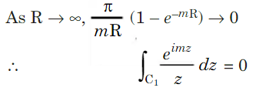
Contour Integration
education for life www.rimt.ac.in
Department of Mechanical Engineering

Slide 19
Topics Discussed in Next Lecture
Bilinear Transformations
education for life www.rimt.ac.in
Department of Mechanical Engineering

